Slide 1
Group 7: Physiology Unit Theme: Cardiovascular System Ali Azghani, University of Texas at Tyler Melody Danley, University of Kentucky Heather Ketchum, University of Oklahoma Laura Laynes, Baton Rouge Community College Mary Miller, Baton Rouge Community College Russell Nolan, Baton Rouge Community College Facilitators: Beth Beason and David Caprette (Rice University)

Slide 2
Teaching Unit Background
Audience
Freshman/sophomore level human physiology class
Small and large classes
When covered
Mid-semester
Activity length
20 minutes
Prior knowledge
Anatomical terms
Overview of circulation

Slide 3
Learning Goals
1) Students will have basic knowledge of the structures and functions of the blood vessels.
2) Students will have basic knowledge of the structures and functions of the blood and hemodynamics.
3) Students will have basic knowledge of the structures and functions of the heart.

Slide 4
Learning Goals
1) Students will have basic knowledge of the structures and functions of the blood vessels.
2) Students will have basic knowledge of the structures and functions of the blood and hemodynamics.
3) Students will have basic knowledge of the structures and functions of the heart.

Slide 5
Goal # 2: Identify structures and functions of the blood and hemodynamics.
Learning Outcomes:
A. Students will be able to state the components of blood.
B. Students will be able to describe the flow of blood through the heart and vasculature.
C. Students will be able to evaluate the role of blood as it relates to temperature regulation.
D. Students will be able to identify medical disorders of blood as it relates to homeostasis.

Slide 6
Goal # 2: Identify structures and functions of the blood and hemodynamics.
Learning Outcomes:
A. Students will be able to state the components of blood.
B. Students will be able to describe the flow of blood through the heart and vasculature.
C. Students will be able to evaluate the role of blood as it relates to temperature regulation.
D. Students will be able to identify medical disorders of blood as it relates to homeostasis.

Slide 7
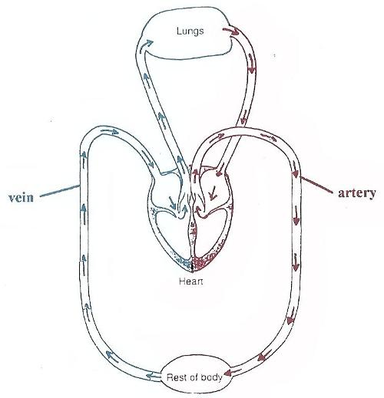
Pre-class Assignment
Reading:
Anatomy of the heart
Blood flow through the heart
http://seys-science.wikispaces.com
Notes:
Tell them we would spend just a few minutes reviewing this with the students.

Slide 8
When blood passes through the tricuspid valve, it enters which chamber?
Right atrium
Left atrium
Right ventricle
Left ventricle
Where’s Waldo?

Slide 9
Active Learning Activity
Strip sequence of blood flow through the heart

Slide 10
Blood Flow Activity
Odd # Groups:
Use the terms in your envelope to trace a single red blood cell through the heart beginning with blood returning to the right side of the heart and ending at the lungs.
Record your sequence on the provided worksheet numbers 1-6.
Even # Groups:
Use the terms in your envelope to trace a single red blood cell through the heart beginning with the lungs and ending once blood exits the heart.
Record your sequence on the provided worksheet numbers 8-14.
http://seys-science.wikispaces.com

Slide 11
8.
7.
9.
6.
1.
14.
5
13
2.
10
3.
11.
4.
12.
http://seys-science.wikispaces.com
Notes:
Here is where we will assess the activity. Students would have this printed out and with them.

Slide 12
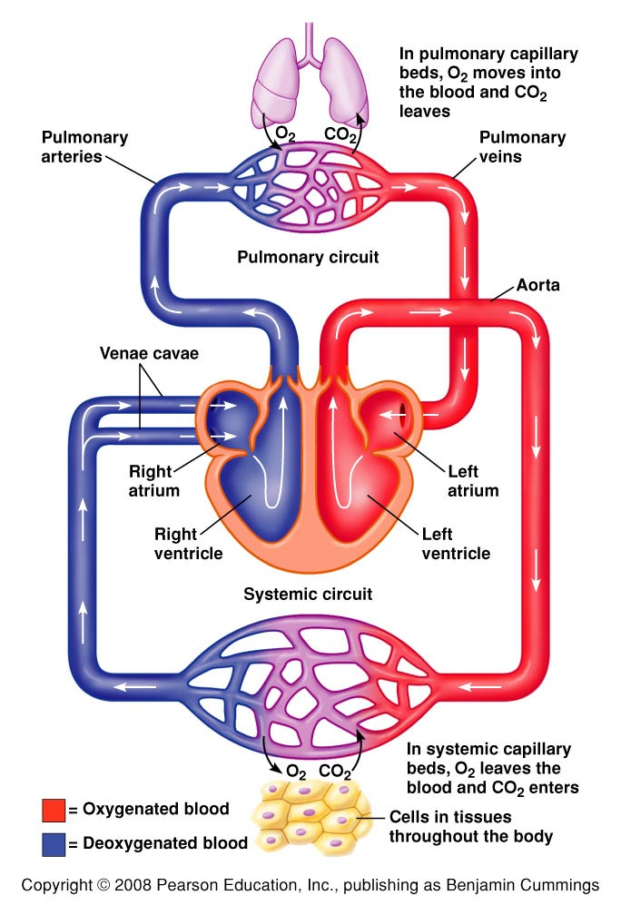
Correct Responses
Deoxygenated blood
Right atrium
Tricuspid valve
Right ventricle
Pulmonary semilunar valve
Pulmonary arteries
Lungs
Oxygenated blood
Pulmonary veins
Left atrium
Bicuspid valve
Left ventricle
Aortic semilunar valve
Aorta

Slide 13
Revote: When blood passes through the tricuspid valve, it enters which chamber?
Right atrium
Left atrium
Right ventricle
Left ventricle
Where’s Waldo?

Slide 14
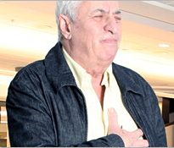
Overview of next class Cardiac Pathophysiology
http://www.heart.org

Slide 15
The most important chamber of the heart is the…
Right atrium
Left atrium
Right ventricle
Left ventricle
I have a heart?

Slide 16
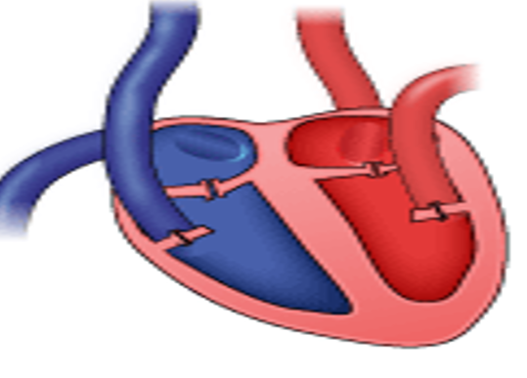
Summative Assessment
Silverthorn, Human Physiology

Slide 17
Extra Credit
Generate an updated version of this music video
http://www.youtube.com/watch?v=gIXcWE0bTwY

Slide 18
Learning Goals
2) Students will have basic knowledge of the structures and functions of the blood and hemodynamics.

