Slide 1
Cell Membrane Permeability Group 2- Cell Development Gladys Alexandre, Cristina Calestani, John Koontz, Silvia Moreno, Brian Ring, William Said
Context: Principles of Biology I (BIOL 1107); >250 students (freshman level)
Student preparation: Read chapter material on cell membrane structure & function and details of cell membrane semi-permeability prior to teaching tidbit
In preparation for Exam 1

Slide 2
Learning Goal
Role of Selective Permeability in Phospholipid Membrane Function

Slide 3
Learning Objectives
Explain the concept of selective permeability.
Predict the movement of molecules across the phospholipid membrane based on their structure.
Interpret and graph kinetics of molecule transport across a phospholipid membrane.

Slide 4
Selective Permeability
A play…

Slide 5
A semipermeable membrane allows...
Only small molecules to cross.
Only charged molecules to cross.
Certain molecules to enter the membrane but not cross to the other side.
Molecules to cross the membrane until they reach equal concentration on both sides.
Molecules to cross dependent upon their chemical characteristics.
30
Countdown

Slide 6
Sally went to the doctor for a fever and she was prescribed a sulfa-drug antibiotic. The doctor and her pharmacist insisted that she took her medication with food. Sally wonders why. Why does she have to take the drug with meals? Let’s find out…

Slide 7
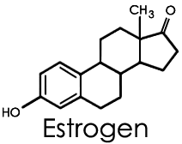
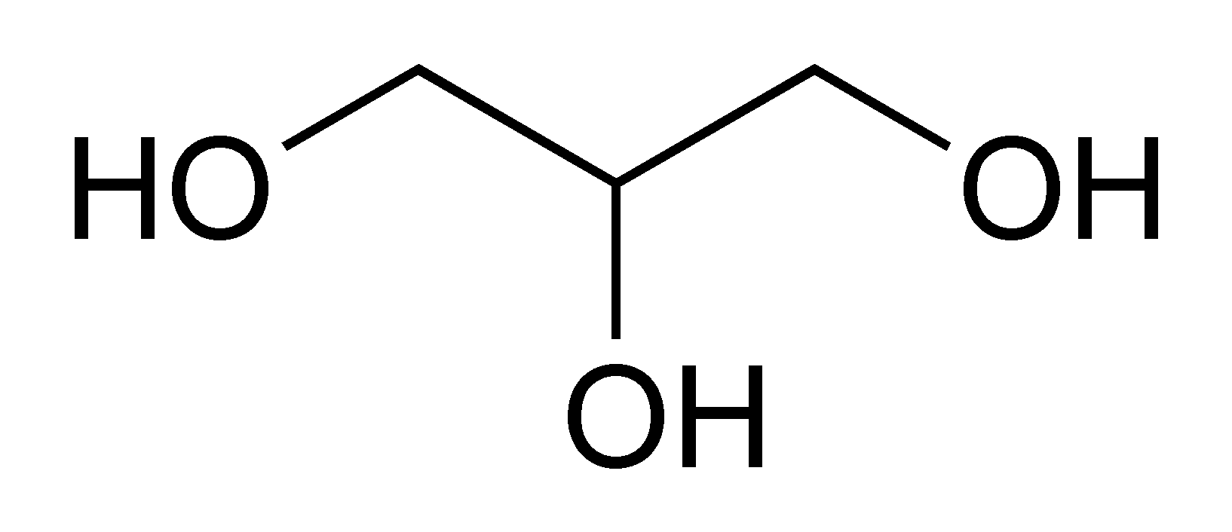
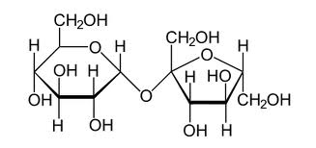
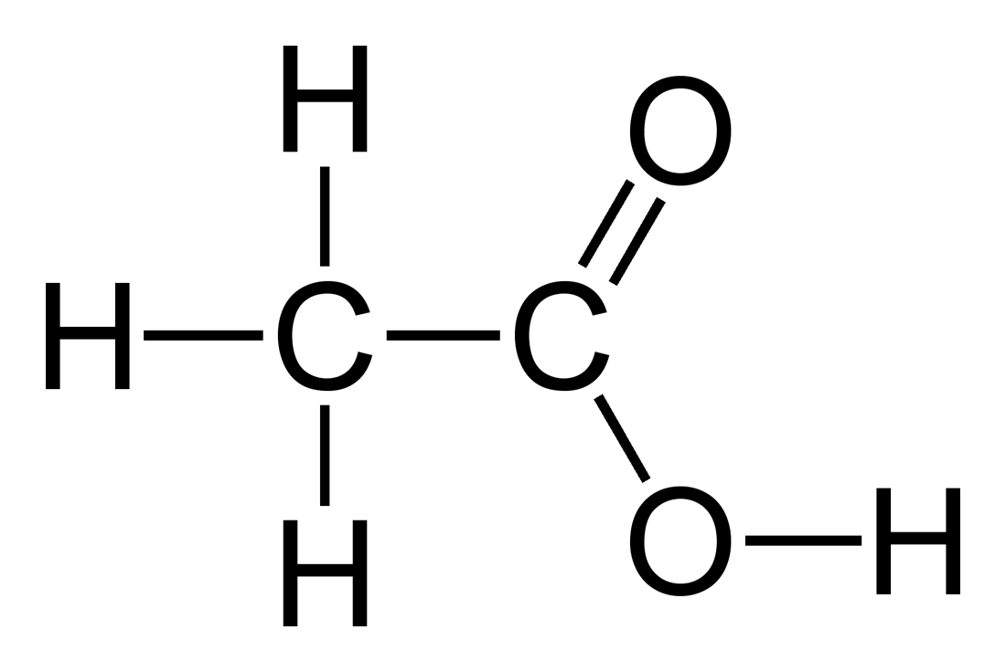
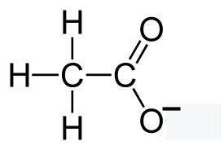
GROUP PROJECT: Discuss and place the compounds under the appropriate category. Write down your reasoning (3 minutes)
Fast
Slow
NO
Glycerol
Oxygen
O₂
Sucrose
Acetic acid pH 1.5
Acetic acid pH 7.0

Slide 8
GROUP PROJECT: Correct order of compounds.
Non polar
Small Polar
Large polar or charged
Fast
Slow
NO
Sucrose
Acetic acid pH 1.5
Acetic acid pH 7.0
Oxygen
Glycerol
O₂

Slide 9
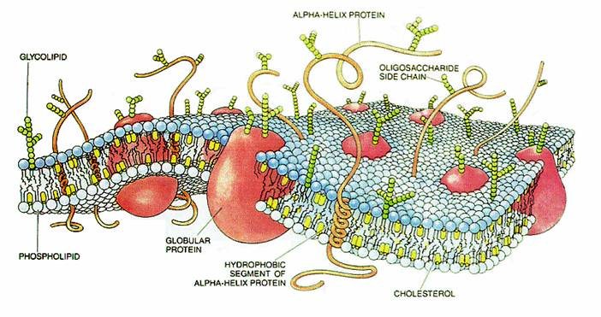
Cell membranes are not just made of phospholipids….
Do some molecules need proteins to cross the membrane?

Slide 10
Imagine you are testing the hypothesis of a drug being transported across the cell membrane. Think-Pair-Share: Which of the following compounds enters the cell exclusively by active transport?
 | A | B | C
With ATP | + | + | -
Without ATP | + | - | -
A
B
C
30
Countdown

Slide 11
Think-pair-share: Which of the following compounds enters the cell by diffusion?
 | A | B | C
With ATP | + | + | -
Without ATP | + | - | -
A
B
C
30
Countdown

Slide 12
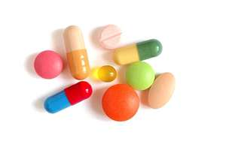
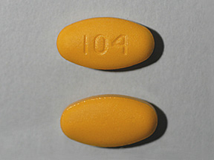
If drugs are transported differently through a cell membrane, would you expect the kinetics of transport of these drugs across the cell membrane to be different?
Recall – covered the characteristics of protein-ligand interactions in kinetics from previous lecture

Slide 13
GROUP PROJECT- 1 minute drill
On a paper, each group graph the expected rate of transport of drugs A, B, & C in presence of ATP
 | A | B | C
With ATP | + | + | -
Without ATP | + | - | -
Rate of transport
Δ [Concentration in A, B, C]

Slide 14
GROUP PROJECT- 1 minute drill
On a paper, each group graph the expected rate of transport of drugs A, B, & C in presence of ATP
A
B
Rate
of transport
C
Δ [Concentration in A, B, C]

Slide 15
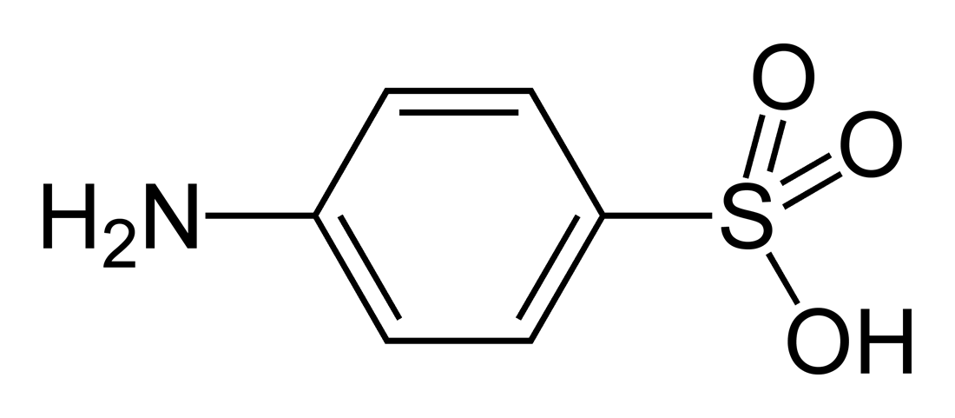
So how about Sally’s question and her need to take the sulfa-drug with meals? What is it about the sulfa-drug that could explain why it needs to be taken with meals? GROUP PROJECT- Write down your answer on a paper (1 minute)
PH 2
PH 7

Slide 16
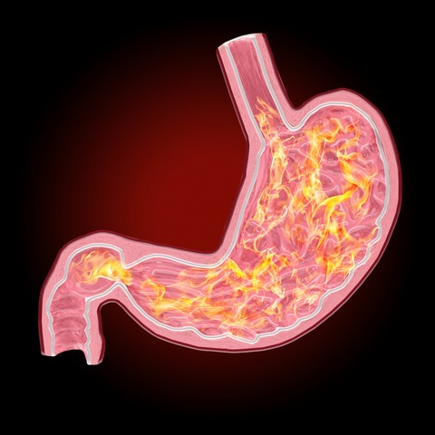
An answer- digestion and chemical changes
PH 2
PH 7

Slide 17
Learning Objective | Assessment | Active learning | Low Order/ High Order
Explain the concept of selective permeability. | Clicker Questions | Homework | Low Order
Predict the movement of molecules across the phospholipid membrane based on their structure. | Group Activity | Group Chart Activity Documented Problem Solving | High Order High Order
Interpret and graph kinetics of molecule transport across a phospholipid membrane. | Group Activities | Group Interpret Transport Data Table Graph Transport Kinetics Group Problem solving | All High Order
Diversity
A mix of individual and group active learning assignments in a large lecture classroom setting. Presentation of problems and data in different formats

Slide 18
Summative Assessment
2012 Southeast National Academies Summer Institute
May 17, 2012
Group 2: Cell & Development
Teachable Unit: Membrane Permeability (Introductory Biology for Majors)
Summative Assessment: Exam 1 after formative assessment through homework, group exercises, etc. (see DropBox).
Table 1. Transport of molecules across a phospholipid membrane in alien cells.
Cellular Conditions | N₂ | Lactose | Sulfanilic Acid
Plus ATP pH 7.0 | + | + | -
No ATP pH 1.5 | + | + | +
No ATP pH 7.0 | + | + | -
Protein Synthesis Inhibitor | + | - | -
Use the above data to answer questions 11-13 below.

Slide 19
Summative Assessment
Table 1. Transport of molecules across a phospholipid membrane in alien cells.
Cellular Conditions | N₂ | Lactose | Sulfanilic Acid
Plus ATP pH 7.0 | + | + | -
No ATP pH 1.5 | + | + | +
No ATP pH 7.0 | + | + | -
Protein Synthesis Inhibitor | + | - | -
Use the above data to answer questions 11-14 below.
11. What type of cellular transport is demonstrated by Nitrogen gas transport (Table 1)?
A) Active Transport
B) Facilitated Diffusion
C) Passive Transport
D) Either B or C
E) None of the above.

Slide 20
Summative Assessment
Table 1. Transport of molecules across a phospholipid membrane in alien cells.
Cellular Conditions | N₂ | Lactose | Sulfanilic Acid
Plus ATP pH 7.0 | + | + | -
No ATP pH 1.5 | + | + | +
No ATP pH 7.0 | + | + | -
Protein Synthesis Inhibitor | + | - | -
Use the above data to answer questions 11-14 below.
12. What type of cellular transport is demonstrated by Lactose transport (Table 1)?
A) Active Transport
B) Facilitated Diffusion
C) Passive Transport
D) Either B or C
E) None of the above.

Slide 21
Summative Assessment
Table 1. Transport of molecules across a phospholipid membrane in alien cells.
Cellular Conditions | N₂ | Lactose | Sulfanilic Acid
Plus ATP pH 7.0 | + | + | -
No ATP pH 1.5 | + | + | +
No ATP pH 7.0 | + | + | -
Protein Synthesis Inhibitor | + | - | -
Use the above data to answer questions 11-14 below.
13. Why does the Sulfanilic acid move across the cell membrane (+) at pH 1.5 (Table 1)?
A) It’s a gas at pH 1.5.
B) It’s a lipid at pH 1.5.
C) Membrane is disordered at pH 1.5.
D) It’s charged at pH 1.5.
E) It’s uncharged at pH 1.5.

