Slide 1
The Central Dogma: A Journey Down a One-Way Street
Cellular and Developmental Biology Group
Kathleen Fitzpatrick, Apollo Kacsinta, Sylvia Lopez-Vetrone, Karen Redwine, Erica Stone, Nienke van Houten and Cindy Xin
Facilitator: Melissa Rowland-Goldsmith
Notes:
Introduce Groups

Slide 2
TU Learning Goals
Understand the Central Dogma:
DNA -> RNA -> protein
Identify the locations in a eukaryotic cell in which these processes occur.
3. Evaluate a statement about how differential gene expression leads to different cell types.
Notes:
After going through the three statements, state that for the purpose of our teachable tidbit, we will focus on learning outcome 3, and click advance slide so red box appears around number 3.

Slide 3
Measurable Learning Outcomes 1 & 2
LOC
Define processes
Identify key molecules and cellular structures
Explain the sequence in your own words
HOC
Compare and contrast the processes
Create/explain an analogy for the Central Dogma
Map the location and sequence of events of the Central Dogma.
Construct a representation of the Central Dogma in a eukaryotic cell
Notes:
To achieve the outcomes for 1 & 2, our instructional approach would be to use both LOCs and HOCs. …

Slide 4
Measurable Learning Outcome for goal 3
Evaluate a statement about how differential gene expression leads to different cell types.
HOC
Evaluate the similarities and differences in gene expression between two cell types.
Assess a statement about how differential gene expression allows for different cell types.

Slide 5
Learning Outcome 3 HOC Summative Assessment
Evaluate a statement about how differential gene expression leads to different cell types:
At a party, a friend says, “What’s the big deal with stem cells? Stem cells, heart cells, muscle cells…they’re all the same.”
Using the central dogma and associated terminology, judge and reframe the statement in order to remove any misconceptions.

Slide 6
Learning Outcome 3 HOC Formative Assessment
Analyze a table that contains information about the relative concentrations of DNA and protein within two different types of cells.
Using the information from the table, formulate answers to questions pertaining to the two cell types.

Slide 7
Learning Outcome 3 Teachable Tidbit
Assumption
TU Learning Objectives 1 & 2 have already been met

Slide 8
What is the flow of information within a cell, according to the central dogma:
A. DNA → Protein → mRNA
B. Protein → mRNA→ DNA
C. DNA → mRNA→protein
D. mRNA → DNA→protein
E. None of the above
Notes:
Correct answer is C
THIS IS WHERE THE LESSON PART BEGINS - should have some introduction to the topic - connect back to previously covered material
As long as 70% or more of the students answer correctly, move on, if not, may need to take a couple of minutes to review/think-pair-share etc
This is readiness assuredness and so needs to be understood by the majority of the class before moving into the exercise

Slide 9
Choose the correct association between cellular process(es) and their location(s) in eukaryotes
A. Transcription and translation: cytoplasm
B. Transcription and translation: nucleus
C. Translation: nucleus; transcription: cytoplasm
D. Translation: nucleus
E. Transcription: nucleus; translation: cytoplasm
Notes:
Correct answer is E
Again,so long as 70% or more of the class gets it, move on.This is review and not readiness assuredness, since it isn’t covered or used in the lesson (therefore can be deleted if desired)

Slide 10
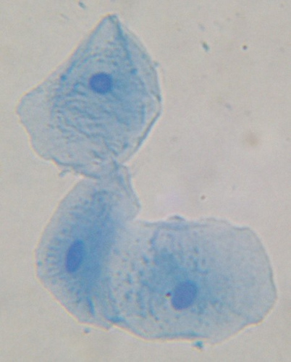
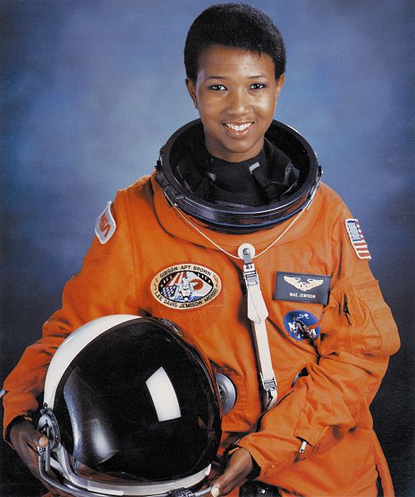
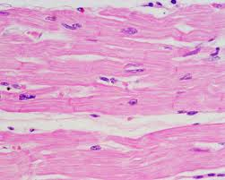
Skin cells
Heart cells
Notes:
This fellow scientist has donated some of her cell samples to be analyzed. The results from the analysis are shown in the following table:

Slide 12
Use the data from the table provided to formulate your answers to the following questions:
What do you observe about the DNA content in heart and skin cells?
What do you observe about the levels of proteins in heart and skin cells?
What do your observations suggest about these cells?
THINK - 1 min
PAIR - 3-5 min
SHARE -3-5min
Notes:
NOTE - suggested times vary depending on how much students already know and understand, how much time you have and whether or not you want to delve more deeply right away, ie looking at exceptions, talking more about modulating levels of expression etc
For debrief, can collect answers from different people,ask those who haven’t said anything yet to contribute (in a voluntary capacity)

Slide 13
Follow-up exercise: in group, as a class, individually or as homework
Notes:
Use this follow up to really focus in more on the role of mRNA - can discuss points of control - could be transcriptional or translational ( plus lots of others, regulating activity of the protein, correct processing,localization, folding etc etc,) Can use in any way desired.

Slide 14
Quick write
Using your knowledge and biological terminology about the Central Dogma:
Justify how a heart cell and a skin cell, from the same individual, can have the same proteins present, but different concentrations/levels of those proteins.
Notes:
Names on it for participation but not to be read by class – collect and go over - or use the sample weak and strong answers on the next slides

Slide 15
Student 1:
The heart cells are a kind of muscle cells and so they have different functions than the skin cells. Both cells have to do some things the same, like respiration and protein synthesis and dividing. But other functions will be different, for example the heart cell has to contract and probably uses glucose faster for the energy needed for contraction. And skin cells need to do other things like making sweat glands.
Notes:
Sample weak answer - not necessarily wrong, but doesn’t use DNA, RNA, in the answer, nor include terms transcription and translation. It needs those terms and those ideas added to it. See upcoming clicker question.

Slide 16
Do you think the previous answer is complete and correct?
A. Yes
B. No - it is not correct or complete
C. No- it is correct but not really complete
Notes:
Poll students - pull out response that though correct, it is missing some important information

Slide 17
Student 2:
The two cell types have the same DNA content - they contain all of the genes. But different cells need different proteins because they have different functions (jobs). So genes are transcribed when and where their protein products are needed
Notes:
This answer contains a response that includes the link between protein content and function and includes the terms transcription and translation.

Slide 18
Do you think the previous answer is complete and correct?
A. Yes
B. No - it is not correct or complete
C. No- it is correct but not really complete

Slide 19
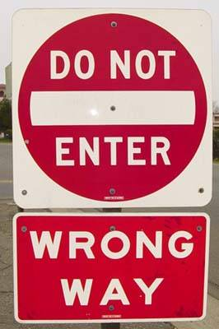
Coming up - exceptions to the rule!
Notes:
Depending on where you want to go next, you may use this or not……

