Slide 1
Winging It: Connecting gene expression, cell signaling and morphology
Group 7
Brad Davidson, Amy Vollmer, Liz Vallen:
Swarthmore College
Missy McElligott and Don O’Malley:
Northeastern University
Tom Torello, Facilitator, Harvard University

Slide 2
Context
Freshman and sophomore biology majors and non-majors
Unit approximates one week of content
Can be used as a complement to either a cell communication module, a development module, or an evolution module
Notes:
This teaching tidbit is part of a teachable unit in an introductory cellular and molecular biology course, enrolled by both majors and non-majors who are usually in their freshman or sophomore years. (Then I just read the slide, emphasizing that third bullet, showinig how adaptable the tidbit can be.)

Slide 3
Recommended Background
Students should have been introduced to the following:
Protein structure and the regulation of protein function
Cell Structure
Cell Division
The Central Dogma: DNA → RNA → Protein
Cell Differentiation
Notes:
This tidbit fits at the end of a cell signaling unit. We recommend that students are given a pre-class exercise in which they review the BMP signaling pathway and have provided a potential formative assessment at the end of this ppt. for use as a pre-class assignment or as a clicker question at the beginning of this tidbit.

Slide 4
Cell Communication Learning Goals
1. Understand the basic principles of cell signaling and signal transduction
2. Understand how cell signaling take place across different temporal and spatial scales (e.g. within a tissue, an organ, organism, or developing organism)
3. Understand how cell signaling impacts differential gene expression and morphology
Notes:
These are the goals that we have articulated for the Teachable Unit.

Slide 5
Cell Communication Learning Goals
1. Understand the basic principles of cell signaling and signal transduction
2. Understand how cell signaling take place across different temporal and spatial scales (e.g. within a tissue, an organ, organism, or developing organism)
3. Understand how cell signaling impacts differential gene expression and morphology
Notes:
It is for this third goal that we have formulated learning objectives (on next slide) that our tidbit addresses.

Slide 6
Learning Objectives:
You will be able to
1) apply your knowledge of the Central Dogma to a cell signaling pathway
2) predict how a mutation in a cell signaling pathway can lead to a developmental change
3) practice careful observation and description.
Notes:
(Just read this slide)

Slide 7
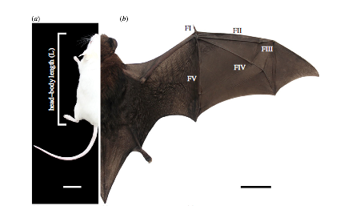
Notes:
Today we are going to focus on these two organisms. Can anyone tell me what the one on the left is? (mouse) The one on the right? (bat) The most noteworthy characteristic of the bat is its long forelimb - which corresponds to our arm and hand.
Wang Z, Dai M, Wang Y, Cooper KL, Zhu T, Dong D, Zhang J, Zhang S. 2014 Unique expression patterns of multiple key genes associated with the evolution of mammalian flight. Proc. R. Soc. B 281: 20133133. http://dx.doi.org/10.1098/rspb.2013.3133

Slide 8
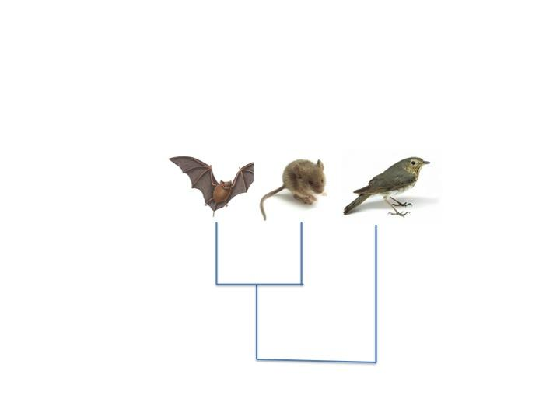
Notes:
I want to point out explicitly that bats and rodents like mice, evolved from a common, mammalian terrestrial ancestor (Juramaia sinensis). Birds, like bats, can fly, but bats and rodents are more closely related to one another than either is to birds.
Some helpful info about the evolution of bats, rodents and birds can be found here: http://evolution.berkeley.edu/evolibrary/article/evo_09

Slide 9
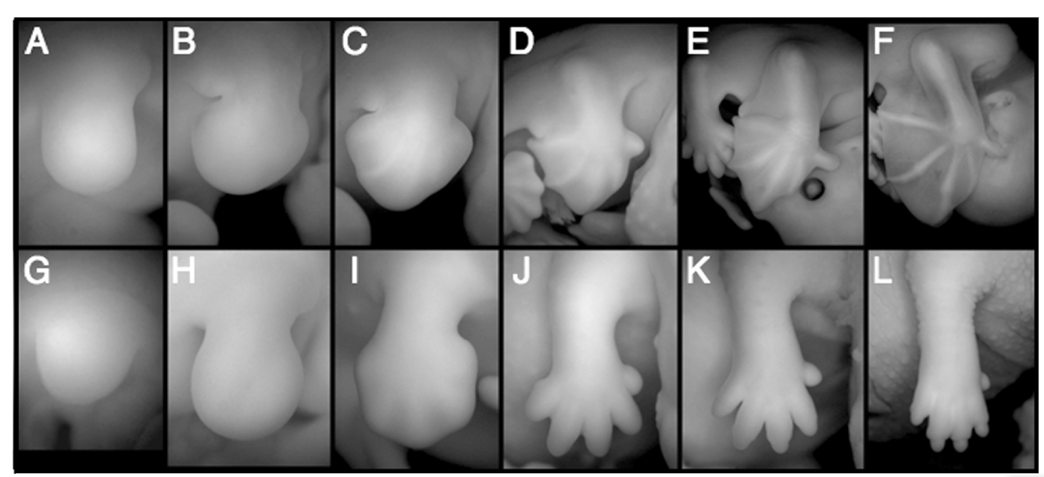
Raise your hand when you know
which is bat and which is mouse
Notes:
Panels of bat (top) and mouse embryos over developmental time.
Image from Genetic Regulation of Mammalian Diversity
R.R. Behringer, J.J. Rasweiler IV, C.-H. Chen, et al.
Cold Spring Harb Symp Quant Biol 2009 74: 297-302 originally published online December 22, 2009
Access the most recent version at doi:10.1101/sqb.2009.74.035

Slide 10
Notes:
Pause after each reveal to allow students time to look carefully and think about what they are seeing.

Slide 14
What were the key clues?
Notes:
The top is bat. Both the membranous connections between the digits and the length of the digits should be noted. In the bat panel E, both the forelimb and the hindlimb are visible, as is the eye (black ring). Students can either share with the entire group what they thought was most important, or do a pair share first.
For the rest of these exercise, we focus on the skeletal differences.

Slide 15
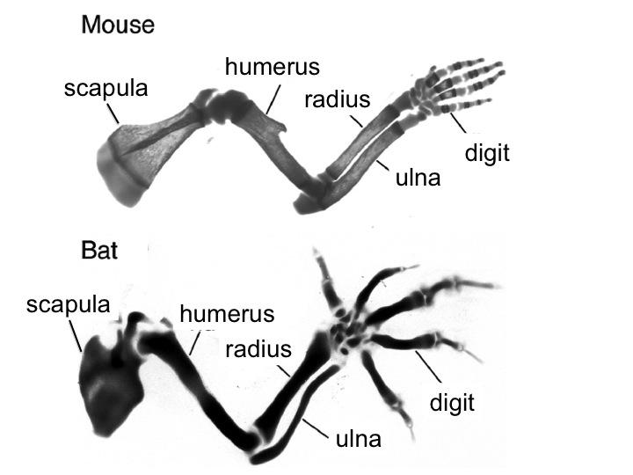
Notes:
Ask students to take about 30-60 seconds to jot down differences that they see between these two embryonic skeletons. Providing an index card to each student allows collection for formative assessment. It is important to make sure the difference in the length of the digits is noted. This can be a think pair-share, or a think and get volunteers from the class.
Image is from Developmental Cell 14, February 2008. Mammalian Limbs Take Flight. S.D. Weatherbee. DOI 10.1016/j.devcel.2008.01.011. They are at different scales and were stained differently. Praise observations about the difference in color or questions about scale and relative length, but students should focus on skeletal morphology.

Slide 16
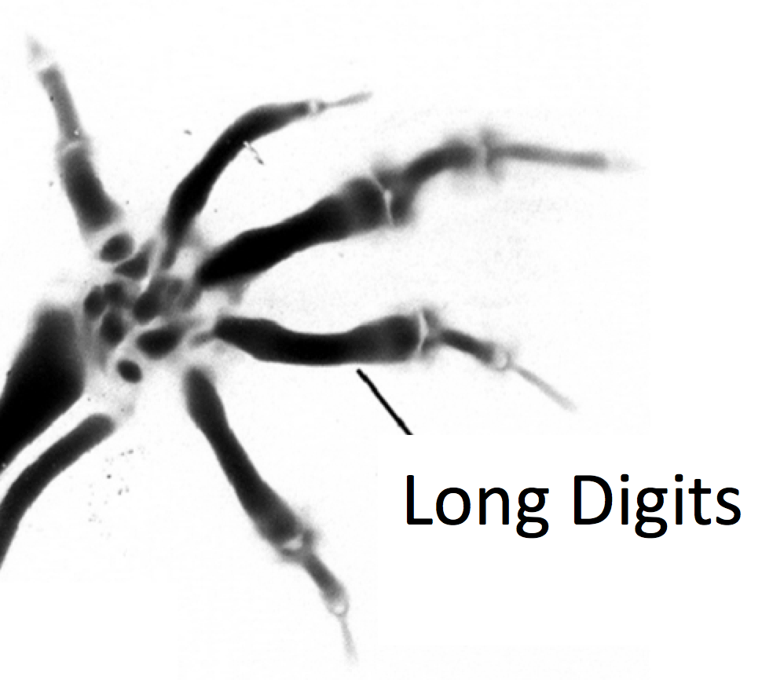
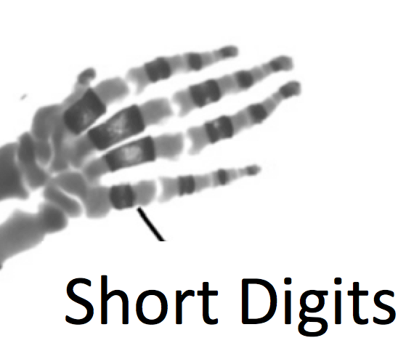
Mouse
(Ancestral Condition)
Bat
short digits
long digits
Notes:
For the rest of the exercise, focus on the length of the digits in the “hand” and the differences between mouse and bat.

Slide 17
Karen Sears Richard Behringer Lee Niswander
Notes:
Script: We are focusing on digit elongation because a team of researchers have recently begun to unravel the molecular basis of this evolutionary change. This research was conducted by Karen Sears and supervised by Richard Behringer and Lee Niswander.

Slide 18
Discovery
Link cell signaling (BMP) to bat wing evolution.
Karen Sears Richard Behringer Lee Niswander
Notes:
Their findings indicate that heritable mutations impacting a specific cell signaling pathway (BMP) contribute to digit elongation during bat wing evolution.

Slide 19
Priming exercise for cell signaling
On your notecard -
1. Make a simple diagram illustrating BMP signaling from one cell to another.
Include 2 cells, the secreted BMP signal and the receptors
2. Give an example of an output in the receiving cell.
Questions?
Notes:
Script:To refresh your memory of BMP signaling please complete the following quick exercise… (30 seconds → 1 minute)
This can be done on the back of the notecard used for observations about skeletal morphology. Collecting the notecards allows for a formative assessment.

Slide 20
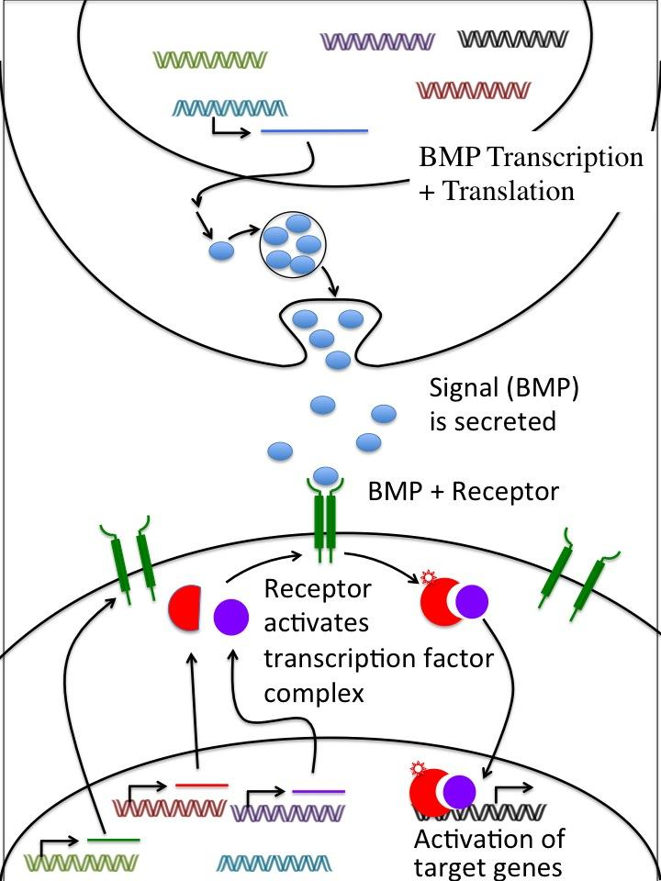
Cell # 1
Cell # 2
Notes:
Script: You can refer to your handout as I review the major steps in BMP signaling. Remember that BMP is encoded by a gene which is transcribe into RNA and than translated into a protein. The BMP protein is then secreted.

Slide 21
Cell # 1
Cell # 2
Output?
Notes:
Script: If the target cell has the right receptors, it is able to respond to BMP. The bound trans-membrane receptor complex promotes the formation of an active transcription factor complex in the cytoplasm. The TF complex then enters the nucleus where it binds to DNA and impacts target gene transcription.

Slide 22
Cell # 1
Cell # 2
Output = Change in gene expression
Notes:
The output in this case involves changes in gene expression.

Slide 23
Cell # 1
What’s the output in bone precursor cells?
Cell # 2
Notes:
What is the impact of BMP signaling in a bone precursor cell?

Slide 24
What’s the output in bone precursor cells?
Cell # 1
BMP
(Bone Morphogenic Protein)
leads to a change in gene expression that causes
Cell Division
AND
Bone Growth
Cell # 2
Notes:
In a bone precursor cell, BMP signaling leads to changes in gene expression that promote cell division, thus BMP signaling leads to bone growth.

Slide 25
1. Hypothesize:
How might BMP signaling have changed during bat evolution to produce elongated hand bones?
Remember:
BMP leads to
bone growth
Notes:
Note: Be careful with your language here. Make sure it is clear that bats idd not evolve from mice! You can refer to the “bat ancestor” when talking about where changes in signaling and associated heritable mutations have occurred.
Script: Let’s now see if you can apply what you’ve learned about signaling pathways to solve the problem of the bat’s long digits. Your job here is to hypothesize [read text in box]. This is an individual, quiet, reflective assignment and you can write your hypothesis on the bottom of the diagram you have in front of you. [Quiet Please]. [wait 60 seconds or so].

Slide 26
2. Illustrate your hypothesis:
Show how signaling has changed on the provided worksheet.
Then, mark the location of the heritable mutation (in the DNA) contributing to this change.
1. Hypothesize:
How might BMP signaling have changed during bat evolution to produce elongated hand bones?
Remember:
BMP leads to
bone growth
Notes:
To make your hypothesis a bit more fine-grained, we’d like you to illustrate your hypothesis on your signaling diagram. First illustrate how the signaling pathway has changed, and second mark the locus of the heritable gene mutation responsible for that change. (wait a bit for students to read and start)

Slide 27
Cell # 1
short digits
ancestral pathway
long digits
Cell # 2
Remember:
BMP leads to bone growth
Notes:
Here is the signaling pathway again so you can refer to it as you illustrate how a change in BMP signaling may have caused digit elongation in the bat ancestor [~30 seconds total for this slide and the previous one].

Slide 28
2. Illustrate your hypothesis:
Show how signaling has changed on the worksheet.
Then, mark the location of the mutation (in DNA) contributing to this change.
3. Share:
Share your illustration with your neighbor.
If you have the same idea, can you develop an alternative hypothesis?
1. Hypothesize:
How might BMP signaling have changed during bat evolution to produce elongated hand bones?
Notes:
Now, for the second part of the exercise, we’d like you to pair up and come up with two distinct hypotheses (nominally one from each of you) and discuss them to consider their location and effect, and within the minute or so we’d like each pair to identify their preferred hypothesis of the two, that we can then discuss as a group.

Slide 29
One Possible Hypothesis
A mutation in the BMP gene increases BMP expression
Remember, this mutation is present in ALL cells.
Notes:
Ask students to share their group hypotheses. After they hypothesize about HOW the pathway was altered to produce a “bat-like” condition, ask the students in which cell the mutation occurred. Some students may suggest either cell 1 or cell 2 depending on their hypothesis. Identify this misconception and communicate that the mutation is an evolutionary mutation and is found in all cells of the organism. Finally, if time allows, the instructor can address the misconception that all mutations are deleterious. In this case, a series of genetic mutations (not just a change in the expression of BMP) contributed to morphological variation, a critical component of evolutionary processes.

Slide 30
Completion of Learning Objectives
1. You have applied your knowledge of the Central Dogma to a cell signaling pathway.
2. You have predicted how a mutation in a cell signaling pathway led to a developmental change.
3. You practiced careful observation and description.

Slide 31
Homework
Summarize your 2 alternate hypotheses
Describe (in one sentence) an experiment that distinguishes between these
Briefly describe the results you would expect that would support each hypothesis
Upload to the class discussion board

Slide 32
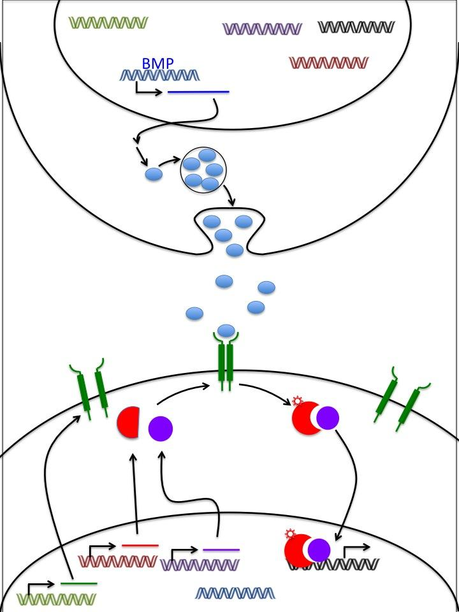
Possible Pre-class Exercise Part 1: BMP Signaling review.
Notes:
May be advisable for students to review BMP signaling before class, potentially using the diagram from the upcoming tid-bit. Have them label the diagram to illustrate 8 major steps from BMP transcription to activation of target genes. You may want to provide them with the following terms...
BMP transcription
BMP translation
BMP secretion
BMP/Receptor binding
Receptor mediated transcription factor complex formation
Activation of target gene expression

Slide 33
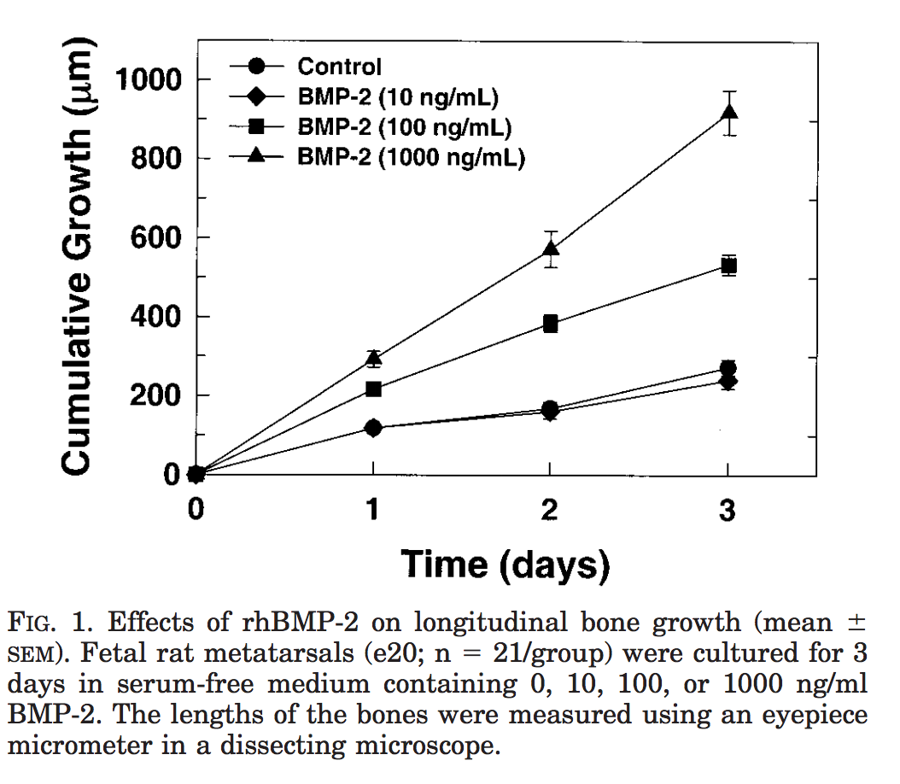
Possible Pre-class Exercise: BMP Signaling and Bone Growth
Notes:
Have students complete a brief pre-class exercise focused on the role of BMP-2 and bone growth.
First have them interpret the graph…
“According to the data in this graph, what is the impact of BMP signaling on bone growth?”
Then have them reflect on...
“How might activation of the BMP signaling pathway in bone precursor cells impact bone growth? Use your diagram of BMP signaling to come up with one potential answer.”
(potential answer… “BMP signaling may lead to expression of target genes that promote cell proliferation”)

Slide 34
Possible Pre-class Exercise: Assessment
How might heritable mutations in genes encoding BMP signaling components lead to a reduction in bone growth? Make sure to choose all correct answers.
a. Mutated BMP receptor is constitutively active, meaning that is active even when no BMP is available.
b. Mutated BMP can no longer bind DNA
c. Mutated BMP can no longer pass through the target cell membrane
d. Mutated BMP-dependent transcription factor components are unable to interact.
e. Mutations in a target gene locus prohibit binding of the BMP-dependent transcription factor complex
f. Mutated BMP receptor can no longer bind DNA
Notes:
To assess student learning from this pre-class exercise have students submit their answer to this multiple choice question. Make sure it is clear that they are to choose all correct answers.
(Correct Answers: D and E)
This question could be used as a clicker question at the beginning and end of the tid-bit. Providing instructors and students with a formative assessment tool focused specifically on the learning objective.

