Slide 1
Cell to cell communication
Introductory 100 level biology class
Non-majors
Christine Andrews, Katie Morrison-Graham, Bianca Breland, Marilyn Thomas,
Sarah Cabbage, Kat Milligan-Myhre
Notes:
Kat

Slide 2
Goals
Understand how cells communicate and pass on information
Appreciate the importance of cell-cell communication to drug activities and response to the environment
Objectives
Describe and diagram a process by which cells communicate
Predict the cause or consequence of alterations in cell communication and justify your answer
Notes:
Kat

Slide 3
Summative Assessment on an exam
Ask students to draw or identify components of a signaling pathway
We will provide a scenario (s) and ask students to:
Identify if an agonist or antagonist is described
Predict effect on cell and/or whole organism
Notes:
Kat

Slide 4
Class prep work
Multiple questions about readings
Notes:
Kat

Slide 5
Scenario
It’s a dark and stormy night… You are walking home alone and you hear a rustle in the bushes. What do you feel? What is happening in your body?
Notes:
Marilyn:
Call out.
This required cell-cell communication, which was in your prep work for today. On to strips. Place strips in order

Slide 6
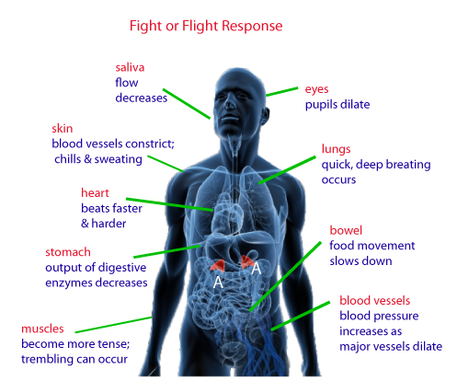
Fight or Flight Response
Notes:
Marilyn:
Review from the call out.
Cell to cell communication leads to whole body affects

Slide 7
Cell communication review
Organize strips in envelope #1 in proper order for cell-cell communication
2 minutes
Check and discuss order of strips
Notes:
Christine:
Call out for answers -> group to group

Slide 8
Signaling Cell
Signaling Molecule
Exocytosis of Signaling Molecule
Signal Molecule Travels to Target Cell
Target Cell
Binding to Receptor
G Protein Activation
Second Messenger
Response

Slide 9
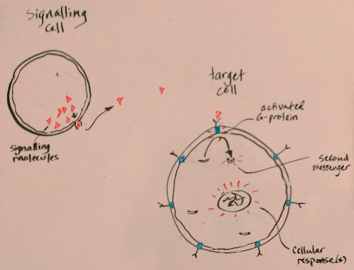
Cell communication review
Draw the cell signaling pathway described on the strips on your white boards.
3 minutes
Notes:
Christine:
Show example drawing.
Remember back to the scenario. The signaling molecule was epinephrine. Where would epinephrine fit into the drawing?

Slide 10
Mini lecture on agonist/antagonist
Notes:
Sarah
If you had them prep beforehand, refer to their reading questions.
If not, at this point we’d have a short lecture on agonists and antagonists of cell signaling.

Slide 11
Sort shapes into categories of agonists, antagonists, no effect and be prepared to justify your answers (Envelope #2)
5
2
4
3
S
1
Notes:
Sarah:
Use homework to review agonist/antagonist
Shapes activity
Now lets tie this back into the scenario

Slide 12
What is the main signaling molecule for fight or flight response?
Notes:
Katie:
Call out: Epinephrine
Where does this fit into the drawing?
Epinephrine is a signaling molecule, known as hormone.

Slide 13
What would an antagonist of epinephrine do to your heart rate? (TPS)
Notes:
Katie:
Epi originates in the blood stream. It affects any cell in body with a receptor for it.
TPS (can give each group a different body part)
Drugs can act as agonists or antagonists. Examples

Slide 14
Can you think of a reason you would like to take an antagonist for this? (TPS)
Notes:
Katie:
TPS
Drugs can act as agonists or antagonists. Examples

Slide 15
Brainstorm: What other examples of cell-cell communication can you think of?
Goal is to reinforce that there are multiple examples of cell – cell communication in the body.
Notes:
Bianca

Slide 16
Goals
Understand how cells communicate and pass on information
Appreciate the importance of cell-cell communication to drug activities and response to the environment
Objectives
Describe and diagram a process by which cells communicate
Predict the cause or consequence of alterations in cell communication and justify your answer
Notes:
Bianca

