Slide 1
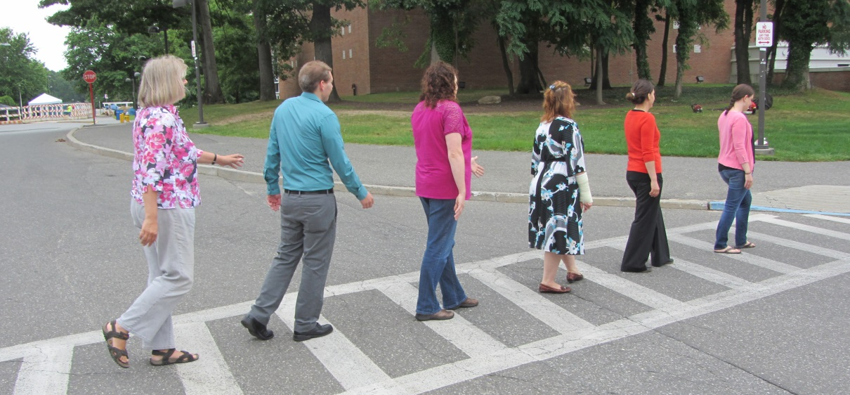
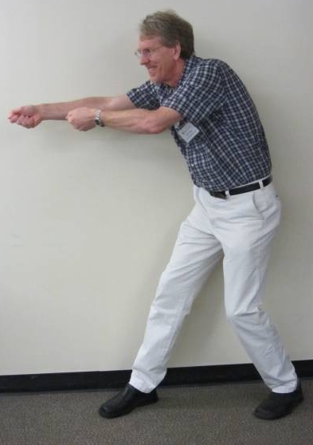
Learning Unit: Cells on the Move
Cindy Jo Arrigo – New Jersey City University
Rebecca Burdine – Princeton University
Jonna Coombs – Adelphi University
Jaclyn Schwalm – Princeton University
David Swope – Rutgers/New Jersey City University
Eugenia Villa-Cuesta – Adelphi University
David Gross – Directional Cue

Slide 2
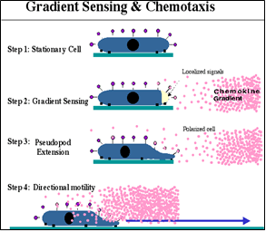
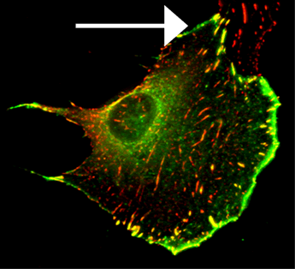
Quick Review from the Balcony:
Course: Sophomores/Intro level
This Unit: middle of the course – 3 hours of class time total
Our tidbit: At the end of the Unit
The students would have learned the following information during the Unit, prior to this tidbit:
Lagging edge
Leading edge
Green signal represents Actin
Cell is migrating in direction of the arrow
http://klemkelab.ucsd.edu/research/cell.html
Notes:
This Unit is being designed for a sophomore/introductory level course and would be presented midway through the course. Preferably, students would have been introduced to the cytoskeleton, extra-cellular matrix and cell-matrix interactions. This slide depicts the types of data the students would already be familiar with before this tidbit would take place.
Our teachable tidbit would come at the end of the learning unit and is designed to bring together the information they have learned in order to design a testable experiment.
To increase inclusion, you can mention that the green may appear gray or white. This would help those students in the course who are red/green color blind.

Slide 3
Learning Goals:
Know how migratory cells sense and respond to environmental cues
Understand how migratory cells become polarized
Know how migratory cells move on and interact with the substrate
Understand the importance of cell migration in development and disease
Describe a ligand-receptor pathway that can direct cell migration and explain a
potential consequence of dysregulation of that pathway. (LG1 and 2)
Create a diagram illustrating three cytoskeletal differences between migrating and
non-migrating cells. (LG1 and 2)
Compare and contrast cell matrix interactions at the leading/lagging edge of a
cell. (LG 3)
Design an experiment to determine if a specific signal is a directional cue. (LG1-4)
Evaluate developmental and disease processes for the importance of cell migration. (LG4)
Learning Unit: Cells on the Move
Learning Objectives/Outcomes:
Students should be able to –
Tidbit
Homework

Slide 4
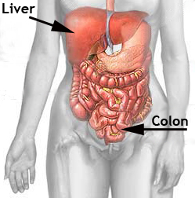
Learning Activity:
Your group is part of an international research and development team for a pharmaceutical company.
Colon cancer is known to metastasize primarily to the lung and liver. Your team has isolated a new secreted protein from the liver you call Roadrunner, that you think may attract colon cancer cells to migrate to this location.
Design an experiment to test whether Roadrunner can function as a directional cue for migrating cells.
Be sure to include what controls you would need and explain how you would analyze your experimental results.
Notes:
To help prevent confusion, you may want to explain that during metastasis, the cells in the colon become migratory and move into the bloodstream. When the migrating cells are in close proximity to the liver, they may sense Roadrunner and move into that tissue. This tissue may be able to support the growth of the cancer cell particularly well, thus the cancer cell is able to populate and grow in the liver. This is often referred to as the “Seed and Soil” hypothesis for metastasis. http://www.nature.com/milestones/milecancer/full/milecancer01.html
The expectation is that class will have practiced skills that would enable them to propose experiments and think about controls. However, if the class has not had this opportunity or is working on these skills you could provide helpful guidelines.
Scaffolding could be used by providing potential reagents and telling the groups they can use all, some or none of them.
For example: Primary antibodies to actin or integrin (could be used to visualize actin polymerization at the leading edge towards the cue)
Primary antibodies to see if the signaling pathway in the migrating cells is polarized towards the cue
Different sources of cell growth media that either contain Roadrunner or do not contain Roadrunner
Different cell types to see if Roadrunner is specific to colon cancer cells or works with all cells
Known directional cues for controls
Things you could provide that they may not need to use:
Cytoskeletal inhibitors (the goals is to see if cells migrate to a cue, inhibiting the cytoskeleton tests if the cell CAN move, but not if it moves towards a cue.)
Knockdown reagents that would test whether the cell could move (like Rnai to integrin) but do not test if the cue is directional
However, not providing guidelines to more advanced classes may encourage creativity.
Depending upon the size of the class, you may be able to request multiple ideas from the class. In larger classes, the groups could upload their experiment to blackboard or write their idea on an index card to be collected. These experimental ideas could then be scanned for interesting experiments. The ideas could be used and/or expanded to create scenarios the students can use to compare, contrast, and evaluate different ideas.
In order to enhance diversity in your classroom, you could provide a picture of an international group to represent the company.
The visceral organ figure was obtained from the following URL and modified in Adobe Photoshop. http://www.minclinic.ru/conservativ/conservativ_eng/visceral_eng.html

Slide 5
One Potential Experiment:
http://people.biology.ucsd.edu/firtel/video.htm
Notes:
After you have discussed examples from class, this slide is used to demonstrate one way the experiment could be conducted. Control for this particular experiment: Mention cells would not move towards the pipet without chemoattractant. You can help relate answers from the class to the movie, for example you could explain that actin would be polymerizing in the lamellopodia orienting towards the directional cue.
This is a Dictyostelium cell moving towards cAMP in a glass pipet. When discussing with the class you can decide whether to leave this point vague to focus only on the cell migration, or you could mention this is not a cancer cell to bring in the concept that lots of cells migrate from different organisms. Another potential activity would be to ask the class to predict what would happen in this experiment if you inhibited actin, remove the ability to sense the chemoattractant, or had the chemoattractant present from two different sources.
The following primary paper has an introduction to cell migration and compares Dictyostelium migration to leukocyte migration. http://jcs.biologists.org/content/117/8/1443.long
Movie legend from the website: Time-lapse video movie of cAMP waves during aggregation. Cells are plated on a monolayer on thin agar and viewed by phase contrast microscopy (4X objective). The movie shows cells from approximately 2 hours to 7 hours after plating. S. Funamoto, Firtel lab. http://people.biology.ucsd.edu/firtel/video.htm

Slide 6
Based on your knowledge of Roadrunner as a directional cue, and cell migration in cancer metastasis, identify the best protein to target with a drug to prevent cell migration in this type of colon cancer.
Actin
B) Roadrunner receptor
Integrins
Fibronectin
E) Roadrunner protein
Notes:
This could be modified as a think-pair-share to have students come up with targets before seeing the clicker choices.
You could also have the students propose answers and populate the clicker list in real time based on class discussion – then have the class vote.
Diversity/Inclusion – group work and clicker questions are two different ways to learn. Clicker questions may be more comfortable for introverted learners.
In the provided answers, the Roadrunner receptor is probably the best answer, as this would prevent the cancer cells from being able to respond to the signal and populate the liver. The Roadrunner protein is also a valid answer, but it is worth discussing the issue that the liver may need this protein for function since it is expressed there and this tissue is “normal” ie not cancerous. The other three would likely be too toxic to the entire organism as they target proteins that are more ubiquitous. Note that with the provided answers, the students may realize that most chemotherapeutic agents target cellular processes that are not specific to cancer. This is the reason that chemotherapy makes patient sick.

Slide 7
Homework:
Provide an example other than cancer, where cell migration is important for either development or disease. Be sure to explain why migration is important in this event and document your sources properly. Your answer should be no more than a paragraph, with sources documented below, and submitted through Blackboard or to your TA by 5pm tomorrow.
Examples from the homework will be selected for sharing with the class.
Rubric | Scored on a 1-3 scale as described below : 3= Meets expectations; 2= Need improvement; 1= Incomplete
Completion of the assignment | 3- Assignment was a full paragraph edited and clearly written 2- Assignment was either not a full paragraph and/or poorly edited 1- Assignment was not submitted
Articulation of the importance | 3- Importance is articulated strongly and concisely 2- Importance is hinted at, but not clear 1- Importance is not addressed
Proper documentation of sources | 3- Sources were credible and documented 2- Sources were provided, but were either not credible and/or not documented 1- No sources were provided
Notes:
This can also be done as an in class activity if time permits.
If it is used as a homework assignment, the rubric should be provided to the students so that expectations are clear.
The professor should define for the class what is a credible source and what is not, preferably at the beginning of the course to apply to all assignments. The professor should also define how complete the source citations must be for full credit – for example, you can require that the citation be complete enough for you to get to their source material or in a specific format provided to the students for their own reference such as Council of Science Editors (CSE) or American Psychological Association (APA) style.
Homework can be assessed by rank (9 being the best, 3 being the worst). If you would like to use a point system, the rubric could be expanded so the items assigned 1 above could be worth 0 points. For a increase in comprehension, you could require students to revise their assignments and correct the issues noted in feedback.
Diversity – allows students to work on their own in a time frame that best fits their life. Sharing of examples would be anonymous so students aren’t highlighted. Be aware that not all students may have access at home to Blackboard.

Slide 8
Ideas for Scaling this Tidbit
Small class <40 –
Tidbit: working groups of 3-4 – could ask for one or two examples
Homework: instructor/TA scan answers and provides feedback
Medium size class 40-100 –
Tidbit: working groups of 3-4 – ask for one or two different answers
Homework: instructor/TA scans answers and provide feedback
Large class 100 + -
Tidbit: working groups of 2-5 students seated close to each other – ask for 1-3 volunteers, especially that have different answers.
Homework: have peer groups score the responses and rank them
Notes:
Tools for peer review - Calibrated Peer Review http://cpr.molsci.ucla.edu/Home.aspx is one for purchase internet tool you can use for peer review.
iPeer http://sourceforge.net/projects/ipeer/ is a free online tool for setting up a peer review instance
A site that lists peer review programs http://www.reap.ac.uk/PEER/Software.aspx

