Slide 1
Control of Eukaryotic Gene Transcription
Teachable Unit
Gene Expression Team
NANSI 2013, University of Minnesota
Participants: Michael Burns, Lucy He, David Kirkpatrick, Bridget Lear, Tamar Resnick, Turk Rhen
Facilitators: Judy Ridgway, Sue Wick
Image Source: http://www.garlandscience.com/product/isbn/9780815341291
Notes:
Chapter 8, (Alberts?)

Slide 2
Context
Course: the teachable unit is intended for use in an upper level undergraduate Genetics course.
Time frame: the unit is expected to cover 1-2 class periods within a two week series of units on eukaryotic gene expression, approximately 1/3 of the way into the semester.
Student background: students in this course would have previously completed Introductory Biology for majors, which would include essential background such as the central dogma. Macromolecular structure would also be covered in the first 1/3 of this course.

Slide 3
Learning goals Students will understand | Outcomes/ objectives Students will be able to
regulation of eukaryotic gene transcription | explain cis and trans regulators, distinguish between them, and explain their interactions recognize and explain examples of transcriptional activation and inhibition predict the effects on gene expression resulting from regulatory perturbations

Slide 4
Learning goals Students will understand | Outcomes/ objectives Students will be able to
regulation of eukaryotic gene transcription that differences in gene expression can lead to different cellular and organismal outcomes | explain cis and trans regulators, distinguish between them, and explain their interactions recognize and explain examples of transcriptional activation and inhibition predict the effects on gene expression resulting from regulatory perturbations provide, recognize, and explain examples in which differences in gene expression produce different outcomes for the cell/ organism

Slide 5
Learning goals Students will understand | Outcomes/ objectives Students will be able to
regulation of eukaryotic gene transcription that differences in gene expression can lead to different cellular and organismal outcomes how to interpret and analyze data | explain cis and trans regulators, distinguish between them, and explain their interactions recognize and explain examples of transcriptional activation and inhibition predict the effects on gene expression resulting from regulatory perturbations provide, recognize, and explain examples in which differences in gene expression produce different outcomes for the cell/ organism draw logical conclusions from data

Slide 6
Scientific teaching themes: Diversity and Inclusivity
Students will be provided with a study guide that will
  describe learning goals and outcomes
  assist students to organize and prioritize material in reading assignment
  provide links to videos/animations/multimedia resources
  include references for relevant background resources from previous units
  Inclusive of differences in background knowledge and learning styles.
Learning activities will be designed to encourage participation from all students through the use of a variety of small group, paired, and individual activities.
  Inclusive of differences in learning styles and personality types.
Multiple forms of assessment will be used.
  Inclusive of differences in learning styles.
Notes:
Other ideas: non-random group assignments that promote diversity, utilize examples of diverse human experiences where appropriate

Slide 7
Presentation Plan: incorporation of active learning and assessment tools
Preclass: Students will read chapter, watch animations, and review study guide to familiarize themselves with the material.
Activity 1: Construction of generic transcription unit using a manipulable model. Activity performed in small groups, followed by class discussion and evaluation. Formative assessment (25 minutes)
Activity 2: Extension of model with hypothetical scenarios in which regulatory components are altered. Individuals will answer clicker questions. Small groups will discuss and manipulate models. Individuals will re-answer clicker questions. Formative assessment (20 minutes)
Activity 3 (tidbit): Mini-lecture and case study that explore the relationship between gene regulation and limb development. Small groups will evaluate data and make predictions using the manipulable model, followed by class discussion and evaluation. Formative assessment (25 minutes)
Notes:
The blue text indicates activity for the tidbit presented

Slide 8
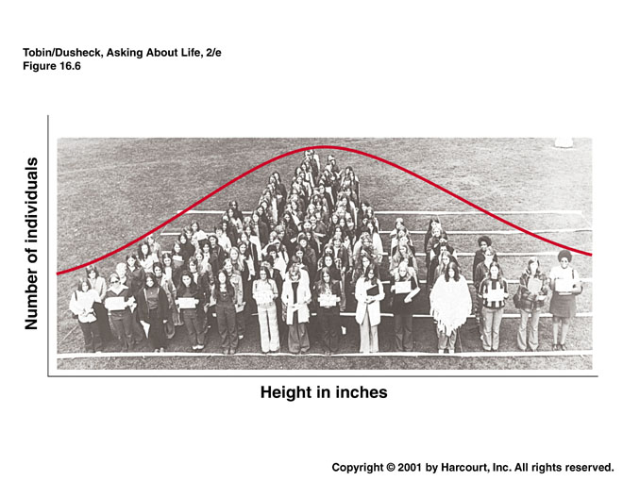
Phenotypic Variation Within Species
Height

Slide 9

Phenotypic Variation Within Species
Appendage length
Source: http://www.sxc.hu/photo/1330423
Notes:
Possible things to note: Begin to draw attention to appendage length. May also emphasize that there is a diversity in length but there is a constraint on the diversity within a species. Students might be drawn to talk about skin color, but focus on appendage length. Photo with diverse skin color was chosen to be inclusive of diversity within the student population.

Slide 10
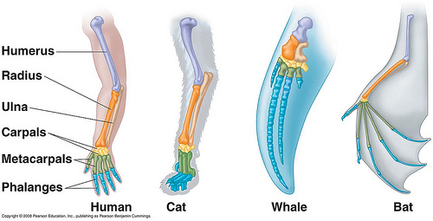
Phenotypic Variation Among Species
Source: http://www.bio.miami.edu/dana/160/160S11_3.html
Notes:
Note that appendages were all scaled to the same size for ease of illustration. Differences illustrated here are differences in proportion. Could also discuss differences in length of appendage relative to body size.

Slide 11
What regulates appendage length?

Slide 12
Prx1, a gene involved in limb length
“Gene” refers to coding sequence and flanking regulatory sequence
Prx1 - Paired related homeobox 1
To understand Prx1 function, scientists compared mouse and bat limb development
Notes:
Emphasize that Prx1 is only one contributor to limb length. Adding an additional slide that lists known regulators of limb outgrowth may help prepare students for the effects of Prx1 being subtle. This may depend in part on student prior knowledge.

Slide 13
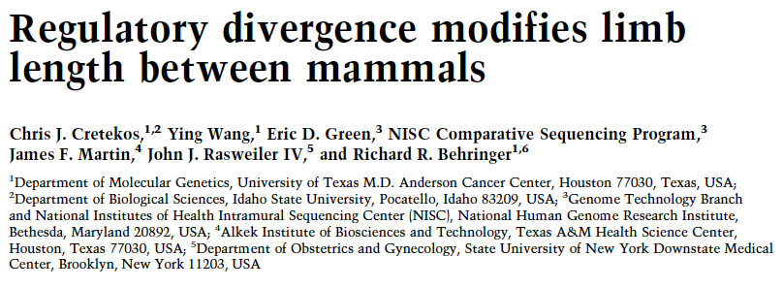
Cretekos CJ, Wang Y, Green ED, et al., Genes Dev. 2008 Jan 15;22(2):141-51.

Slide 14
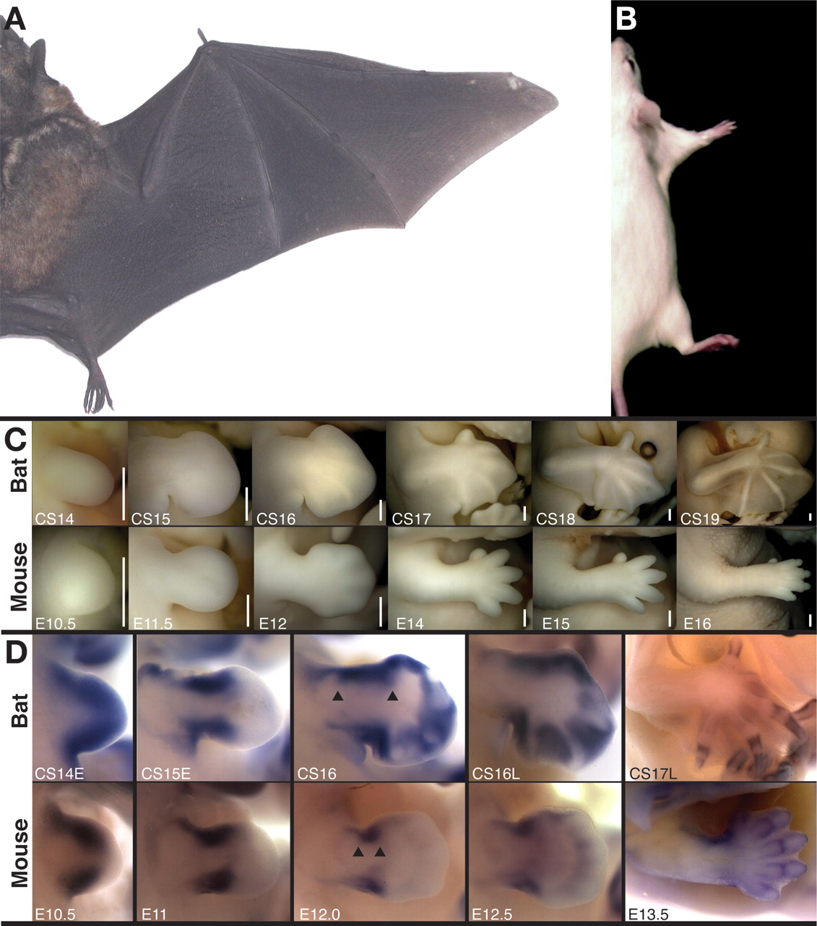
Bats have longer forelimbs relative to body size than mice do
Adapted from Cretekos CJ, Wang Y, Green ED, et al., Genes Dev. 2008 Jan 15;22(2):141-51.
Notes:
Note that the blue line shows that the body sizes are normalized and the yellow line shows the differences in ulna/radius length.

Slide 15
Bats have higher Prx1 expression in the forelimb than do mice
Prx1 mRNA
Expression
Bat
Mouse
Adapted from Cretekos CJ, Wang Y, Green ED, et al., Genes Dev. 2008 Jan 15;22(2):141-51.
Notes:
This slide illustrates the differences in gene expression level between the bat and mouse. Blue color shows presence of mRNA. Unless students have prior understanding of molecular techniques, such as in situ, the details of the experimental design will not be elaborated.

Slide 16
What changes in Prx1 might cause this difference?
Wild-type
Mutant
Manipulate your models
Come up with as many different hypotheses as you can
Adapted from Cretekos CJ, Wang Y, Green ED, et al., Genes Dev. 2008 Jan 15;22(2):141-51.
Notes:
Note that these are both mice illustrations. Students should brainstorm as many possibilities as they can, however, they should be plausible explanations. Students should be able to demonstrate the relationship among the way the gene is disrupted, the outcome for gene expression, and the resulting phenotype.
Also note, some students may infer from the previous slide that Prx1 promotes limb extension (bat has more Prx1 and longer limbs). Other students may not be sophisticated enough to make this leap. Whether or not students do make this assumption will affect what hypotheses are plausible. The best way to deal with this will depend on the specific students and context.

Slide 17
Wild type
Prx1-coding sequence deletion
Adapted from Cretekos CJ, Wang Y, Green ED, et al., Genes Dev. 2008 Jan 15;22(2):141-51.
Notes:
Emphasize once more before revealing the mutant identity that many hypotheses could explain these data. An extension could be to ask students to design experiments to distinguish among their hypotheses. Revealing that these actual data are from a coding sequence deletion is intended to set up the next part of the investigation.
Also note that the deletion is an exon 1 deletion in the original source. Whether or not to be specific about that depends on whether students are sophisticated enough to find it clarifying instead of confusing.

Slide 18
Do Prx1 regulatory elements contribute to interspecies variation?
Scientists replaced mouse Prx1 regulatory sequence with bat Prx1 regulatory sequence
  Do this with your model.
Use your model to predict the effect on mRNA and protein expression
Draw your hypothetical mouse
Notes:
Give 5 minutes to brainstorm, draw what you think the mouse limb would look like (active learning exercise). Have students record the different hypotheses.
Ask for hypotheses from random groups, discuss logic behind their ideas (formative assessment)
Make sure students remove enhancer and silencer elements and replace them with the bat regulatory region. Make sure that they retain the core promoter.

Slide 19
Wild type
Prx1-delete
Bat regulatory region
?
Adapted from Cretekos CJ, Wang Y, Green ED, et al., Genes Dev. 2008 Jan 15;22(2):141-51.
Notes:
Give 5 minutes to brainstorm, draw what you think the mouse limb would look like (active learning exercise). Have students record the different hypotheses.
Ask for hypotheses from random groups, discuss logic behind their ideas (formative assessment)

Slide 20
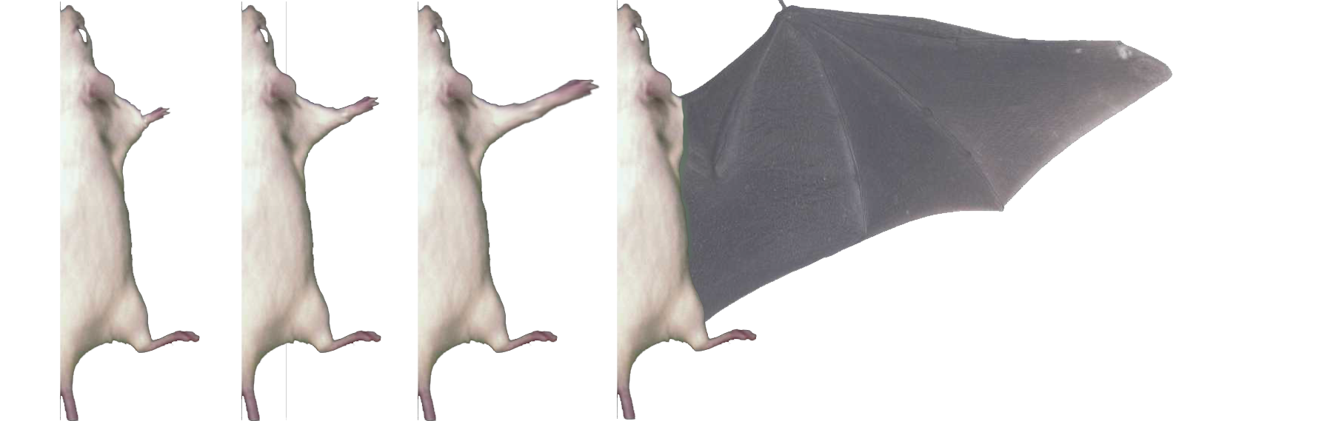
Which would you predict?
Shortened
Limb
Normal
Limb
Elongated
Limb
Functional
Wing
A B C D
Adapted from Cretekos CJ, Wang Y, Green ED, et al., Genes Dev. 2008 Jan 15;22(2):141-51.
Notes:
This could be a clicker question. Ask students to explain their reasoning for their choices, and making sure that they start at the transcriptional unit and make their way up to the phenotype.

Slide 21
Bat regulatory region
Wild type
Prx1-delete
Adapted from Cretekos CJ, Wang Y, Green ED, et al., Genes Dev. 2008 Jan 15;22(2):141-51.

Slide 22
Take-Home Question
Why is there only a small change in mouse limb length with the bat enhancer, considering that bats have much longer forelimbs?
Give an explanation in terms of gene expression (150 words max)
Notes:
This exercise could also be done in class or could be discussed in the following class.

Slide 23
Summary/ debriefing
explain cis and trans regulators, distinguish between them, and explain their interactions
recognize and explain examples of transcriptional activation and inhibition
predict the effects on gene expression resulting from regulatory perturbations
provide, recognize, and explain examples in which differences in gene expression produce different outcomes for the cell/ organism.
draw logical conclusions from data
Notes:
Blue text indicates the outcomes that were assessed and practiced during the tidbit.

Slide 24
Summative Assessment
Potential mechanisms
  Exam questions -new example
  Part of term paper would involve transcriptional regulation
  Part of poster would involve transcriptional regulation
Notes:
Other summative assessments are possible. These are just some selections.

Slide 25

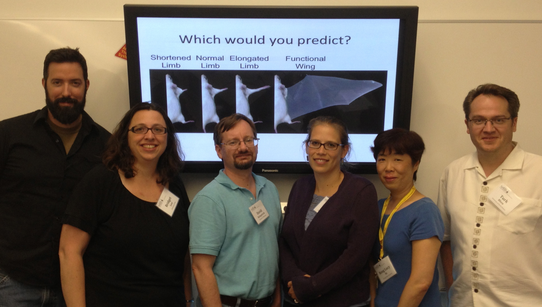
Acknowledgements
Sue Wick, University of Minnesota
Judy Ridgway, The Ohio State University
NANSI organizers

Slide 26
Source: https://www.youtube.com/watch?v=XHTZTJpNRc8

