Slide 1
Ecology and You: Ecosystem Perturbation
Group 5
Lorelei Patrick
Peter Stiling
Riaz Khan
Xavier Gonzales
Adelaide Rhodes
Facilitators: Donata Henry and Conrad Toepfer

Slide 2
Learning Outcomes
Predict the outcome of perturbation on ecosystems
Analyze the outcomes of ecosystem perturbation from the perspective of different stakeholders at multiple levels

Slide 3
Target Audience
Freshman/sophomore biology or Ecology
1-2 weeks; 2-4 class periods
Beginning of ecology unit or ecology course
Any class size

Slide 4
1-minute paper
What is your favorite wild organism?
If it goes extinct, how might it impact you and its ecosystem?
2 minutes

Slide 5
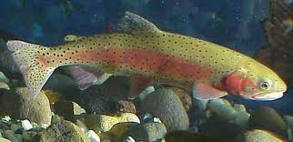
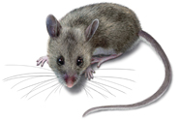
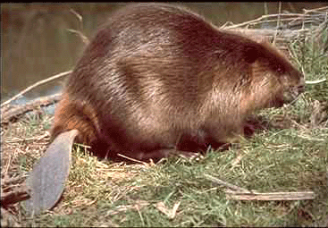
Trout
Insectivore
1
8
Willow
Primary producer
2
Elk
Herbivore
7
Mouse
Herbivore
3
Coyote
Carnivore
6
Warbler
Insectivore
Draw arrows showing how your organism might interact directly or indirectly with the other organisms
4
Beaver
Herbivore; ecosystem engineer
Raven
Scavenger
5
2 minute individual; 3 minute T-P-S
Notes:
Print a copy for each student

Slide 6
Trout
Insectivore
1
8
Willow
Primary producer
2
Elk
Herbivore
7
Mouse
Herbivore
Wolf
Carnivore
3
Coyote
Carnivore
6
Warbler
Insectivore
Draw arrows showing how your organism might interact directly or indirectly with the other organisms
4
Beaver
Herbivore; ecosystem engineer
Raven
Scavenger
5
2 minute individual; 3 minute group disc.
Notes:
Print a copy for each student. Have students draw lines on board?

Slide 7
Stakeholders
Hunter
Fisher-person
Forester
Bird watcher
Rancher
Politician
Camper/hiker
Park ranger
Take another look at the species interactions.
Would your group decide to allow wolves to be taken off of the Endangered Species List and be hunted?
Why or why not?
What’s your most convincing justification?
5 minute group disc.

Slide 8
1-minute paper
Think back to your favorite wild organism.
If it goes extinct, how might it impact you and its ecosystem?
1 minute
Notes:
Have them flip the card over to does this minute paper to utilize as a post-assessment. Afterwards pick up the cards to have a summative assessment. It may also be useful to show a completed guide of how all the organisms are affected by the wolf.

Slide 9
Future Directions
Homework assignment (concept map or paragraph):
How might abiotic perturbations (precipitation, temperature, etc.) impact ecosystems?
Describe how the extinction of your favorite wild organism would impact its ecosystem

