Slide 1
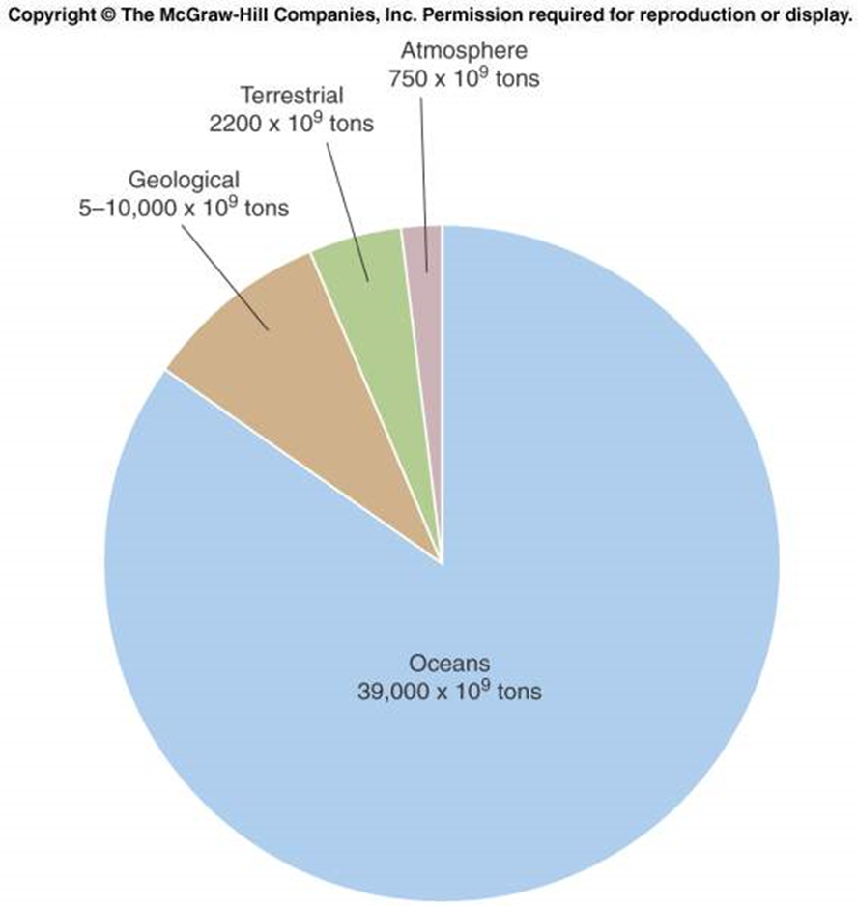
Label the pie chart with the carbon reservoirs.
A. Land
B. Air
C. Water
D. Rocks
Notes:
Ask for examples once you have answers
Ask them to explain their rationale for answer choice

Slide 2
Label the pie chart with the carbon reservoirs.
A. Land
B. Air
C. Water
D. Rocks
Notes:
Ask for examples once you have answers
Ask them to explain their rationale for answer choice

