Slide 1
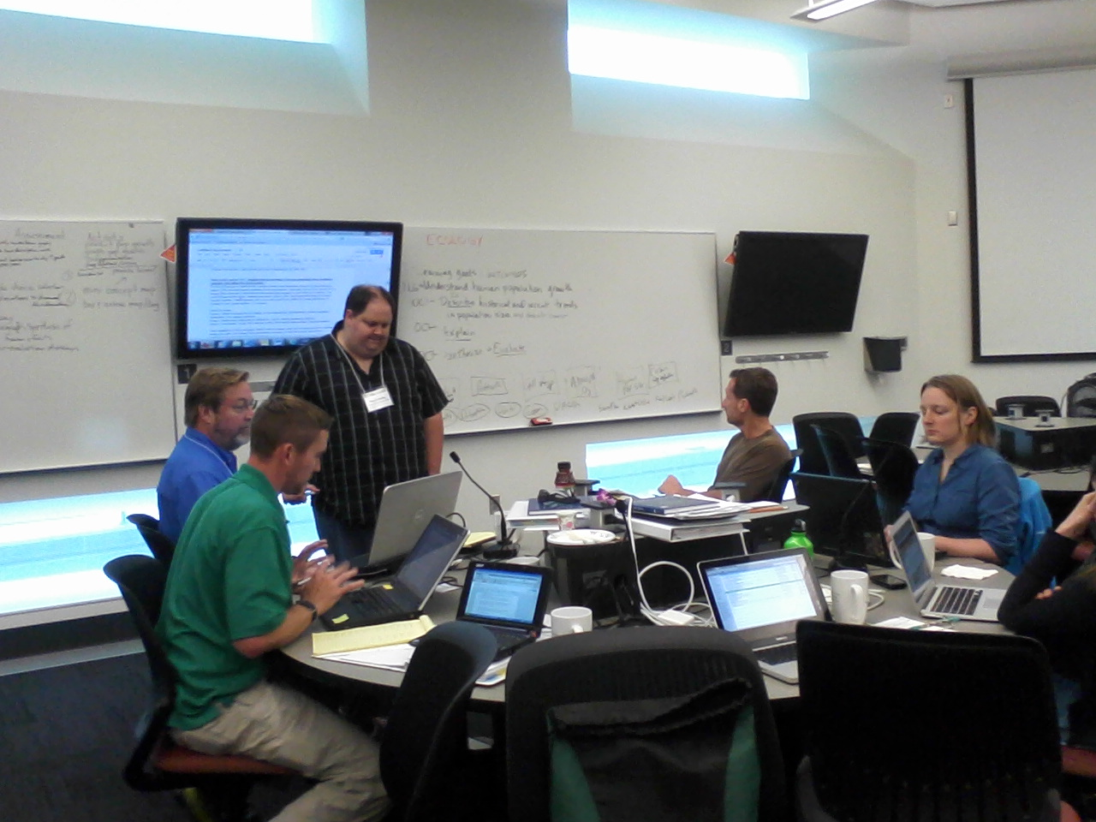
Ecology Group
Participants
Bryan Darby
Christopher Felege
Krista Fritz
Steven Kelsch
Lisa Kenyon
Lindsey Tuominen
Mary Williams
2012 NANSI
Minneapolis, Minnesota
Facilitators
Catherine Kirkpatrick
Rob Brooker

Slide 2
Ecology Group
Learning Goal:
Understanding human population growth and its environmental impacts
Context:
Target: Biology Majors or Non-Majors
One semester Introductory Biology Course
Active Learning Classroom (where students are experienced with these types of activities)

Slide 3
Ecology Group
Learning Goal:
Understanding human population growth and its environmental impacts
Context:
Near the end of the semester – Ecology Unit
Already covered in class: concepts like abiotic and biotic interactions, community ecology, diversity, nutrient cycling and energy flow

Slide 4
Ecology Group
Learning Goal:
Understanding human population growth and its environmental impacts
Learning Outcomes:
1. Identify historical and recent trends in human population
growth and describe causes of this growth,
2. Explain how human population size relates to global
environmental issues,
3. Based on explanations from OC2, synthesize
human impacts via diagrammatic model, and use that model to predict environmental outcomes,
4. Based on a provided rubric, peer evaluate diagrammatic
models for strengths and weaknesses of synthesis.

Slide 5
Ecology Group
Learning Outcome 1
Identify historical and recent trends in human population size and describe causes of this growth.
Summative assessment: Multiple Choice Exam questions that test identification of population growth trends, description, and causes.
Activity: Graph 1) prediction, and 2) actual data of historical trends.

Slide 6
Group Roles
Ecology Group
Left: Manager (keep track of time and task objectives, and participation)
Middle: Recorder (run computer and write group responses)
Right: Skeptic/Reporter (challenge group conclusions when necessary, report results to table).

Slide 7
Can the human population continue to grow?
Ecology Group
Link to world population clock here

Slide 8
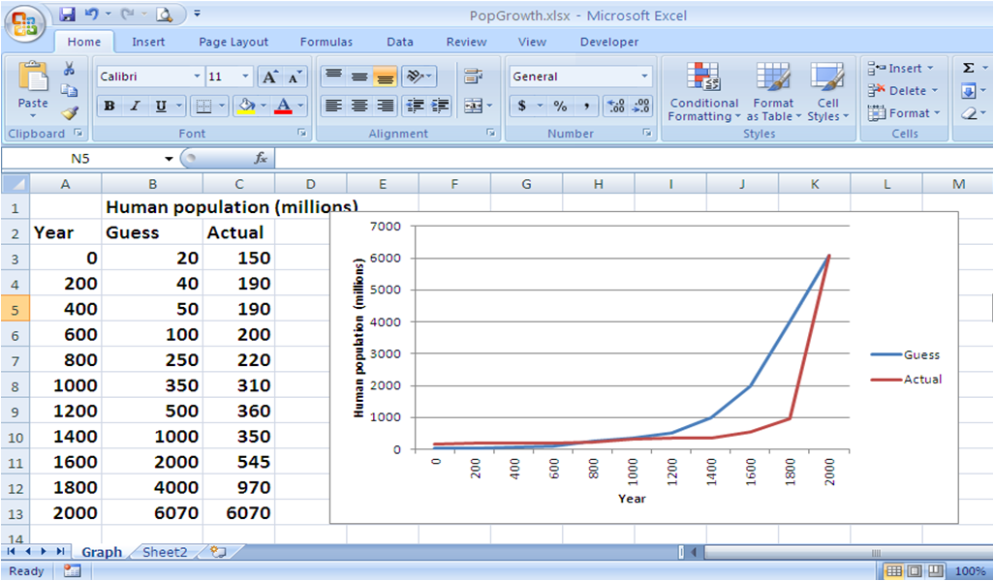
Ecology Group

Slide 9
Ecology Group
Why the depression around 1400?
Why does the human population seem to increase so rapidly around the 1800's and 1900's?

Slide 10
Human population map
Ecology Group

Slide 11
Carbon emissions map
Ecology Group

Slide 12
Land use map
Ecology Group

Slide 13
Global Urbanization Map
Ecology Group

Slide 14
Learning Outcome 2
Ecology Group
Describe how human population size relates to global environmental problems/processes
Summative Assessment: Choosing the most appropriate explanation from a set of options describing the relationship between a given problem/process and human population size
Activity: Individually define terms on cards, then write one sentence describing relationship to human population size

Slide 15
Ecology Group
How does human population size relate to global environmental problems?
STEP 1: Your tables are divided into 3 subgroups
Each subgroup gets a set of cards
STEP 2: After you get your cards…
Remove the “human population” card
Each individual should select two cards
to work on

Slide 16
Ecology Group
How does human population size relate to global environmental problems?
STEP 3: Write a separate definition on each card for the term written on it. Individual work (2 min)
STEP 4: On each card, write one sentence describing the connection between the term and human population size. Individual work (2 min)
STEP 5: Share, critique, clarify definitions & “connection” sentences within the group (6 min)

Slide 17
Ecology Group
Learning Outcome 3
Outcome 3: Based on the explanations developed in OC 2, synthesize human impacts into a diagrammatic model.
Summative Assessment: Construct a model that explains relationships among different individual factors within the 3 categories(Carbon, Urbanization, and Agriculture) that are affected by human population that are to be used to predict environmental outcomes.

Slide 18
Activity: Your job now is to build a model with your group of 3 at the white boards based on one of the following 3 categories:
Carbon Agriculture Urbanization
Human Population Human Population Human Population
Fossil Fuel Combustion Photosynthesis Housing
Oceans Food Supply Deforestation
Atmospheric CO2 Water Erosion
Climate Change Erosion Biodiversity
Carbon Sequestering Nitrogen Runoff Oceans
Photosynthesis Cattle Lot Pollution
Use a black marker to construct the arrows and linking terms to explain connections related to Human Populations
Remember to consider your audience: This will be evaluated by your peers - FOCUS ON ACCURACY AND CLARITY FOR OTHERS TO UNDERSTAND!!!
8 Minutes

Slide 19
Ecology Group
At this point
Each group have their reporter take 2 minutes to explain their model (Carbon, Agriculture, and Urbanization) to the 9 person group as a whole.
This provides an opportunity for peer edits, review, and "tweaking" as needed
First Group - 1 minute for explaining, 1 minute for feedback
Second Group - 1 minute for explaining, 1 minute for feedback
Third Group - 1 minute for explaining, 1 minute for feedback

Slide 20
Understanding human population growth and its environmental impacts
Ecology Group
Carbon
Human Population
Urbanization
Agriculture

Slide 21
The Ultimate Model Challenge
Ecology Group
As a table team, construct a synthesis model showing all three models and their linkage to Human Population (5 minutes)
Using colored markers include arrows and linking terms to explain these connections
Consider your audience. This will be evaluated by your whole class peers--check model for accuracy and clarity for others to understand.

Slide 22
Summative assessment OC3 – one paper per 3
1. If the human population continues to grow at approximately its current rate, what effect would that have on your overall Carbon, Agriculture, OR Urbanization model and WHY (select one of the three).
2. If science found a way to increase global photosynthesis levels, what effects would you predict that to have on global climate change and WHY?
3. If the human population continues to grow at approximately the current rate, what other impacts do you think might occur to the environment, and how might you model this?

Slide 23
Ecology Group
Learning Outcome 4
You Decide! Peer evaluation of synthesis models.
Assessment: Peer evaluation of another group's model for strength and weakness with suggestions for improvement based on a rubric.
Summative assessment will be instructor grading of the revised final version of the model

Slide 24
Rubric for evaluating models
Your Name_________________________________ Your Group Number Group Number Being Evaluated
Goal Understand human population growth and its environmental impacts
Outcomes 2 through 4. Students will demonstrate that they are able to accurately synthesize the major impacts of the human population on aspects of the global environment:
Exceptional | Good | Needs Work
Model generally represents an accurate synthesis of relationships among among human populations and the global environment as affected by humans (terms provided on cards), possibly with minor misconceptions or inaccuracies (over 85 percent accurate) Minor misconceptions or lack of clarity in Relationships Processes Model as presented An exceptional model will connect all terms with arrows indicating an understandable rationale and provide links among cards of different color. More than one model may be correct Circle words or phrases above that describe any/all weaknesses | Model partially demonstrates ability to synthesize human impacts on the global environment. Model mostly represents an accurate synthesis of these relationships and processes with more substantial misconceptions and errors (60 to 84 percent accurate) Weaknesses Inaccuracies, misconceptions, or ineffective presentation in Relationships Processes Model as presented A good model will connect most terms with an understandable rationale. Circle words or phrases above that describe any/all weaknesses | More work needed to demonstrate ability to synthesize human impacts on the global environment. Model and with inaccuracies, misconceptions, errors, or ineffective presentation (0 to 59 percent accurate). Weaknesses Inaccuracies, misconceptions, or ineffective presentation in Relationships Processes Model as presented Models that need work will not connect a number of terms or will connect some without an understandable rationale. Circle words or phrases above that describe any/all weaknesses
5 4 points (circle score) | 3 2 points (circle score) | 1 0 points (circle score)
Model strengths
Suggestions for Improvement

Slide 25
Judging the Ultimate Model
When your table's model is complete, each student will be given a rubric to be used to evaluate the model prepared by another group.
When instructed, your whole table will move clockwise to the whiteboard model of neighboring group.
Each student will independently evaluate the model using the rubric.
Look over the model paying attention to the following:
How the model is put together, in other words, its synthesis.
Are all terms within each color connected by arrows in an order that makes sense?
Are the submodels of each color connected to the Human Population and to the other color submodels in a way that makes sense?
Note that there are different correct ways that the model can be constructed so it doesn't have to be exactly like yours.
Use the rubric to provide feedback about the model to the other group by noting strengths and circling words on the rubric that describe weaknesses if any.
Taking into account strengths and weaknesses that you have observed, assign your score for the model by circling a number (5 best to 0 worst). Be sure to give your honest judgment.
Add notes on the bottom of the rubric page on what you think is good (strengths) about the model and what you think could be changed to help the group improve their final model.
When instructed, collect your group’s completed rubric forms and return them to the group you evaluated.

Slide 26
The Judges have spoken
Work with your whole table to revise your Ultimate Model using the feedback you have received from your neighboring group. Note that the individual evaluations may not agree so do your best to make changes according to the majority of judges. If you do not agree with the feedback, consider that clarifying your model may be all that is needed.
When you have used the feedback from the judges to create a final version of your model, use a computer or phone to take a clear digital image of your model.
Be sure that one member of your group submit the image of your model to the instructor for grading. The instructor will use the same rubric for assigning your group’s grade.
Also, collect the rubrics that you received from your neighbor group and turn them in to the instructor by the end of the class period.

