Slide 1
Mechanisms of Evolution

Slide 2
Goal(s):
1) Understand the four mechanisms of evolution, how each causes evolution, how these mechanisms (potentially) interact to produce this change, and why evolution is relevant to me.
Outcome(s):
1) Analyze a dataset and propose a mechanism for evolution.

Slide 3
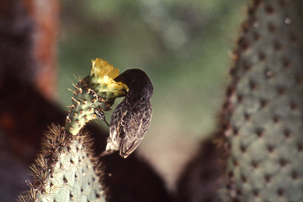
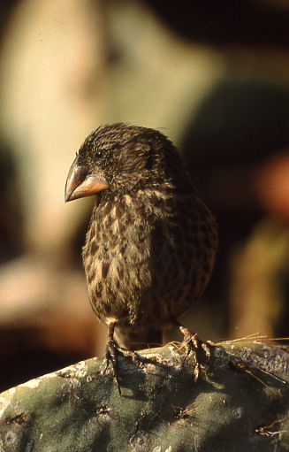
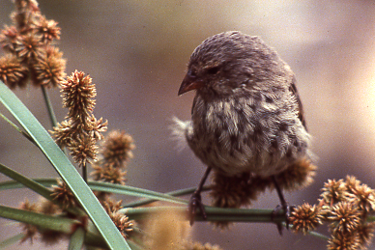

Slide 4
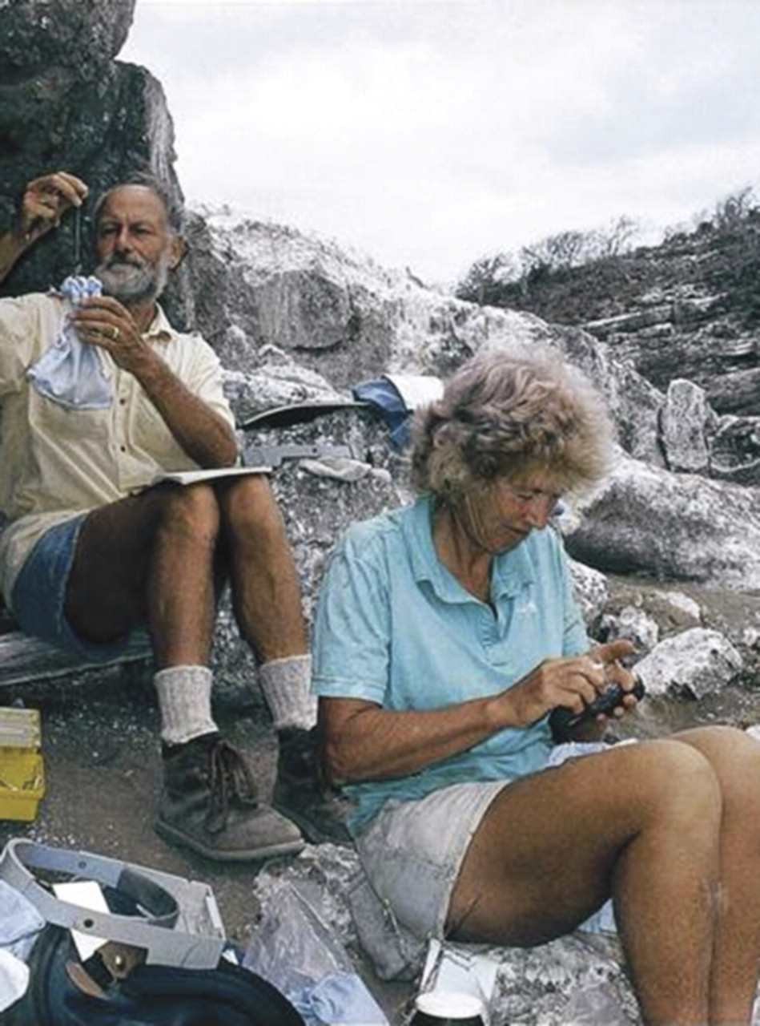
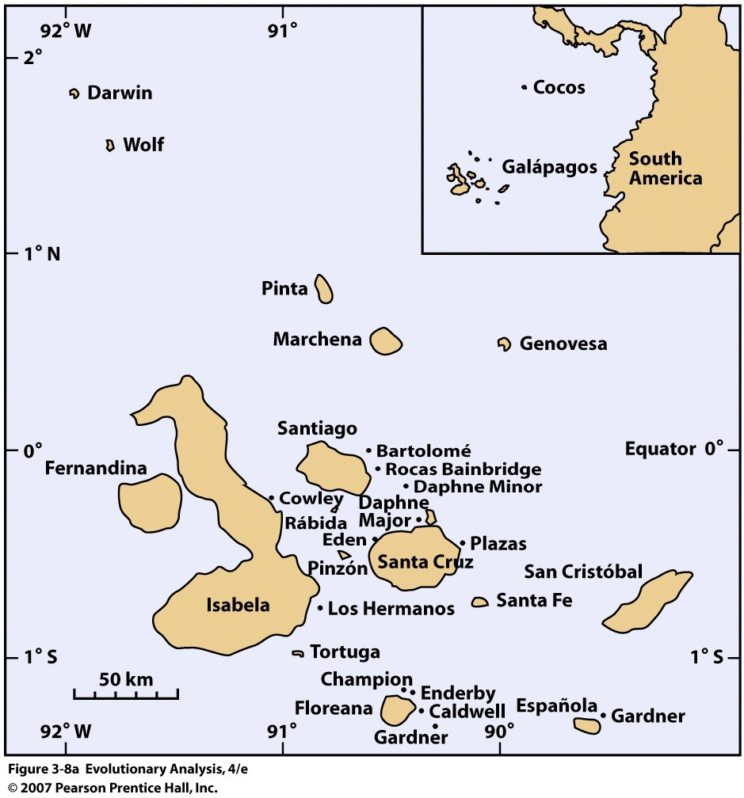
Peter and Rosemary Grant have been studying finches in the Galapagos Islands since 1973.
Notes:
B. Rosemary Grant and spouse Peter Grant. Image courtesy of K. Thalia Grant.

Slide 5
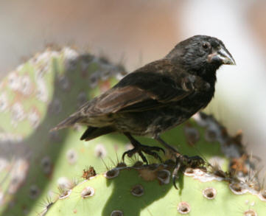
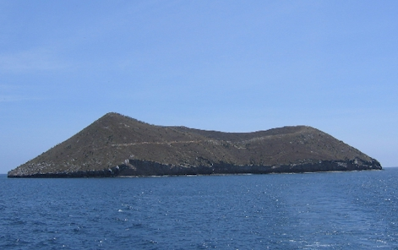
Case Study: Geospiza fortis on Daphne Major

Slide 6
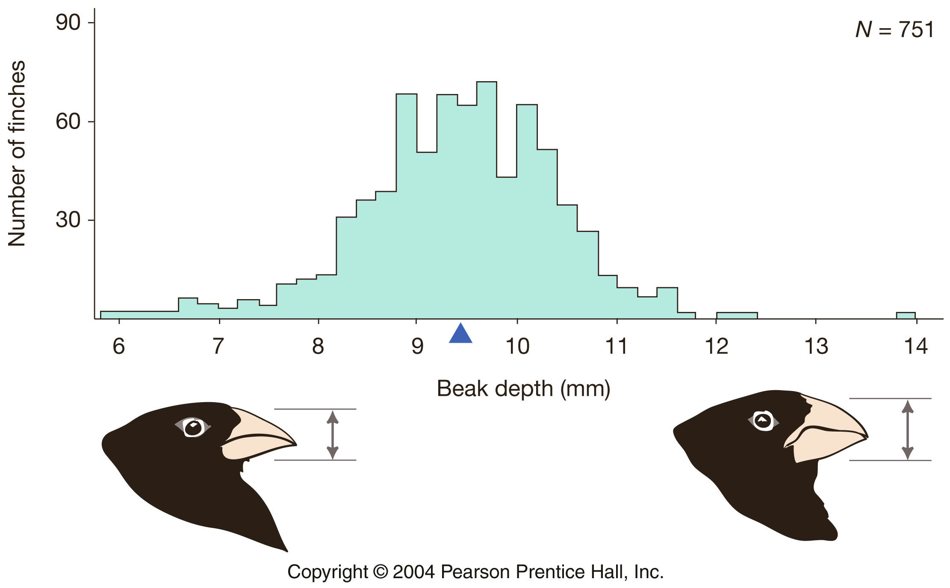
Variation in beak depth in Geospiza fortis
1976

Slide 7
Information of Interest
1. Beak size corresponds with a preference for seed size.
i.e. large beak depth = large seeds, small beak = small seeds
2. A major drought occurred in 1977.
3. The majority of the seeds pre-drought = medium seeds; post-drought = large seeds

Slide 8
Given the information of interest and initial beak depth distribution:
Which of the following graphs best represents the beak size distribution of the population of adults in 1978 (after the drought)?
1.
2.
3.

Slide 9
Given the information of interest and initial beak depth distribution:
Which of the following graphs best represents the beak size distribution of the population of adults in 1978 (after the drought)?
1.
2.
3.

Slide 10
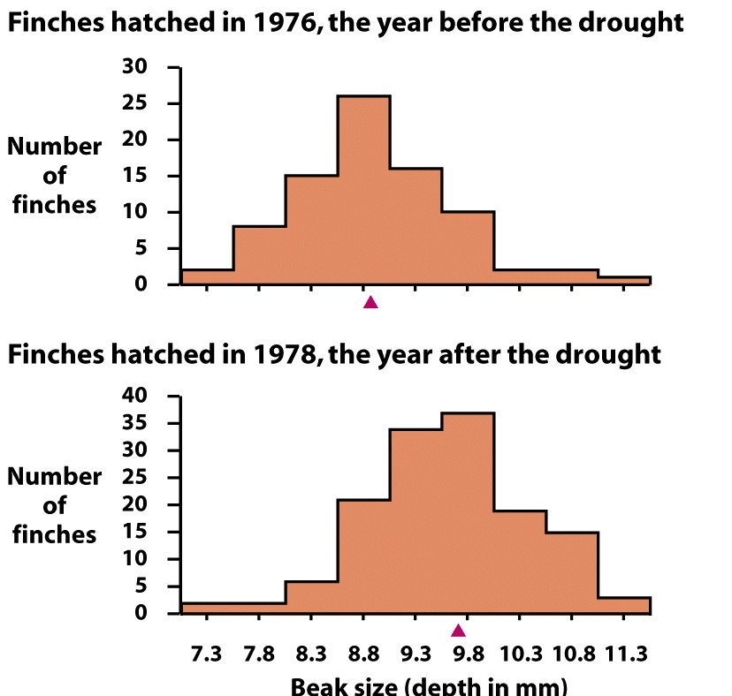
Geospiza fortis: Offspring
Given, genetic traits (e.g., in this case - beak depth) are heritable
(i.e. can be passed from generation to generation):
describe any observed difference(s) in beak size of chicks born in 1976 versus 1978, and
(2) formulate a hypothesis to explain this difference.

