Slide 1
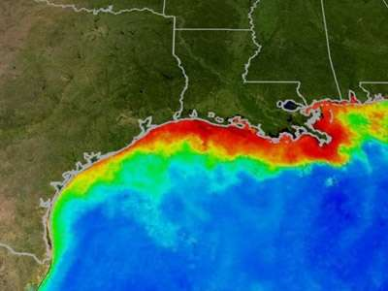
Notes:
http://science.howstuffworks.com/environmental/earth/oceanography/dead-zone.htm

Slide 2
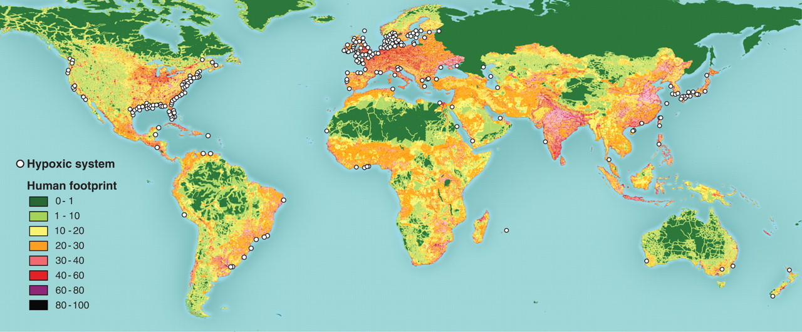

Fig. 1. Global distribution of 400-plus systems that have scientifically reported accounts of being eutrophication-associated dead zones.
R J Diaz, R Rosenberg Science 2008;321:926-929
Published by AAAS
Notes:
Global distribution of 400-plus systems that have scientifically reported accounts of being eutrophication-associated dead zones. Their distribution matches the global human footprint [the normalized human influence is expressed as a percent (41)] in the Northern Hemisphere. For the Southern Hemisphere, the occurrence of dead zones is only recently being reported. Details on each system are in tables S1 and S2.
R.J. Diaz and R. Rosenberg. 2008. Science 321:926-929

Slide 3
Notes:
Vitousek, P.M., J.D. Aber, R.W. Howarth, G.E. Likens, P.A. Matson, D.W. Schindler, W.H. Schlesinger and D.G. Tilman. 1997. Human alteration of the global nitrogen cycle: Sources and consequences. Ecological Applications 7(3): 737-750.

Slide 4
Notes:
Nitrogen and phosphorus in the Upper Mississippi River:
transport, processing, and effects on the river ecosystem
Jeffrey N. Houser • William B. Richardson
Hydrobiologia (2010) 640:71–88
DOI 10.1007/s10750-009-0067-4

Slide 5
Notes:
Vitousek, P.M., J.D. Aber, R.W. Howarth, G.E. Likens, P.A. Matson, D.W. Schindler, W.H. Schlesinger and D.G. Tilman. 1997. Human alteration of the global nitrogen cycle: Sources and consequences. Ecological Applications 7(3): 737-750.

Slide 6
Notes:
http://www.sott.net/articles/show/228591-US-Does-a-Monster-Flood-Have-to-Fuel-a-Monster-Dead-Zone-Too-

Slide 7
Notes:
Vitousek, Peter M., John D. Aber, Robert W. Howarth, Gene E. Likens, Pamela A. Matson, David W. Schindler, William H. Schlesinger, and David G. Tilman. 1997. “HUMAN ALTERATION OF THE GLOBAL NITROGEN CYCLE: SOURCES AND CONSEQUENCES.” Ecological Applications 7 (3) (August): 737-750. doi:10.1890/1051-0761(1997)007[0737:HAOTGN]2.0.CO;2.

Slide 8
Notes:
Vitousek, Peter M., John D. Aber, Robert W. Howarth, Gene E. Likens, Pamela A. Matson, David W. Schindler, William H. Schlesinger, and David G. Tilman. 1997. “HUMAN ALTERATION OF THE GLOBAL NITROGEN CYCLE: SOURCES AND CONSEQUENCES.” Ecological Applications 7 (3) (August): 737-750. doi:10.1890/1051-0761(1997)007[0737:HAOTGN]2.0.CO;2.

Slide 9
Notes:
Plant and Soil 228: 3–15, 2001. © 2001 Kluwer Academic Publishers. Printed in the Netherlands.
The impact of humans on the nitrogen cycle, with focus on temperate arable agriculture
D. S. Jenkinson

