Slide 1
Ecology
Group Members: Martina Ederer, April Ann Fong, Sarah Gerken,
Mary Oswald, Alison Rodal, and Michael Gillespie

Slide 2
Course Context
Majors Biology course (with other STEMs)
Student Background: High School Biology
Ecology Component: Timing varies
Notes:
Midway through the semester, students are familiar with active learning in this course

Slide 3
Ecology Unit Learning Goal
Students will appreciate the interconnectedness of the living and non-living components on earth and the relevance of this interconnectedness to climate change.
Notes:
Ecology Unit. This is the overall unit goal

Slide 4
Chapter Learning Objectives:
Describe and draw three biogeochemical cycles, including the major reservoirs and the fluxes between reservoirs.
Follow one atom/molecule through a cycle given specific examples.
Predict the outcome of altering inputs to a particular biogeochemical cycle.
Identify human impacts on biogeochemical cycles and explain one example of how to mitigate those impacts.

Slide 5
Chapter Learning Objectives:
Describe and draw three biogeochemical cycles, including the major reservoirs and processes regulating movement between reservoirs.
Summative Assessments:
Identify and rank the size of carbon reservoirs.
Draw the carbon cycle. Label reservoirs and fluxes.

Slide 6
Carbon Cycle Teaching Tidbit
Introduction to biogeochemical cycles, using the carbon cycle as an example

Slide 7
Formative Assessment 1: Think-Pair-Share
Think on own (30 sec)
Pair and talk about it (30 sec)
Share out
Prompt:
List specific things containing carbon.
Notes:
Compile class list/Make sure you right list down middle of board
Step 2 – prompt the class: what disciplines study these? Get class to ID biological, geological,
Step 3 – another way to organize: by physical location on earth

Slide 8
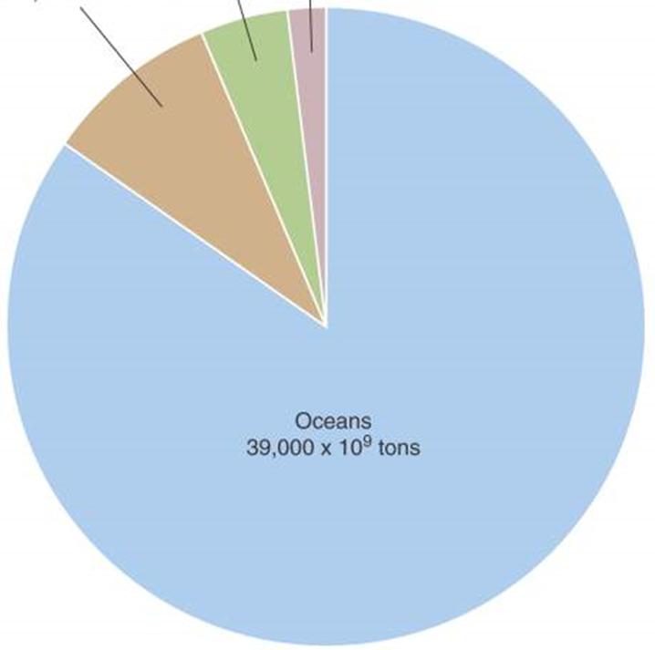
Formative Assessment 2: Handout
Label the pie chart with the carbon reservoirs.
Land
Air
Water
Rock
Which reservoir did you pick as the largest wedge?
A. Land
B. Air
C. Water
D. Rocks
Notes:
Hand out pie chart worksheet, ask students to assign a location to each segment

Slide 9
Land
2,200 x 10⁹ tons
Air
750 x 10⁹ tons
Rock
5-10,000 x 10⁹ tons
Water
39,000 x 10⁹ tons
Notes:
Show image
Id misconception about where carbon is stored

Slide 10
We determined that the largest reservoir of carbon is in the ocean.
In what form is most of the oceanic carbon?
Clicker Question
Dissolved in the water as HCO₃⁻
Living organic matter (fish and plankton)
Dead organic matter
I guessed/I don’t know
CaCO₃ (shells and bones)
Notes:
Prompt students to think about where water carbon is located/what form it is in

Slide 11
Land
2,200 x 10⁹ tons
Air
750 x 10⁹ tons
Rock
5-10,000 x 10⁹ tons
Water
39,000 x 10⁹ tons

Slide 12
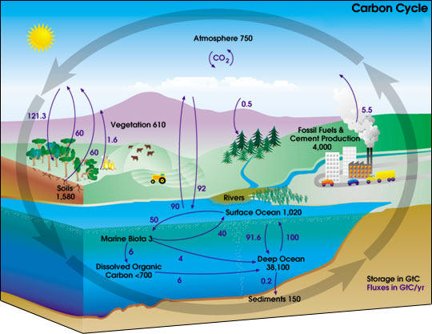

Slide 13
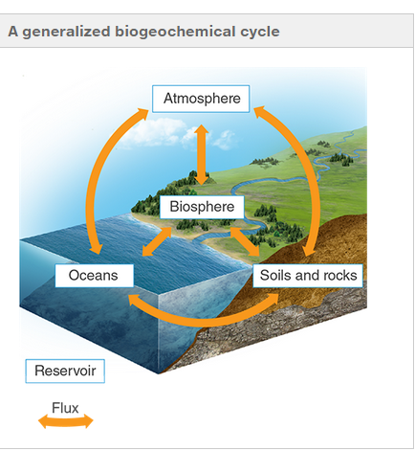
Notes:
Describe general biogeochem cycle. Link back to intro activity with disciplines to help students realize what bgc is/why important

Slide 14
Chapter Learning Objectives:
Describe and draw three biogeochemical cycles, including the major reservoirs and the fluxes between reservoirs.
Summative Assessment:
Identify and rank the size of carbon reservoirs.
Draw the carbon cycle. Label reservoirs and fluxes.
Formative Assessment: Carbon Cycle Teaching Tidbit

Slide 15
The Thought Process…
Learning Outcome | Summative Assessment | Necessary Knowledge | Lesson Plan/Formative Assessments
 | 1. Identify and rank the size of carbon reservoirs. | -C sources, sinks, & reservoirs | 1. T-P-S: what contains carbon
 |  |  | 2. Generate class list of #1, organize by discipline & location
 |  |  | 3. T-P-S: How is the global amt of C distributed in these locations (pie chart)
 |  |  | 4. Clicker: which of these locations did you pick for the biggest wedge? Sample class for 'why' of each possible answer, then show class histogram. Then show actual pie chart.
Describe & draw 3 BGC cycles, including major reservoirs & processes regulating movement |  |  | 5. Clicker: those of you that picked 'water' (correct), which of these is the reason you picked it? (identify misconceptions, give explanations)
 | 2. Draw the carbon cycle. Label sources, sinks and transition arrows. | - How C moves (transitions) between reservoirs | 6. Mini-lecture: C isn't static in these locations, movement between locations, "B-G-C" cycles
 |  | - Photosynthesis & Cellular respiration | 7. Group Activity: apply Process & Location info, general BGC cycle fig, and create a C cycle fig
 |  | - Geologic processes (sedimentation & preservation) | 8. Class discussion of #7
 |  | - General BGC cycle fig | 9. Mini lecture on cross-disciplinary examples of C cycle figs

Slide 16
Chapter Learning Objectives:
Describe and draw three biogeochemical cycles, including the major reservoirs and the fluxes between reservoirs.
Follow one atom/molecule through a cycle given specific examples.
Predict the outcome of altering inputs to a particular biogeochemical cycle.
Identify human impacts on biogeochemical cycles and explain one example of how to mitigate those impacts.

Slide 17
Thank you

Slide 18
Summative Assessment:
Describe the path of a carbon atom as it moves from fish to cow.
Predict what would happen in the climate change scenario of…

Slide 19
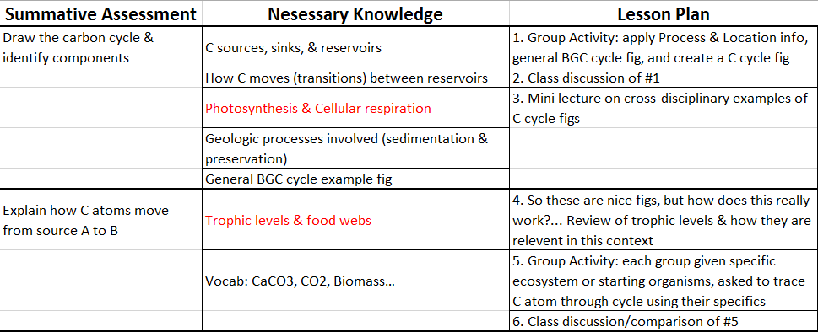
Next Steps…
Combine 3 slides

