Slide 1
Group 5: Gene Expression II
Aimee Bernard
Greg Buck
Manuela Gardner
Erica Suchman
Jenny Taylor
Alan Vajda
Facilitator: Tina Garza

Slide 2
Teachable Unit: Epigenetics
Tidbit: ‘Are you what your parents ate?’
The Tidbit within the Unit will be presented to a student body consisting of majors at the junior/senior level.
The ‘Epigenetics’ unit assumes that the students will have basic competency in general and molecular biology, genetics, and general and organic chemistry.
Epigenetics unit will have examples that can be used in molecular, cellular, organismal, and ecological biology courses.

Slide 3
UNIT Learning Goals
Biology students will become informed on breadth and depth of epigenetics.
Students will understand the role of chemistry in epigenetics.
Students will understand the importance of epigenetics in trait regulation.
Students will appreciate state-dependent epigenetic outcomes.
Students will connect and translate laboratory animal findings to human health outcomes.
Students will personalize extrapolated human health outcomes to assess relative personal risk .

Slide 4
TIDBIT Learning Goal
Students will understand the importance of epigenetics in trait regulation

Slide 5
Learning Outcomes for Tidbit
Students will analyze sequence data and recognize if mutations have or have not occurred (LOC 2).
Students will interpret how in utero events can influence epigenetics (HOC 3/4 and HOC 6).
Students will develop hypothesis about possible epigenetic changes that may explain phenotypic changes that occur in the absence of mutations (HOC 5 ).

Slide 6
Tidbit Outline:
“Are You What Your Parents Ate?”
Pre-test and Hook – Pregnancy, diet, and effects on offspring
Activity - Clicker Questions with Think-Pair-Share and Group Discussion (know vs. need to know): mouse coat color varies but sequence is conserved – why?
Mini-lecture – Explanation of methylation patterns and coat color AND epigenetic inducer BPA
Post-assessment – identical to pre-test

Slide 7
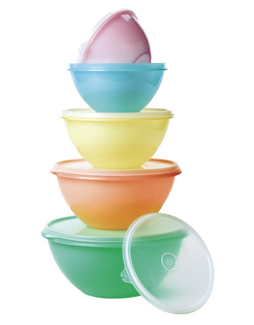
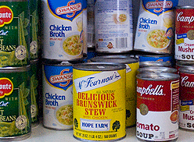
Are You What Your Parents Ate?
http://www.environmentalhealthnews.org/newscience/2007/2007-0730dolinoyetal.html
http://images.google.com/imgres?q=tupperware

Slide 8
The Hook and Pre-Test: Clicker Question
Your mom ate food from a microwaveable plastic container while she was pregnant. Which of the following could be affected by this:
a) Mom (F0)
b) Baby (F1)
c) Grandkids (F2)
d) “a” and “b”
e) “a”, “b”, and “c”
Perera, Herbstman. In Press Reproductive Toxicology
HOC 6

Slide 9
Mouse coat color is controlled by 1 gene.
The sequence of this gene is shown for 3 mice.
Mouse 1 coat color gene Sequence 1: ATCGAGTT
Mouse 2 coat color gene Sequence 2: ATCGAGTT
Mouse 3 coat color gene Sequence 3: ATCGAGTT
Clicker Question: Based on your analysis of the three sequences above, that represent the gene for coat color in mice, do you think that all three mice have the exact same coat color?
A. Yes
B. No
C. Not sure
LOC 2

Slide 10
Think-Pair-Share
Convince your neighbors why your answer is correct.
Ask volunteers to share their responses.

Slide 11
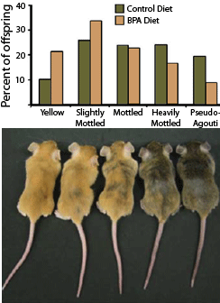
Mouse coat color is controlled by 1 gene.
Question: Based on your visual comparison of the three mice, do you think that all three mice have the exact same nucleotide sequence for their coat color gene?
A. Yes
B. No
C. Not Sure
1
2
3
http://www.environmentalhealthnews.org/newscience/2007/2007-0730dolinoyetal.html
HOC 3/4

Slide 12
Think-Pair-Share
Convince your neighbors why your answer is correct.
Ask volunteers to share their responses

Slide 13
You are a Scientist
Mom (F0)
Dad (F0)
Methods: The F1 were all raised in the same cage and ate the same foods with no known toxins added.
Results: All three FI mice with varying coat color have identical nucleotide sequences for the gene that encodes the coat color in mice which is identical to their parents.
F1
1
2
3
http://www.environmentalhealthnews.org/newscience/2007/2007-0730dolinoyetal.html

Slide 14
Group Activity:
Know vs. Need to Know
Why are the coat colors different if the DNA sequence is the same?
Hypothesize possible molecular mechanisms and other factors that may alter coat color that are independent of nucleotide sequence.
http://www.environmentalhealthnews.org/newscience/2007/2007-0730dolinoyetal.html
HOC 4/5

Slide 15
KNOW
NEED TO KNOW

Slide 16
Individuals with identical genes can exhibit variable phenotypes due to differences in methylation patterns
(Mini Lecture)
The yellow Agouti mouse has emerged as an important tool for studying epigenetic programming because dietary and other factors can prevent the gene from being turned on
It is called a 'metastable epiallele’ as epigenetic modifications (i.e. methylation patterns) at certain points on the gene are set randomly early in development
Relevant example: BPA-exposure alters the percentage of cells with methylation at particular sites on the Agouti gene. The effect of BPA on coat color was largely mediated by BPA's effect on methylation

Slide 17
Post-Test: Clicker Question
Your mom ate food from a microwaveable plastic container while she was pregnant. Which of the following could be affected by this:
a) Mom (F0)
b) Baby (F1)
c) Grandkids (F2)
d) “a” and “b”
e) “a”, “b”, and “c”
HOC 6

Slide 18
Summative Assessment
The summative assessment will occur during in-class examinations
1. (HOC 3) You are studying polar bears in Northern Alaska that have been rummaging in trash dumps and licking food from discarded cans that are lined with resin containing BPA. You find a high level of pseudohermaphroditism in these bears. Do you expect to observe this in
  Adults
  Adults and new born babies who are not yet foraging for food
  a & b
  Neither
2. (HOC 4) Written question: Explain to your room mate who is not a science major why this foraging behavior can lead to pseudohermaphroditism.

Slide 19
How did we address:
Active Learning, Assessment, and Diversity
Active Learning/Formative Assessment: Think-pair-share, clicker questions, know vs. need to know, develop a hypothesis.
Diversity: many different learning styles, multiple types of activities, made sure we did not use red and green to avoid problems for the color blind.
Summative Assessment: Multiple-choice prediction and explanatory essay.
Notes:
- epigenetic imprinting gone wrong!

Slide 20
Alignment
Unit Goals | Outcomes | Assessment | Activities
Biology students will become informed on breadth and depth of epigenetics
Students will be able to understand the role of chemistry in epigenetics
Students will understand the importance of epigenetics in trait regulation. | Students will analyze sequence data and recognize when mutations are or are not occurring (LOC 2). Students will interpret how in utero events can influence epigenetics (HOC 3/4; HOC 6). Students will develop hypothesis about possible epigenetic changes that may explain phenotypic changes that occur in the absence of mutations (HOC 5 ). | Formative Assessments: Clicker question with think-pair-share (LOC 2), Clicker questions with think-pair-share (HOC 3/4) and Pre/Post-Test (HOC 6) Develop a hypothesis with know vs. need to know (HOC 5) Summative Assessment: Multiple-choice prediction (HOC3) and explanatory essay (HOC 4). | Clicker question with think-pair-share (LOC 2) Clicker questions with think-pair-share (HOC 3/4) and Pre/post-test (HOC 6) Develop a hypothesis (HOC 5) In-class exam
Students will appreciate state-dependent epigenetic outcomes
Students will connect and translate lab animal findings to human health outcomes
Students will personalize extrapolated human health outcomes to assess relative personal risk

Slide 21
Mini-Lecture
1 - explanation (via example) of methylation patterns and coat color
Learning Outcome #2: Students will integrate and extrapolate laboratory animal findings to human health outcomes.
2 – role of epigenetic inducer BPA
Learning Outcome #3: Students will personalize extrapolated human health outcomes assess relative personal risk

