Slide 1
2013 Southeast Summer Institute Gene Expression
Facilitator: Peggy Brickman, University of Georgia
Brian Hammer, Georgia Institute of Technology
Marcia Hesser Southern Polytechnic State University
Anna Karls, University of Georgia
Shana Kerr, Georgia Institute of Technology
Zachary Lewis, University of Georgia
Tsai-Tien Tseng, Southern Polytechnic State University
Notes:
For the exercise turn on devices

Slide 2
Some notes
Slides in gray are notes to SSI participants
Please pull up Pollev.com/brianhammer
Or make sure your phone is ready

Slide 3
Context
Introductory Biology course including majors and non-majors
Can be adjusted for various class-sizes
Can be adapted for various course levels
The students are accustomed to working in small groups

Slide 4
Gene expression unit
2 week set of lectures on gene expression
Prior knowledge includes:
Central Dogma
Transcription/translation
Promoters/coding sequences

Slide 5
Learning goals of two-week unit
The students will understand:
How differential gene expression leads to development
How misregulation of gene expression leads to disease
How genetic and environmental factors lead to misregulation
Notes:
Now onto our 20-min tidbit which could be at the beginning or end of a 50 min lecture

Slide 6
Today’s learning objectives
After today’s activities you will be able to:
Describe events that lead to gene activation.
Describe the role of regulatory elements in directing differential gene expression.
Predict possible functions of estrogen-target genes.
Predict patterns of gene expression in response to estrogen.
Predict how environmental perturbations in a regulatory pathway can lead to altered gene expression.
Notes:
As usual have your device available for polling today

Slide 7
Case study: Scientist documents seasonal appearance of feminized fish in the Potomac River
Frontline: Poisoned Waters
http://splicd.com/IBrRxWdLDBw/0/120
Notes:
We’re going to begin our discussion of gene expression by talking about inter-sex fish. Let’s start with a case study of endocrine disruptors, i.e. an chemical that interferes with or disrupts gene regulation by a hormone (endocrine)…….
In the case of the Potomoc River, scientist have not identified the precise cause of these dramatic developmental defects in fish. However, many researchers hypothesize that increasing concentrations of chemical contaminants, for example those that alter or mimic estrogen, are driving these alarming phenotypic changes.

Slide 8
Endocrine disruptor case study: How could an increase in estrogen produce these developmental changes?
Think back to our work last week on gene expression
DNA
Gene
Promoter
Regulatory Element
Transcription
mRNA
Translation
Protein
Notes:
. (1 minute; poll direct regulation versus causes a mutation)

Slide 9
Working individually…..
Using your knowledge of gene expression, take a moment to draw a model for how estrogen might regulate expression of specific genes (2 minutes).
What do your models look like?
Take 2 minutes to correctly order the pictured events of estrogen-regulated gene activation.
Notes:
**There are multiple POSSIBLE correct answers to this question:
For example, a show of hands:
DOES ANYONE’S MODEL INVOLVED CHANGING THE DNA SEQUENCE (mutagen?)
Although possible that chemicals cause DNA changes, there is little evidence that estrogen does this
DOES ANYONE’S MODEL INVOLVE CHANGES AT THE LEVEL OF mRNA ?
This is what we are talking about today. Changes (in this case increases) in mRNA levels > gene activation
Objective 1: Describe events that lead to gene activation (or increase in mRNA levels)

Slide 10
correctly order the events below (2min)
Estrogen
Estrogen
Receptor (ER)
A.
B.
Estrogen-ER
complex
Gene 1
Gene 1
Estrogen-
Response
Element
Gene 2
Gene 2
Promoter
mRNA
protein
nucleus
nucleus
cytoplasm
cytoplasm
C.
D.
BDAC
DBAC
CABD
ACBD
DACB
BACD
Gene 1
Gene 1
Gene 2
Gene 2
nucleus
nucleus
cytoplasm
cytoplasm
Notes:
Objective 1 (continued): Objective 1: Describe events that lead to gene activation
2 minutes individually. Pair, Discuss why you did what you did. Do you want to change your answer? (1 minute)

Slide 11
A.
B.
Gene 1
Gene 1
Gene 2
Gene 2
nucleus
nucleus
cytoplasm
cytoplasm
C.
D.
Gene 1
Gene 1
BDAC
DBAC
CABD
ACBD
DACB
BACD
Gene 2
Gene 2
nucleus
nucleus
cytoplasm
cytoplasm
Notes:
******Make note that unbound estrogen receptor does not bind regulatory element

Slide 12
Discuss with your group:
-Why do you think the estrogen-ER complex activates Gene 2, but not Gene 1?
-Given what we learned about feminized fish, what might you predict about the function of Gene 2 (i.e. what might they do?)
Groups report answers (2 min)
Gene 1
Gene 2
nucleus
cytoplasm
Notes:
Objective 2: Describe the role of regulatory elements in directing differential gene expression.
Objective 3: Predict possible functions of estrogen-target genes.
Group 7
Group 3

Slide 13
Discuss with your group:
-Why do you think the estrogen-ER complex activates Gene 2, but not Gene 1?
-Given what we learned about feminized fish, what might you predict about the function of Gene 2 (i.e. what might they do?)
Groups report answers (2 min)
Gene 1
Estrogen-target Gene
nucleus
cytoplasm
What is Gene 1?
Notes:
Just to get everybody on the same page, we can now refer to Gene 2 as an Estrogen-target gene.
Gene 1 could be any gene not regulated by estrogen
Great! So now we have figured out together how estrogen turns on estrogen response genes… what mIght these estrogen response genes do?

Slide 14
Estrogen controls processes in select tissues
Primary roles of estrogen-target genes in humans are in:
Development of breast and uterine tissues
In breast and uterine cells some of the estrogen-target genes control cell cycle (cell growth and proliferation)
Bone remodeling
Cholesterol production in the liver
Notes:
So we now have a model for how estrogen activates estrogen-target genes, but what do these genes actually do?
In humans, estrogen performs very similar functions to what we saw in fish. For example,
estrogen-target genes control:
In breast and uterine cells - cell growth and proliferation
in other tissues such as bone - regulates bone density
in the liver - controls cholesterol production.
All of these tasks involve regulation of GENE expression.

Slide 15
How many estrogen-target genes do you think there are in the human genome?
A. One or two
B. Tens
C. Hundreds
D. Thousands
E. Every gene in the genome
Notes:
Let’s take a vote………

Slide 16
Which of the following can explain the expression pattern in the following cell? (1min)
Normal response to estrogen
No estrogen exposure
No estrogen receptor
Estrogen-target Gene
Estrogen-target Gene
Notes:
1 MIN
Either answers: no estrogen (ie, male), no estrogen receptor
Objective 4: Predict patterns of expression in response to estrogen.

Slide 17
What cells normally wouldn’t be exposed to high levels of estrogen?
Male tissues
Adolescents
Female tissues vary throughout adult life
Notes:
In all of us levels of estrogen vary throughout development
male cells exposed at low levels
levels vary in females throughout life and menstrual cycle

Slide 18
Assuming this cell has ER, which of the following can explain the expression pattern in the following cell? (1min)
Normal response to estrogen
Exposure to estrogen mimic
Mutation in estrogen response elements
Estrogen-target Gene
Estrogen-target Gene
Notes:
Either answers: normal response to estrogen; estrogen mimic

Slide 19
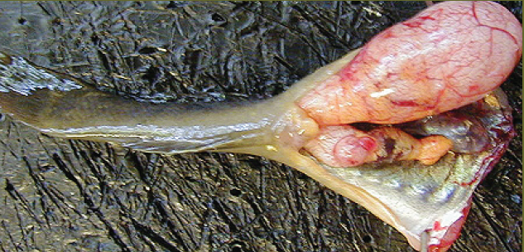
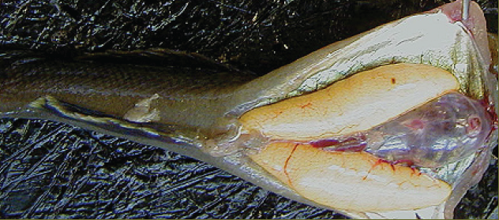
Why might it be detrimental for cells to be exposed to an estrogen mimic?
Discuss in your groups
Left: Gonads of Longjaw mudsucker: “ovotestes”. The upper gonad is an enlarged testes with sperm, while the smaller lower gonad consists of some testicular tissue and ovary (orange color). Right: normal ovaries of equal size.
Pacific Estuarine Ecosystem Indicator Research Consortium
Notes:
Think back to the beginning of class
Answer: Cells that shouldn’t be exposed to estrogen at high levels or at all (males testiculal tissue) may inappropriately develop female characteristics
So today we have discussed how ONE chemical, for example a synthetic chemical like an estrogen mimic, may have detrimental effects on male FISH development… exposing cells that normally to do experience estrogen at high levels

Slide 20
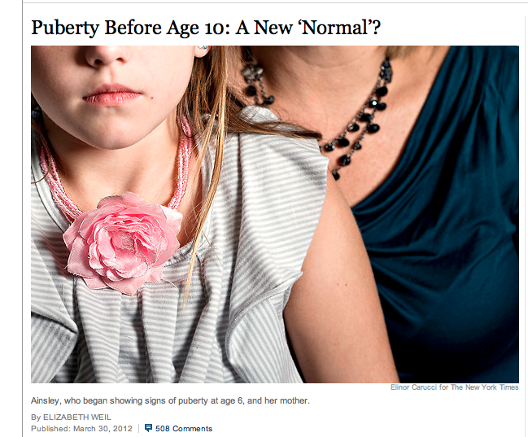
http://www.nytimes.com/2012/04/01/magazine/puberty-before-age-10-a-new-normal.html?pagewanted=all
Notes:
What I’d like to leave you with today is that this is unlikely a problem exclusive to fish.
There is evidence that early puberty in girls may be a result of exposure to high levels of estrogen mimics at the wrong time resulting in early onset of puberty.
Your homework is to post to our class website a link to more information on another chemical you find that has been implicated in altering human development. In next class be prepared to discuss what you learned in your group, and then I will select a few groups to share one of their discoveries with the entire class.

Slide 21
Sample summative question
Objective 1: Describe the steps involved in gene activation. Describe events that lead to gene activation.
1. Progesterone (PG) functions with its corresponding nuclear receptor (PGR) to regulate target gene expression. Choose the answer that describes the correct sequence of events in progesterone-dependent gene activation:
a. PG-PGR complex formation, promoter binding, transcription, translation, PG production
b. PG-PGR complex formation, promoter binding, translation, transcription PG production
c. PG production, PG-PGR complex formation, promoter binding, transcription, translation
d. PG production, promoter binding, PG-PGR complex formation, transcription, translation

Slide 22
Sample summative question
Objectives 2/3: Describe the role of regulatory elements in directing differential gene expression; 3.Predict possible functions of estrogen-target genes:
2. In class we discussed the activation of estrogen-target genes in breast cells that result in normal developmental tissue changes. Many breast cancers are effectively treated with the chemotherapy agent Tamoxifen, which prevents binding of estrogen to the Estrogen Receptor. Explain why this treatment would inhibit growth of the breast cancer cells.

Slide 23
Sample summative question
Objective 4: Predict patterns of gene expression in response to estrogen:
3. Predict the expression of three Estrogen-target genes (gene 1, gene 2, and gene 3) in the cells shown in the table below when exposed to estrogen. Fill in the table Indicating predicted levels of expression by minus (-) for no expression, plus (+) for low-level expression, and plus-plus (++) for high-level expression:
Cells/Target Genes | Target Gene 1 | Target Gene 2 | Target Gene 3
Normal breast cells
Deletion of the regulatory element in Target Gene 1 in breast cells
A muscle cell that doesn’t express the Estrogen Receptor

Slide 24
Acknowledgements
Southeast Summer Institute organizers and facilitators
Group 6 (Heredity)
Group 3 (Physiology/Biochemistry)
Notes:
For the exercise turn on devices

