Slide 1
“Chunky and Chips”
Gene Expression Group
University of Notre Dame
Kristin Hager, Associate Teaching Professor, Biological Sciences
Joseph O’Tousa, Professor, Biological Sciences
WH Freeman
Marc Mazzoni, Senior Editor, Life Sciences
Elaine Palucki, Editor, Adjunct Assistant Professor Biology, Brooklyn College
Susan Winslow, Executive Editor, Life Sciences

Slide 2
Set- Up:
Topic: Gene Expression
Course: Introductory Majors Biology (First university level biology course)
Course Name: Introductory Biology, week 4 of semester
Syllabus Placement:
These topics have been completed:
Central Dogma, transcription, translation.
Ready for a synthesis of what they have already learned

Slide 3
By the end of lecture today you should be able to:
Learning Goal: Understand that gene expression is dynamic
Learning Outcomes:
  Describe an everyday activity that alters gene expression.
  Describe the cellular location for the events of gene expression
  Draw and interpret multiple types of graphs to display gene expression
Notes:
Decide if we need the rest of the outcomes, like in the other doc

Slide 4


Case: Elaine is working out, Marc is more sedentary likes to eat chocolate chip cookies…
Kristin’s undergrads want to do a muscle biopsy to see if anything different is happening on the cellular level
Notes:
Add pictures of cookie eating and muscles.

Slide 5
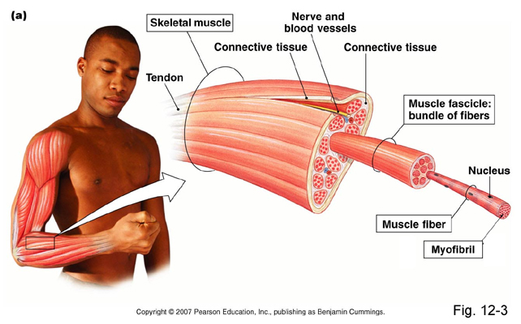
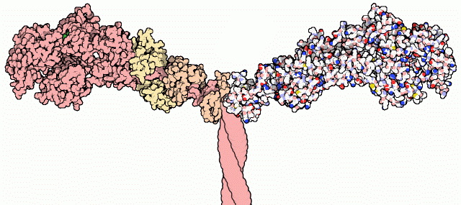
Background Information:
Skeletal Muscle
muscle cell that
contains alpha-myosin
Picture of myosin protein here…
Myosin
Notes:
Traditional blow out of muscle cells from Elaine’s bicep…introduce the concept of myosin as the major protein in skeletal muscles.
Myosin is a molecular motor that provides force…there are many different types of myosin. One of which is alpha-myosin. Shown here in skeletal muscle.

Slide 6
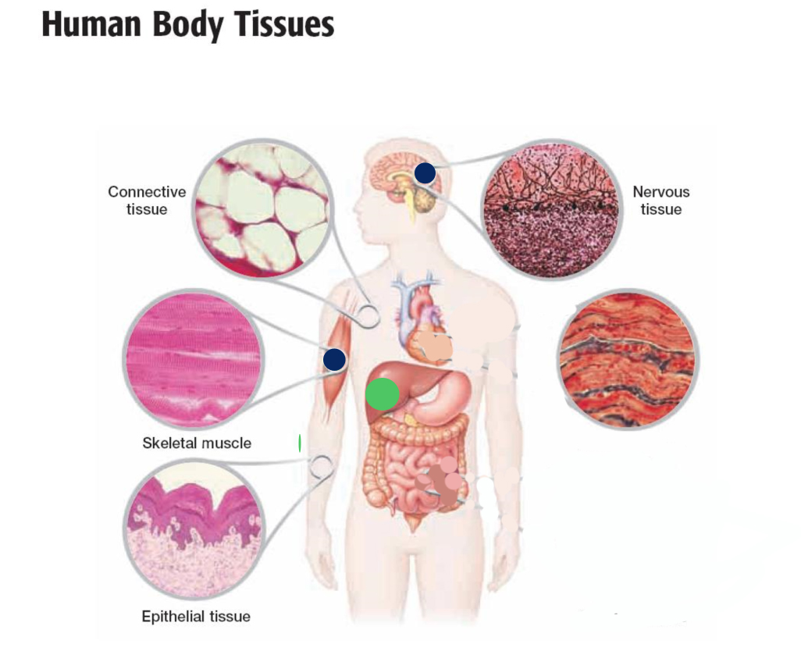
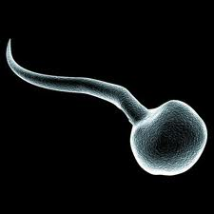
Which of the cells in the tissues shown have a gene for α−myosin?
Muscle cells
All cells
Skin and muscle cells
Sperm cell
Liver
Sperm
Notes:
The right answer here is B (all four) and we need to find pictures of these four. We suspect that there might be a split…if so, go back and allow peer instruction. Possibly use fake results…
Make text bigger in this figure…

Slide 7
Which of the cells in the tissues express the protein for α−myosin?
Muscle cells
All cells
Skin and muscle cells
Sperm cell
Liver
Sperm
Notes:
The right answer here is B (all four) and we need to find pictures of these four. We suspect that there might be a split…if so, go back and allow peer instruction. Possibly use fake results…

Slide 8
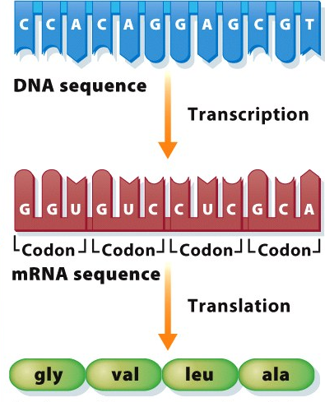
Definition of Gene Expression of α-myosin
DNA
Transcription
RNA
Translation
Protein
(alpha-myosin)
Notes:
Wikipedia: Gene expression is the process by which information from a gene is used in a synthesis of a functional gene product (protein). Diagram: Central Dogma
Note: Could do a one-minute activity, asking the students to define gene expression.

Slide 9
Complete this picture of a cell undergoing gene expression using the list of molecules and processes given.
Molecules and Processes
Transcription
Translation
DNA
mRNA
Protein – alpha-myosin
nucleus
Notes:
Point of slide: Showing cellular location of the gene expression process with respect to the nucleus.

Slide 10
Finish the bar graph that shows the levels of each molecule in Marc and Elaine’s muscle cells following a week of activity:
Amt per cell
Marc
DNA RNA Protein
(myosin)
Notes:
At the beginning of the week, Marc and Elaine’s levels were tested and found to be similar for each of the molecules. Assume Marc continued eating cookies and Elaine dutifully worked out. One week later, samples were taken from Marc and Elaine’s muscles and measured for each type of molecule (DNA, RNA, protein). As a group, please graph what you would expect to see…whether levels would go up, down or stay the same.
Notes: Slide will be introduced, students will be asked to create graphs in groups. The groups will then come up to the front of the room and include the graph.

Slide 11
Finish the bar graph that shows the levels of each molecule in Marc and Elaine’s muscle cells following a week of activity:
Elaine
Elaine
Amt per cell
Marc
Marc
Marc
Elaine
DNA RNA Protein

Slide 12
Now add Elaine’s liver cell levels of each:
Elaine
Elaine
Amt per cell
Elaine’s
Liver
Elaine’s
Liver
Elaine’s
Liver
Marc
Marc
Marc
Elaine
?
?
?
DNA RNA Protein
Notes:
Note: Students will be asked to fill in the liver values and will then come up to the front of the room and fill in the graph.

Slide 13
Now add Elaine’s liver cell levels of each:
Elaine
Elaine
Amt per cell
Marc
Elaine’s
Liver
Marc
Marc
Elaine
Elaine’s
Liver
Elaine’s
Liver
DNA RNA Protein

Slide 14
Create three line graphs that shows how each molecule might change over time in the muscle. First show Elaine:
Protein
mRNA
DNA
| | | | | | |
1 2 3 4 5 6 7
Time (days)

Slide 15
Now a line indicating Marc’s expression levels
Protein
Elaine
Elaine
mRNA
DNA
Elaine
Time

Slide 16
Now a line indicating Marc’s expression levels
Protein
Elaine
Marc
Elaine
mRNA
Marc
DNA
Elaine & Marc
Time

Slide 17

Gene Expression is like this picture:
Liver Marc Elaine

Slide 18
What part of this diagram represents the DNA?
The faucet
The water
I’m not sure…
Liver Marc Elaine

Slide 19
Now that it’s the end of lecture you have shown that you….
Understand that gene expression is dynamic (temporal, level of mRNA, protein produced)
  Described an everyday activity that alters gene expression.
  Described the cellular location for the events of gene expression
  Worked with multiple types of graphs to display gene expression

Slide 20
For homework, think about:
In our cells, what will act as the handle on the faucet?
How might our cells
control whether the handle is turned on or off?
3. How might our cells control how much water (mRNA) is being released from the faucet?

Slide 21
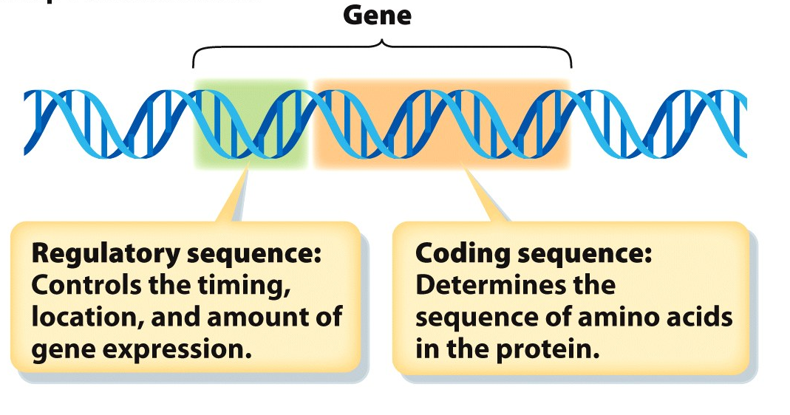
Definition of a gene promoter
The handle of the spigot
(include real definition here and a diagram with coding information and RNA being made as an arrow away from the promoter)

Slide 22
Which cells will express the myosin gene?
What do you know?
What do you need to know?
Notes:
What do you know/What do you need to know? Outcome:

Slide 23
INDUCTION OF SLOW MYOSIN GENE IN FAST-TWITCH MUSCLE
Am. J. Physiol. Cell Physiol- 1996 Barton Davis

Slide 24
How do you know that the myosin gene is being expressed?
You have 30 seconds to talk to your neighbor
Notes:
(talk to your neighbor) Answer we are looking for: There are many ways. Good examples (northern blot, protein/western blot, measure protein, measure RNA). The instructor should use this as a bridge for the next slide based on the most correct answer…saying that data was gathered by the aforementioned students. The sample came back to the lab and there were no labels… The students are now trying to figure out who is who?

