Slide 1
Prokaryotic gene regulation
Group # 1
Akhtar Ali
Lucile McCook
Marcella Hackney
Sarah Lea Anglin
Anne Grove (Facilitator)

Slide 2
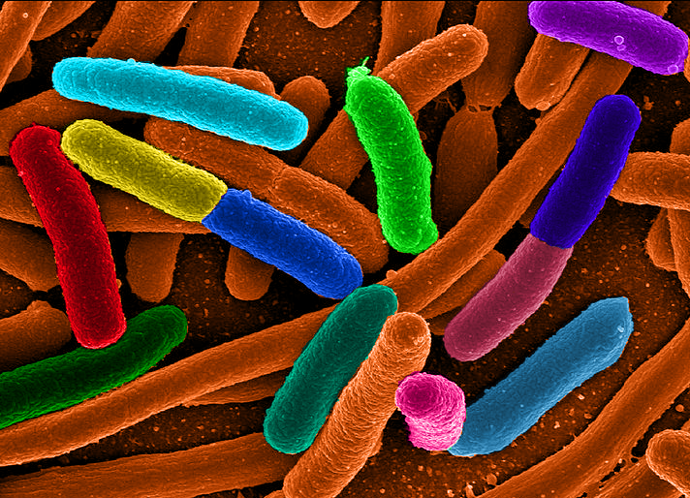
Prokaryotic gene regulation

Slide 3
Context
Target Audience: Intro Biology for Freshmen

Slide 4
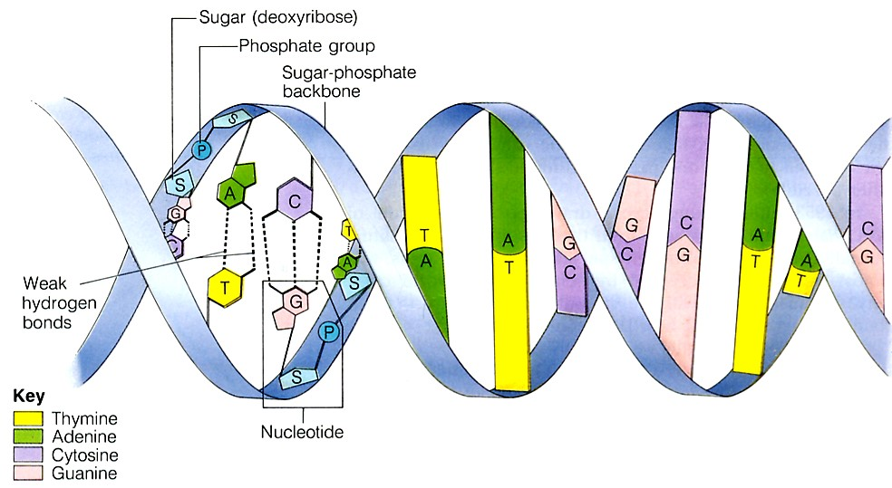
DNA structure

Slide 5
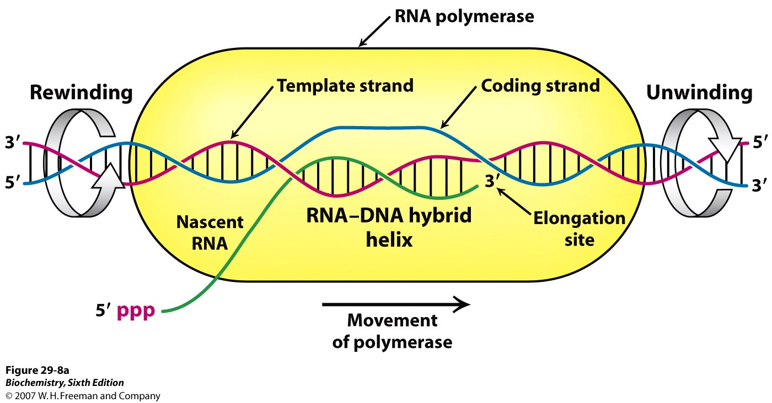
Prokaryotic transcription

Slide 6
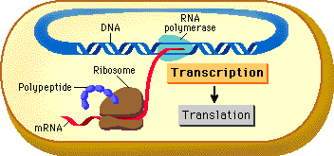
Prokaryotic translation

Slide 7
Context
Students have already covered transcription and translation
Now we are talking about gene regulation

Slide 8
Learning Objective
The overall goal of the teachable unit is for students to understand why and how genes are regulated

Slide 9
Learning Goals
The learning objective is to understand the role of the lac repressor in regulating the lac operon
The goal of
Teachable Tidbit # 1 is to define the terms that are required to understand the functions of operons
Teachable Tidbit # 2 is to use this terminology to model the structure and functions of the lac operon

Slide 10
Outcomes
Students will be able to understand terms in a functional context with regard to prokaryotic gene regulation specifically using the example of lac operon

Slide 11
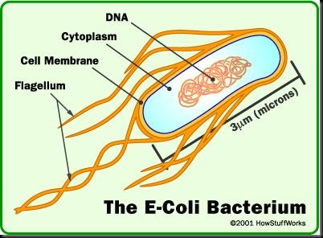
Prokaryotic gene regulation

Slide 12
Tidbit # 1
Forming TermAnalogies

Slide 13
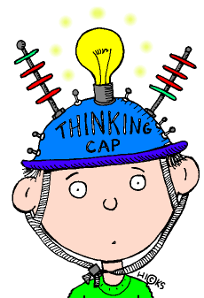
Tidbit # 1
Each group of students assigned a specific term
Promoter
Operator
Inducer
Repressor
Terminator

Slide 14
Terminator

Slide 15
Promoter
Operator
Inducer
Repressor

Slide 16
Instructions
FIRST: devise a non-science (lay person, normal earth person) definition of/use of/function for the term
SECOND: find/determine the scientific definition of the term with regard to gene expression
THIRD: look for the similarities of how the term is used to gain an understanding of it in the scientific context
Write/draw this information on the paper provided
(5 min total)

Slide 17
Instructions-continued
One team member will then explain these to the class, providing a FUNCTIONAL definition of the scientific term

Slide 18
Instructions-continued
The terms will then be used to develop ideas of how each one functions in controlling the lac operon (the beginning of a model for the operon)—NEXT ACTIVITY

Slide 19
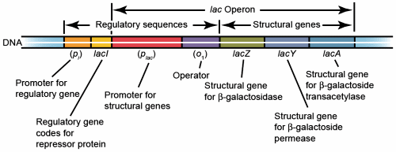
Model of lac operon

Slide 20
Instructions for the teacher
This activity is an interactive physical demonstration
of steps in lac operon function
FIRST:
Post and discuss the model of the lac operon
SECOND:
Assign students into groups to discuss the sequence of the events that must happen in the model

Slide 21
Teachers eye only,
Sequence of events for situation # 1 – No lactose
RNA polymerase binds to lacI promoter
Repressor mRNA is transcribed
Repressor protein is translated at the ribosome
Repressor protein bind to operator
The bound repressor protein prevent RNA polymerase from binding to Plac promoter
No structural gene expression
Instructor should shuffle these events and ask the groups to place them in order

Slide 22
Instructions for the teacher
This activity is an interactive physical demonstration
of steps in lac operon function
THIRD:
Using ENTIRE CLASS, assign students specific roles from the this list
FOURTH:
Students instruct the role players to act out their roles in the proper sequence with the assistance of the ENTIRE CLASS
RNA polymerase Lac Repressor
Lactose/Allolactose Repressor-mRNA
Structural gene-mRNA

Slide 23
Modeling lac repressor
Players
RNA polymerase
Lac Repressor
Lactose/Allolactose
Repressor-mRNA
Structural gene-mRNA
Situation # 1 = No lactose
Situation # 2 = With lactose
Situation # 3 = Remove lactose
Assume no glucose

Slide 24
Situation # 1 (recap)
No lactose
Repressor protein, constitutive, bound to operator
RNA polymerase trying to bind promoter
but Repressor protein will stop it from binding
Thus no structural gene expression

Slide 25
Situation # 2 (recap)
Repressor protein binds inducer (Allolactose) and dissociates from operator
RNA polymerase attaches to the promoter and synthesizes mRNA, dissociates at terminator
Keep synthesizing mRNA until all Allolactose is gone (Situation # 3)

Slide 26
Formative Assessment
Write the steps in sequence for both situations on note cards

Slide 27
Assessment (clicker?)
Where does the repressor comes from?
Once ONE mRNA is produced, does it just stop?
Can only one repressor block all the RNA polymerases?
How many places does RNA polymerase bind?
Why does this gene need to be regulated?
Where does lactose comes from and where does it go?
How many lac operons are in a single E. coli cell?
How long would it take in real time?

Slide 28
Diversity
Images
Term definitions
Analogies
Actors/role play
Clicker questions
Group work
Mini lectures
Shout out

Slide 29
Ideas for modification and extension
Use this process with transcription early in the semester using similar props
Add the rest of the chromosome (or on separate slide)
Teach termAnalogy in one lecture and send them home with home work
Next lecture shall be modeling (Tidbit #2)
(optional) Embedded clicker questions between situation 1 and 2
Slow the process if the students did not pick it up
Place the students into groups how it will be modeled
Could be extended to other operons (tryptophan)
Individual final formative assessment (brief assignment)
Instructor should prompt the student if the class is unable to do it
Use multiple RNA polymerases, mRNA and Allolactose

Slide 30
Thanks for being
Good Listeners and Participants

