Slide 1
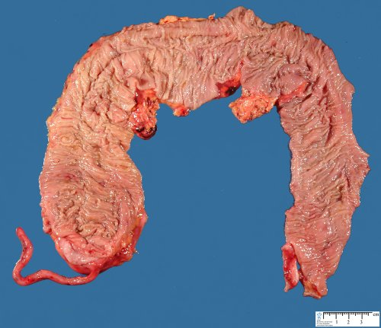
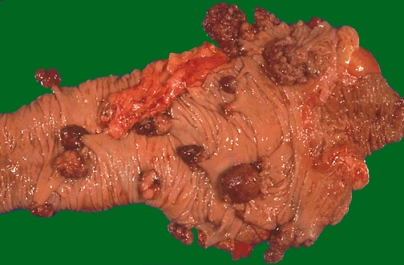
Transcription gone bad…
Colon with cancerous polyps
Normal colon
http://www.humpath.com/colonic-dysmotility&id_document=23133
http://www.aboutcancer.com/genetic_colon_cancer.htm
Notes:
This picture is of a human colon and is a hook to increase student engagement. The image is graphic and may be disturbing to some students. Make sure to come back to the hook at a later point.

Slide 2
Teaching Unit: Transcription
Unit’s context:
Sophomore level course
(the third week of Genetics or Molecular Cell Biology course)
Students would have already had an Introductory Biology course.
At the beginning of the course, we established groups that incorporated diversity of gender, race, and high school graduating class size.
Notes:
The information to form groups came from a pre-class, student survey.

Slide 3
Prior knowledge students will have from this course
DNA structure
RNA structure
DNA replication

Slide 4
Goals
Outcomes
Understand the importance of transcription as a process that allows expression of genetic information.
Explain the role of transcription in the flow of genetic information.
Know the components & steps that underlie transcription in both bacteria and eukaryotes, and distinguish it from replication.
1. Outline steps & components involved in bacterial and eukaryotic transcription.
2. Distinguish between transcription and replication.
Analyze data and design experiments to assess transcription.
Interpret experimental data involving mutant and normal genes.

Slide 5
Review of last night’s readings
Concept map:
DNA → RNA → protein
DNA replication
Transcription
Translation
DNA
RNA
Protein

Slide 6
Goals
Outcomes
Understand the importance of transcription as a process that allows expression of genetic information.
Explain the role of transcription in the flow of genetic information.
Know the components & steps that underlie transcription in both bacteria and eukaryotes, and distinguish it from replication.
1. Outline steps & components involved in bacterial and eukaryotic transcription.
2. Distinguish between transcription and replication.
Analyze data and design experiments to assess transcription.
Interpret experimental data involving mutant and normal genes.

Slide 7
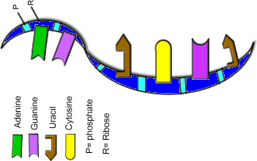
Question 1
In the final transcript, which would you expect to find?
Exons
Introns
Promoter
A and C
A, B, and C
Notes:
A figure after any of these clicker questions could be used for clarification.

Slide 8
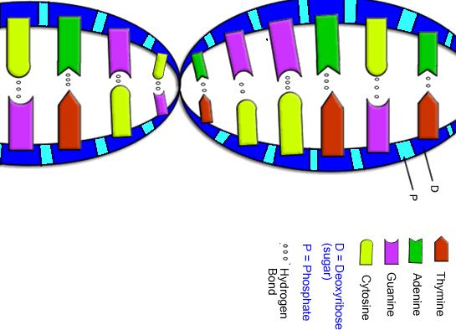
Question 2
Which of the following components is NOT involved in transcription?
A. Free deoxyribonucleotides
B. Free ribonucleotides
C. RNA polymerase
D. Template DNA
E. Promoter

Slide 9
Question 3
What is the order of the steps of transcription?
A. Primer binding ➔ elongation ➔ termination
B. Elongation ➔ initiation ➔ termination
C. Primer binding ➔ initiation ➔ elongation
D. Initiation ➔ elongation ➔ termination
E. Initiation ➔ primer binding ➔ termination
Notes:
May want to add a more difficult, or higher order clicker question after this one.

Slide 10
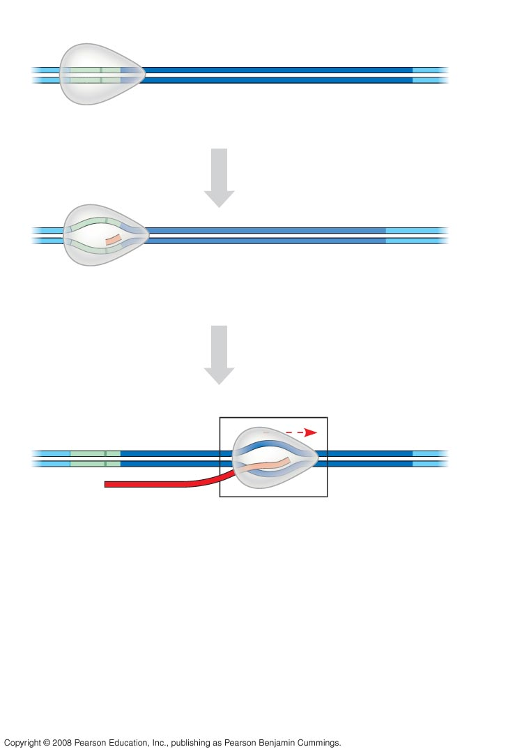
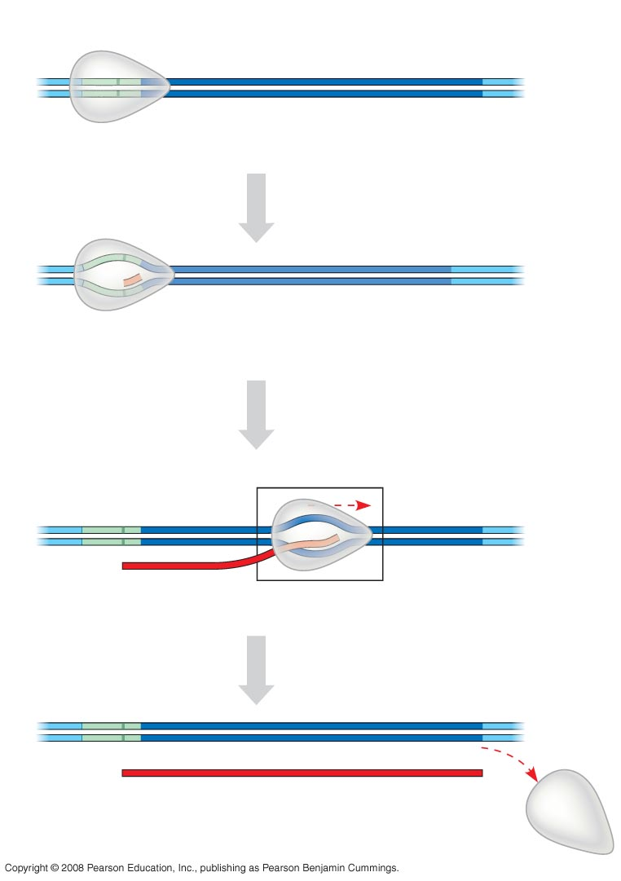
Overview of Transcription
Promoter
Transcription unit
5′
3′
3′
DNA
5′
Start point
RNA polymerase
INITIATION
1
Initiation
5′
3′
3′
5′
RNA
transcript
Template strand
of DNA
Unwound
DNA
ELONGATION
2
Elongation
2
Elongation
Rewound
DNA
Rewound
DNA
5′
3′
5′
3′
3′
3′
3′
5′
3′
5′
5′
5′
RNA
transcript
RNA
transcript
TERMINATION
3
Termination
5′
3′
3′
5′
5′
Completed RNA transcript
3′
Notes:
Initiation: RNA polymerase binds to promoter of gene, unwinds the helix and adds 1 or 2 complementary nucleotides– different details for bac and euk genes
Elongation: RNA polymerase adds nts to transcript
Showing of an animation here could be useful.

Slide 11
Goals
Outcomes
Understand the importance of transcription as a process that allows expression of genetic information.
Explain the role of transcription in the flow of genetic information.
Know the components & steps that underlie transcription in both bacteria and eukaryotes, and distinguish it from replication.
1. Outline steps & components involved in bacterial and eukaryotic transcription.
2. Distinguish between transcription and replication.
Analyze data and design experiments to assess transcription.
Interpret experimental data involving mutant and normal genes.

Slide 12
Flow of Genetic Information
DNA replication
Transcription
Translation
DNA
RNA
Protein
Transcripts
Initiation
Elongation
Termination
RNA polymerase
DNA template
Ribonucleotides
Promoter
Notes:
This may be an opportunity for students to fill out their concept map with these terms. Students could also generate these terms on their own.

Slide 13
Strip Sequence Instructions
Divide your table into three groups.
Each table has three Post-its and each group has a set of 12 sentence strips.
Place the Post-its on the board in order of transcription (top to bottom)
IN YOUR GROUP:
Sort the strips by the steps in transcription
(Not all strips have to be used)
Notes:
Be sure to clarify what un-used strips are involved in. May add pictures to strips to address diversity of learning styles. Give instructions before students handle strips. Each group will need a whiteboard. Strips should be packaged with pre-labeled, different colored post-it notes.

Slide 14
AT YOUR TABLE (LARGE GROUP)
Compare your answers with the other groups at your table
Reconcile any differences and come up with a consensus.
For your reconciled sorted strips, write the letter corresponding to the strip under each Post-it.
Notes:
Instructor can monitor progress to determine time to completion.

Slide 15
IN YOUR SMALL GROUP
Now, separate the strips within each step according to bacterial vs. eukaryote and in a temporal order.
Move the letters for bacteria-specific strips to the left, eukaryotic to the right
Notes:
Instruct students to leave strips common to both in the middle. Strip sequences can be shown on document camera to explain.

Slide 16
AT YOUR TABLE
Compare your strip sequences between the groups
Reconcile any differences
Write the letter corresponding to each strip in order of sequences on the board

Slide 17
Goals
Outcomes
Understand the importance of transcription as a process that allows expression of genetic information.
Explain the role of transcription in the flow of genetic information.
Know the components & steps that underlie transcription in both bacteria and eukaryotes, and distinguish it from replication.
1. Outline steps & components involved in bacterial and eukaryotic transcription.
2. Distinguish between transcription and replication.
Concept map
Clicker Qs and Clarifications
Strip sequence
Day 1
0-6
7-24
25-50
Notes:
This is not a slide for the students, just summary for the instructor

Slide 18
Mini-lecture/clicker Qs
Further clarify steps involved in transcription:
Parts of a transcript in bacteria/eukaryotes
Splicing and processing events
Notes:
May add higher-order clicker questions here.

Slide 19
Goals
Outcomes
Understand the importance of transcription as a process that allows expression of genetic information.
Explain the role of transcription in the flow of genetic information.
Know the components & steps that underlie transcription in both bacteria and eukaryotes, and distinguish it from replication.
1. Outline steps & components involved in transcription in bacteria and eukaryotes.
2. Distinguish between transcription and replication.
Analyze data and design experiments to assess transcription.
Interpret experimental data involving mutant and normal genes.

Slide 20
Data Analysis (stepping out)
Students are familiar with
differences between bacterial and eukaryotic transcription
eukaryotic gene structure
northern blots
Reminder: basic eukaryotic promoter is often composed of TATA box at -35 and -100 CAAT box
NOW, back in the classroom…
Notes:
Notes to instructor

Slide 21
Instruction
Organize into your previous groups.
You will discuss the following data.
Then, discuss as a table and designate a reporter.

Slide 22
m1
WT
m2
Globin mRNA
Control mRNA
RNA blot
exon1
exon2
exon3
-100 region
TATA box
+1
Questions:
How do the two mutants differ from wild-type (WT)?
Which part of the gene is most likely to be defective in mutant 1 (m1) and mutant 2 (m2)?
Notes:
This is a good place to add more data interpretation slides. Could give more context here by talking about loss of globin gene in humans. In future class periods can tie into changes in expression of tumor suppressor or growth factor genes.

Slide 23
One-minute paper
Take a moment to reflect on what you have learned about transcription. On your notecard, write a one minute paper answering one or both of the following questions:
Why is transcription an important cellular process?
What about transcription is still confusing to you?
Put your paper in the collection box when you leave.

Slide 24
Goals
Outcomes
Know the components & steps that underlie transcription in both bacteria and eukaryotes, and distinguish it from replication.
1. Outline steps & components involved in bacterial and eukaryotic transcription.
2. Distinguish between transcription and replication.
Activities: clicker assessment and strip sequences
Analyze data and design experiments to assess transcription.
Interpret experimental data involving mutant and normal genes.
Activity: brainstorm & sharing of northern data analysis
Notes:
If used for students, add first goal and outcome.

Slide 25
Timeline for Day 2: 50 minutes
One-minute paper
Mini lecture/ clicker Qs
Brainstorming, data analysis
Day 2
0-20
21-45
46-50
Notes:
Note to instructor.

Slide 26
To be continued…
Regulation of gene expression
Translation
DNA replication
Transcription
Translation
DNA
RNA
Protein

Slide 27
Gene Expression Anisa Angeletti Greg Burg Vicki Corbin Steve Harris Choong-Min Kang John Osterman Anna Strain Robert Ward
Notes:
Make sure to give us credit and any feedback would be appreciated!

