Slide 1
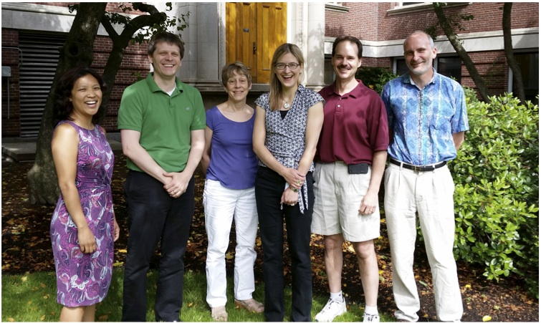

Teachable Unit:
Meiosis and genetic diversity
Learning Goal:
Understand how meiosis contributes to genetic diversity
Group 5 - Team Phoenix!
UMBC
Stephen Miller
Michelle Starz-Gaiano
Wellesley College
Emily Buchholtz
John Goss
York College of PA
Ron Kaltreider
Meda Higa Facilitator – Casey Roehrig

Slide 2
Learning objectives for meiosis unit
Students will be able to…
Compare and contrast normal mitosis, meiosis I, and meiosis II
Describe the 2 sources of genetic variation in meiosis.
Based on karyotype data, distinguish among non-disjunction errors that occurred during different stages of meiosis.
Describe the molecular events that occur during homologous recombination.
Identify the product of a homologous recombination event.
Evaluate the products of homologous recombination to do linkage analysis.
Compare and contrast the processes of DNA repair and homologous recombination.
Notes:
This teachable tidbit focuses on learning objectives 4 & 5

Slide 3
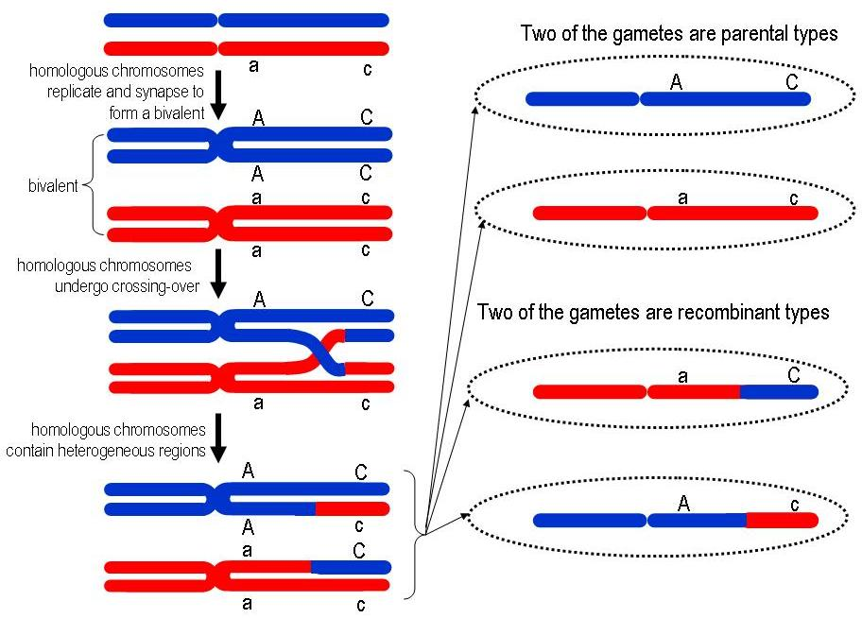
Meiosis, homologous recombination, and genetic variation
Homologous
Recombination
Parental Gametes
Recombinant Gametes
Adapted from http://geneticssuite.net/node/21
Notes:
We used this slide to provide the context for homologous recombination as a tool for generating genetic diversity during Meiosis in a simplified form before getting into the mechanistic details.

Slide 4

Homologous Recombination
http://www.youtube.com/watch?v=hpHVryxV4UU
Notes:
* Preload on youtube in your internet browser and pause the video at the start, because an advertisement precedes the video.
* The video goes very quickly. We narrated the steps to provide a review of the process, but paused frequently to avoid going too fast.

Slide 5
“G”
How do we go from this…
to this?
“B”
Notes:
* Introduce the idea of the strip sequence activity – give them the start (G) and end (B) products and they must order the steps in between.
* Some students will quickly realize that it spells “GREAT JOB” and finish early – they next step will force them to go back and explain what’s happening in each step, though.

Slide 6
Clicker 1:
Did you do a “G.R.E.A.T. J.O.B”?
Yes, and I can tell you how it all works!
Not quite, I almost had it!
I just put the letters in order…
No – more help please!
Notes:
If there are a lot of 2’s-4’s you can have the groups compare with their neighbors, or tell the students that the next exercise may clear up some of the confusion.

Slide 7
G
R
E
A
T
J
O
B
GREAT JOB!!
now describe
the steps in
your own words…
…and then give them
scientific names
Notes:
This is an animated slide – the words “…and then give them scientific names” should not be revealed until AFTER students have had a chance to describe the process in their own words. We explicitly told the students NOT to use the scientific terms that they might be familiar with and to put the steps in their own words (“If you think something is being broken– say ‘it gets broken’”). After giving them time to do this, we provided them with a term list of the scientific names for what they had just described in their own words to match up with their descriptions (see supplemental slides below for term list).

Slide 8
G
R
E
A
T
J
O
B
Clicker 2:
Which letter(s) correspond to
product(s) of Ligation?
R and T.
J and B.
A and O.
J.
B.
Notes:
Answer: (2) J and B - represent steps where a ligation event has occurred (for J, ligation of newly synthesized DNA strands with the original strands; for B, ligation of the ligation products to form the final recombined strands).

Slide 9
G
R
E
A
T
J
O
B
Check your labels
double strand break
5’ to 3’ exonuclease activity
strand invasion
DNA synthesis
ligation
endonuclease activity
ligation

Slide 10

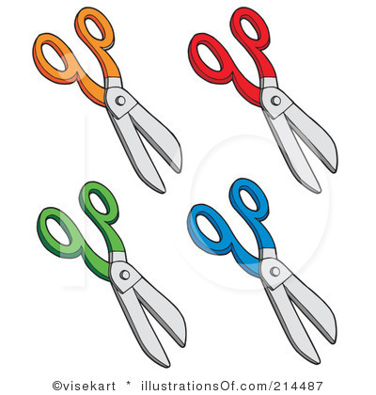
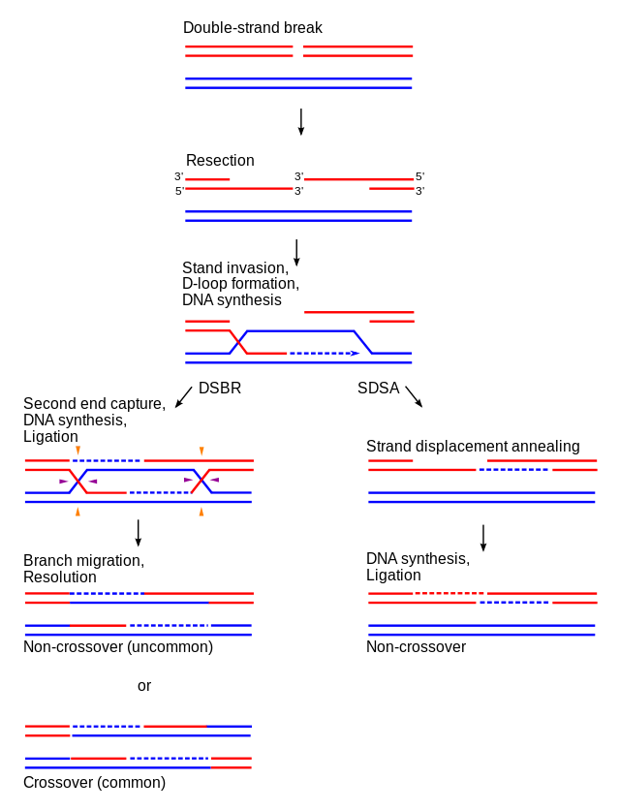

Clicker 3:
In the schematic shown below, which of the listed scissor pairs must be used to yield this crossover products?
black
black & blue
blue
blue & red
white
non-recombinant
Notes:
This is an animated slide – only the first pair of chromosomes show up initially. The second chromosome pair shows up as a follow up question (informal, not clicker)
Correct Answer: (2) – black and blue
* The most common incorrect answer will be (4) – if there are a lot of students that answer (4) you can walk through what products those cut sites will yield (we have an inset that can appear showing this alternate form).
* If students are having difficulty seeing how different cut sites give different products, suggest for homework that they draw out the potential products for each combination of cuts.

Slide 11
Wrap-Up:
Learning accomplishments
Students should be able to…
Describe the molecular events that occur during homologous recombination.
Identify the product of a homologous recombination event.

Slide 12
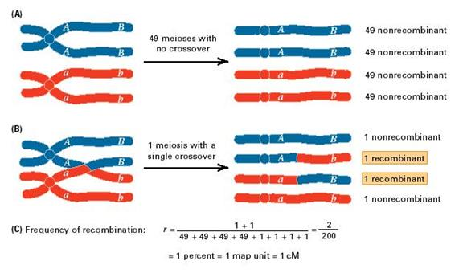
Apply your knowledge!
C
C
c
Homework on your own (see website):
Diagram the steps involved in homologous recombination.
Based on what we previously learned about repair of double strand breaks in DNA, write a 1 page summary that compares and contrasts the steps involved in homologous recombination and DNA repair.
c
Figure adapted from http://blog.canacad.ac.jp/bio/BiologyIBHL1/3092.html

Slide 14
More ways to apply your knowledge!
C
C
c
homework on your own (see website):
Imagine a pair of chromosomes (shown) with three separate genes A, B, and C (heterozygous for all genes). If recombination occurs between genes A and C, then draw all of the resulting gametes from this crossing over event.
In yeast, a mutation occurs that makes Spo11 protein non-functional. Based on your knowledge of homologous recombination, predict how this mutation would affect this organism. Explain your answer.
c
Figure adapted from http://blog.canacad.ac.jp/bio/BiologyIBHL1/3092.html
Notes:
Alternative/additional homework assignments

Slide 15
possible processes at each step
(on board – rule out wrong answers)
RNA synthesis
DNA synthesis
ligation
5’ to 3’ exonuclease activity
3’ to 5’ exonuclease activity
Endonuclease activity
reverse transcription activity
strand invasion
Double strand break
CAUTION:
Some processes may occur more than once!
Some processes may not occur!
Notes:
We started by writing all these terms on the board, having the students do a ‘think-pair-share’ about which terms don’t belong (those crossed out above) and then assigning the remaining terms to the appropriate steps

