Slide 1
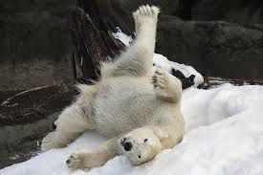
MWSI 2013 Group 1: ECOLOGY Teachable Unit- Population Ecology Tidbit: What’s your Happy Zone?
Asim Auti Lauryn Benedict Maggie Richards Scott Franklin Susan McGrath Tammy Maldonado

Slide 2
Unit Learning Goals
Know how a population fits in the hierarchy of ecology.
Understand the factors that contribute to population growth and dynamics.
Define and describe niche as a fundamental concept of ecology.

Slide 3
Tidbit learning objectives
Define niche in relation to evolving characteristics.
List multiple biotic and abiotic factors that determine a niche
Interpret niche distribution graphs
Compare and contrast the niches of different organisms
Explain how the concept of “niche” links ecology and evolution, including how evolved adaptations determine the niche

Slide 4
Inclusivity
Acknowledged that individuals differ in the way they do things (i.e. pronunciation)
Used a diverse set of organisms and gave their cultural associations.
Incorporated work by individuals, pairs and small groups
Presented material through visual and auditory channels
Used multiple types of formative assessment including written, group discussion, and clickers

Slide 5
Learning Goal | Learning Objective | Assessment | Learning Activity
What will students learn? | If they have learned it, what will students know and be able to do? | How will students demonstrate they know it or are able to do it? | What will students do to learn it?
Define and describe niche as a fundamental concept of ecology. | 1. List multiple biotic and abiotic factors that determine a niche 2. Interpret graphs that represent components of an organism’s niche 3. Compare and contrast the niches of different organisms 4. Explain how the concept of “niche” links ecology and evolution, including how evolved adaptations determine the niche | 1. Class discussion of factors for different species; 2/4a. Students identify and compare components of niche distributions for different species (optimum, stress, death); students explain the distribution is a function of past evolution 2b. Students will demonstrate they can interpret and draw component niche curves 3a. Students will demonstrate each species has a different niche component distribution 3b. Students will interpret the shape of the distribution and what that shape means (generalist, specialist, dominance) 4b. Students will predict changes in curves based on changes in climate; Students will predict changes in curves based on adaptive changes | 1. Students list biotic and abiotic factors that determine a niche; clicker question asking if one resource = niche 2/4a. think-pair-share about how to interpret graph of a component niche distribution 2b. Homework where they interpret and draw component niche distributions (2 Qs) 3a. Students will be given graphs that represent components of an organism’s niche and will match the organism to the niche 3b. Class discussion (shout out) regarding the different optimums, apexes, and widths of distributions 4b. Summative homework following lecture
Alignment Table

Slide 6
Before the tidbit begins
What has been covered. . . .
Second Semester Introductory Biology Course
Basics of Biodiversity and Evolution
Biotic and Abiotic factors
Home Work:
Come to class with a note-card to turn in with the definition of “Ecological niche.”

Slide 7
Everybody shout out the word in 3..2..1
“NICHE”
Ecologists use many different pronunciations

Slide 8
The Book Definition
“The unique set of habitat resources that species requires, as well as its influence on the environment and other species”

Slide 9
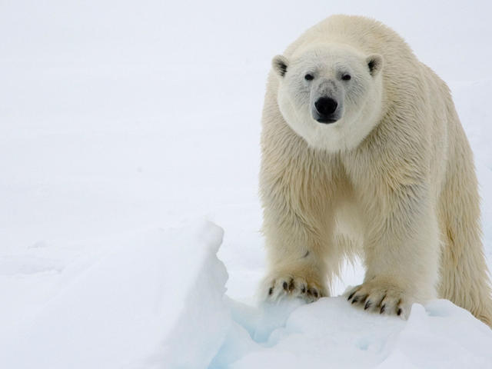
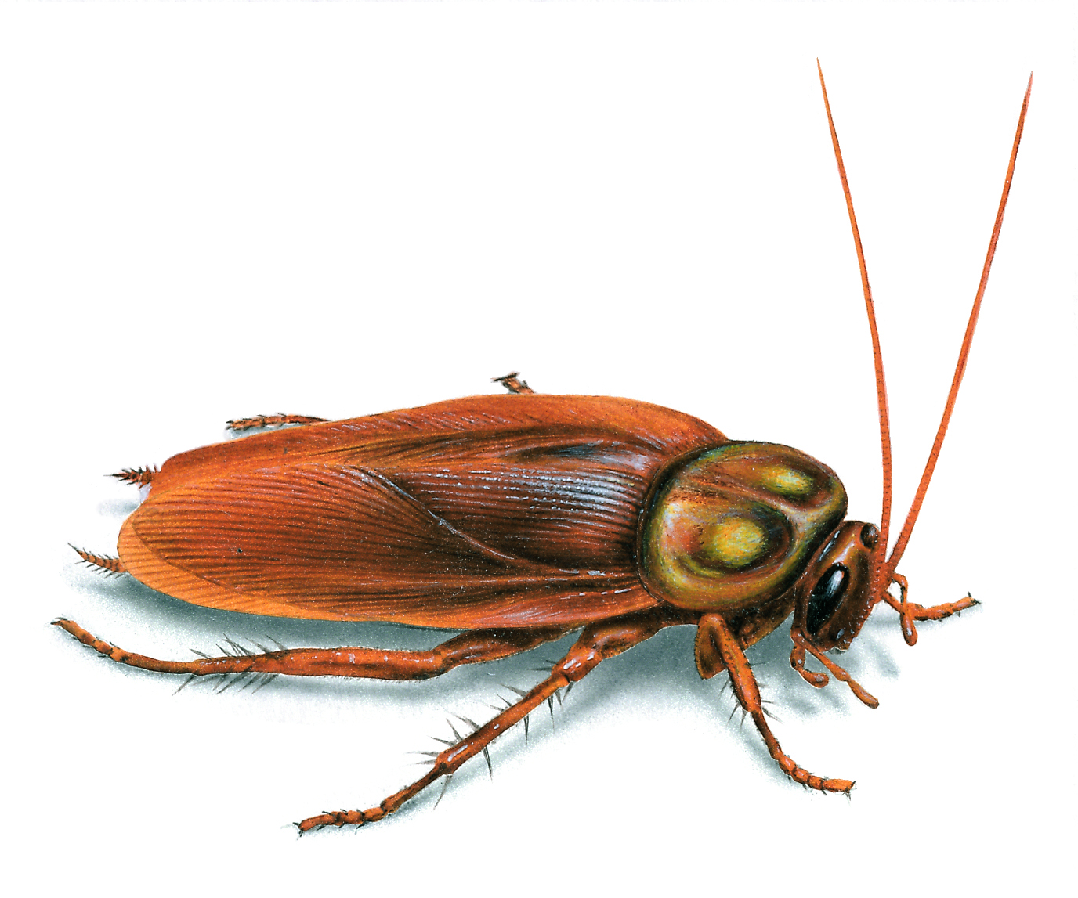
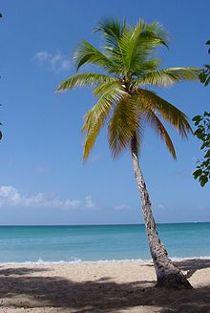
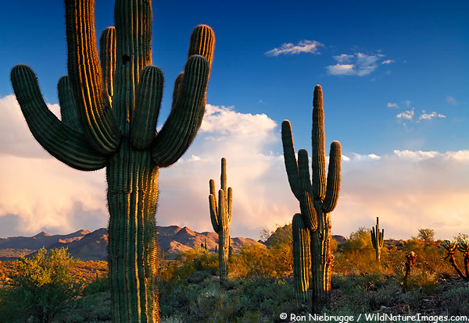
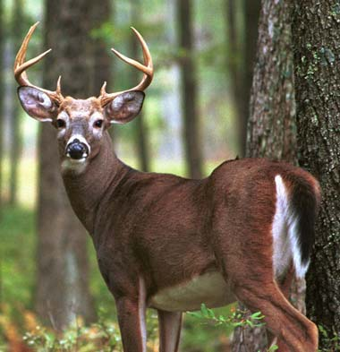
Ursus maritimus
Periplaneta americana
Norway, isbjorn, the ice bear.
Spanish, cucaracha
Cocos nucifera
symbol of tropical island paradise
Carnegiea gigantea
Saguaro (sahuaro) originated in the Mayo language.
Odocoileus virginianus
most important Cherokee game animal (ahwi)

Slide 10
Group Instructions
Where do you find your organism and why?
Answer the “why” question with a list of 10 factors that may matter.
Be sure to include abiotic and biotic factors.
Spend 3 minutes brainstorming this list and then Write your list in the indicated place on the board.

Slide 11
Ursus maritimus
Periplaneta americana
Norway, isbjorn, the ice bear.
Spanish, cucaracha
Cocos nucifera
symbol of tropical island paradise
Carnegiea gigantea
Saguaro (sahuaro) originated in the Mayo language.
Odocoileus virginianus
most important Cherokee game animal (ahwi)

Slide 12
Think-pair-share:
Natural distribution of
Thermophilus aquaticus
60
Relative abundance (%)
0
40
50
60
70
80
Temp (○C)
Why are there no individuals at 40 ○C?
Why are there so few at 55 ○C?
Why are most between 60 and 70 ○C?
E. coli can grow at 40 ○C, why not T.a.?

Slide 13
Think-pair-share:
Natural distribution of
Thermophilus aquaticus
60
Relative abundance (%)
0
40
50
60
70
80
Temp (○C)
A species niche is derived from evolved characteristics. This graph is a model of that relationship.
Why are there no individuals at 40 ○C?
Why are there so few at 55 ○C?
Why are most between 60 and 70 ○C?
E. coli can grow at 40 ○C, why not T.a.?

Slide 14
As a group “Match” the organisms to the correct curves
60
D
E
A
B
C
Relative abundance (%)
0
-40
-30
-20
-10
0
10
20
30
40
50
Temp (○C)
What do you notice about the Curves?
Saguaro cactus:
Polar bear:
Coconut Tree:
Cockroach:
White-tailed deer:

Slide 15
60
Coconut Palm
Polar Bear
Relative abundance (%)
0
-40
-30
-20
-10
0
10
20
30
40
50
Temp (○C)
Do these two organisms have the same niche?
Yes
No

Slide 16
100
Coconut Palm
Relative abundance (%)
Saguaro Cactus
0
-40
-30
-20
-10
0
10
20
30
40
50
Temp (○C)
Do these two organisms have the same niche?
Yes
No
One environmental factor does not equal a niche for an organism.

Slide 17
Individual Reflection:
Flip your notecard over and write your own definition of “ecological niche” on the back.
Notes:
Option: use an analogy instead of a definition

Slide 18
Summative assessment questions for homework and tests
1. The graph shows the distribution of sea nettles in Chesapeake Bay in relation to salinity. At which salinity level (indicated by a letter) would a sea nettle survive but be most stressed?
A
B
C
Sea nettles would not be stressed at any of the indicated salinity levels
Sea nettles would be equally stressed at all 3 salinity levels
100
Relative abundance (%)
A
B
C
0
low
high
Salinity
For more assessment questions and teaching tools look in the Group 1 Ecology folder
or notes below

