Slide 1
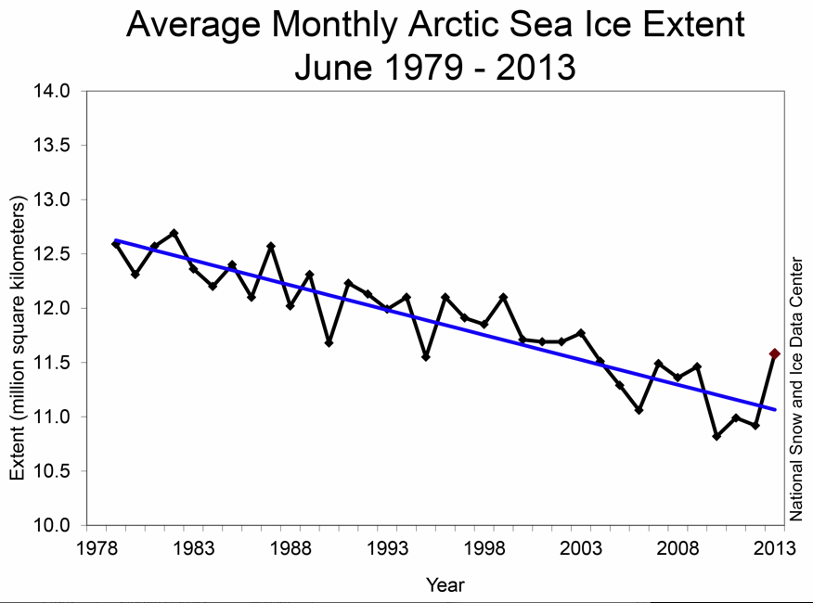

Slide 2
Atmospheric greenhouse gas concentration
Year
These records are maintained by the World Data Center for Paleoclimatology, National Oceanic and Atmospheric Administration
Notes:
http://www.esrl.noaa.gov/gmd/ccgg/trends/history.html

Slide 3
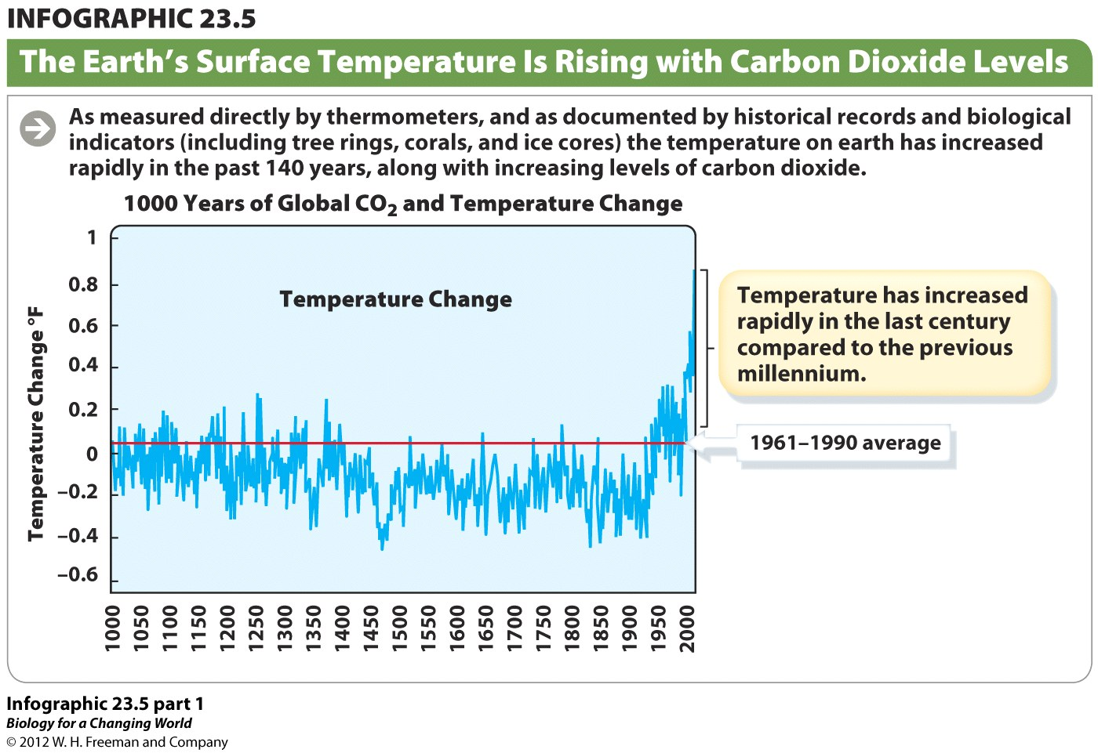
Year

Slide 4
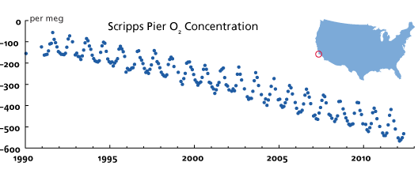
Year
This plot show the atmospheric O₂ concentration relative to the level around 1985.
http://scrippso2.ucsd.edu/

