Slide 1
Regulation of Gene Expression in Multicellular Organisms
Gene Expression Group
7/14/11
Notes:
If you have not figured it out, our focus today is on differential gene expression.

Slide 2
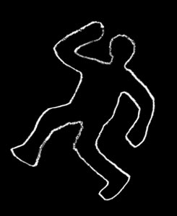
Outline
Context
Review: Clicker Questions
Cell Differences (Think-Pair-Share)
Regulation of Gene Expression (Mini-Lecture)
Application Exercise (Data Activity)
Summary and Conclusions

Slide 3
Outline
Context
Review: Clicker Questions
Cell Differences (Think-Pair-Share)
Regulation of Gene Expression (Mini-Lecture)
Application Exercise (Data Activity)
Summary and Conclusions

Slide 4
Context
Class setting:
-Introductory Biology course for majors;
-50 minute class session
-large lecture hall
Foundation/background:
-Macromolecules
-Central dogma of Biology including mechanisms of
replication, transcription, and translation
-Energetics
-Prokaryotic gene regulation (lac operon overview)
-Readings covering today’s material

Slide 5
Goals and Outcomes
Goal:
To understand regulation of gene expression in multicellular organisms
Outcomes:
Diagram, explain and summarize gene regulation in multicellular organisms.
Interpret relevant expression data accurately.
Know two cells with the same DNA can look and function differently and why this is important.
Compare and contrast eukaryotic and prokaryotic gene regulation.

Slide 6
Outline
Context
Review: Clicker Questions
Cell Differences (Think-Pair-Share)
Regulation of Gene Expression (Mini-Lecture)
Application Exercise (Data Activity)
Summary and Conclusions

Slide 7
Purpose:
Activating prior knowledge
Simple to complex
Leading towards todays material
Notes:
Activatin

Slide 8
Q1. Which of the following correctly orders the events of gene expression
a) RNA is translated into proteins which is transcribed into DNA
b) DNA is transcribed into RNA which is translated into protein
c) Protein is transcribed into DNA which is translated into RNA
d) DNA is translated into RNA which is transcribed into protein

Slide 9
Q2. Transcription starts when RNA polymerase binds to:
A promoter sequence
A terminator sequence
A repressor protein
An inducer molecule

Slide 10
Q3. Proteins that regulate transcription are called:
RNA polymerase
DNA polymerase
Transcription factors
Promoters

Slide 11
Q4. An Operon contains:
One or more structural genes which are transcribed together
Promoter sequences upstream of the structural genes and operator sequences close to the promoter.
Both a and b are correct
None of them is correct

Slide 12
Q5. The Beta-galactosidase protein of the lac operon in Escherichia coli is at low concentrations in the presence of:
Glucose
Lactose
Both a and b
Neither

Slide 13
Outline
Context
Review: Clicker Questions
Cell Differences (Think-Pair-Share)
Regulation of Gene Expression (Mini-Lecture)
Application Exercise (Data Activity)
Summary and Conclusions

Slide 14
Think-pair-share #1: examples of different human cells
Individually, list 2 different kinds of human cells (1 minute)
How are they similar in form or function (2-3 ways)?
How are they different in form or function (2-3 ways)?
Discuss your ideas within your pod (two minutes)
Share with class!

Slide 15
Takeaway
Cells can be different!
Different cells share common features and components (e.g., nucleus, membrane)
Different cells have different shapes and forms
Different cells have different functions

Slide 16
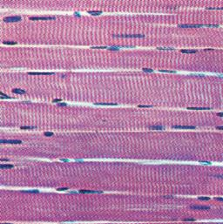
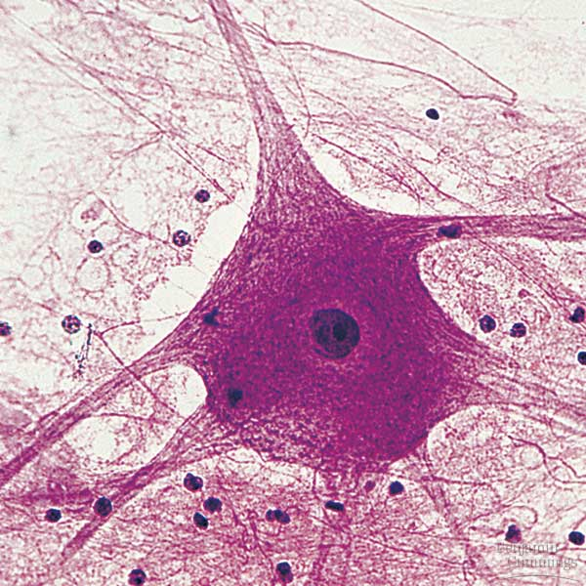
Same or Different?

Slide 17
Which of the following macromolecules is primarily responsible for the differences between these two cells?
A. Carbohydrates
B. DNA
C. Lipids
D. mRNA
E. Proteins

Slide 18
Which of the following macromolecules is primarily responsible for the differences between these two cells?
A. Carbohydrates
B. DNA
C. Lipids
D. mRNA
E. Proteins

Slide 19
Takeaway
DNA sequence is not different
Differences in mRNA and proteins are important
How these differences in mRNA and protein occur is the subject of our mini-lecture.

Slide 20
Outline
Context
Review: Clicker Questions
Cell Differences (Think-Pair-Share)
Regulation of Gene Expression (Mini-Lecture)
Application Exercise (Data Activity)
Summary and Conclusions

Slide 21
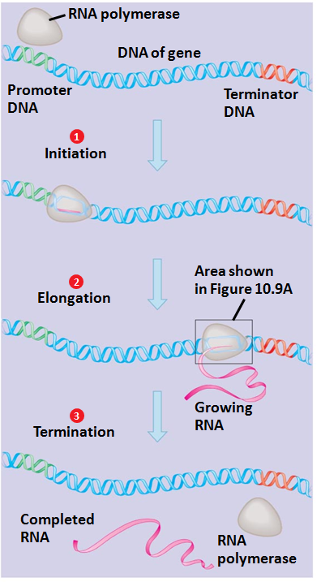
Transcription Refresher
Initiation
Elongation
Termination

Slide 22
Promoters and Enhancers
E
P
Coding Region
Enhancer-
  enhances transcription
  position and orientation independent
  can be far away from the gene it controls
Promoter-
  binds RNA polymerase to help initiate transcription
  usually close to the 5’ end of the gene
Notes:
Enhancers:
Most genes require enhancers
Determine temporal and spatial regulation of transcription.
Oftentimes multiple enhancers per gene
Multiple enhancers allow for different signal inputs to control gene expression.
Transcription factors bind enhancer sequences to increase promoter accessibility or stabilize RNA polymerase.
They can sometimes inhibit gene expression (Silencers).

Slide 23
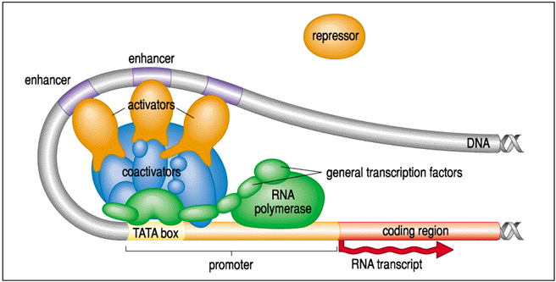
Transcription Initiation Complex
Initiation Complex
  -General transcription factors
  -RNA polymerase
Transcription Factors
  -Activators
  -Repressors
  -Basal transcription factors

Slide 24

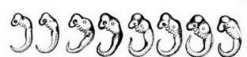
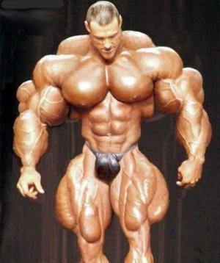
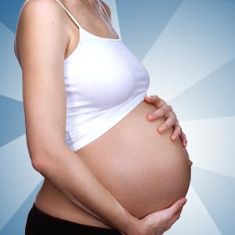
Types of Gene Regulation
Spatial Regulation
Temporal Regulation
Conditional Regulation
Red Blood
Cells
Connective Tissue
Bone
Cells
Adipose
tissue
Intestinal
Cells
Neurons
Muscle
Notes:
Spatial Regulation-Genes are expressed only in certain tissues/cells
Temporal Expression-Genes expressed at different times
Conditional Expression-Genes expressed under certain conditions (heat shock, muscle building, sun tan, pregnancy)
Spatial
Temporal
Conditional
Effects (structural vs. functional)

Slide 25
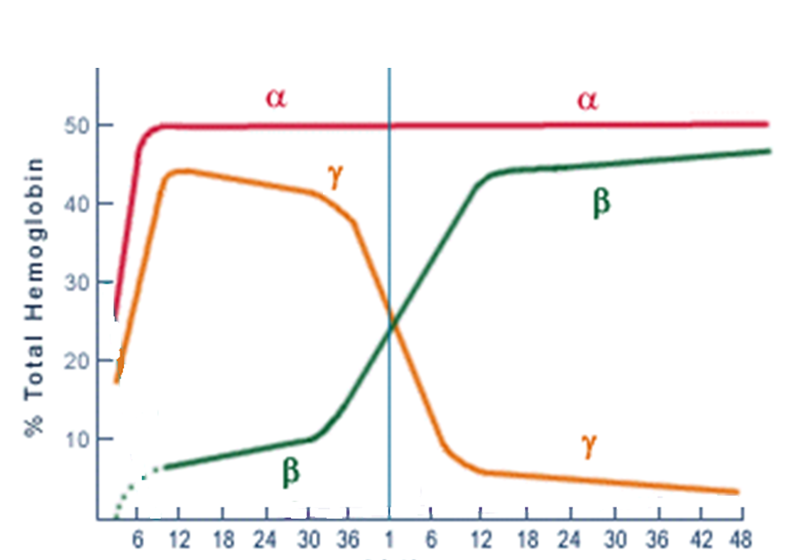
Example: Temporal Regulation of Globin
Fetal
Adult
% Total Hemoglobin
α
γ
α
β
γ
α
β
α
Gestational Age
Birth
Postnatal Age
http://mol-biol4masters.masters.grkraj.org/html/Gene_Expression_II9-Regulation_of_Gene_Expression.htm

Slide 26
Clicker Question
Muscle cells and neurons differ because they have:
A. different DNA
B. different mRNAs
C. different proteins
A and B
B and C

Slide 27
Clicker Question
Muscle cells and neurons differ because they have:
A. different DNA
B. different mRNAs
C. different proteins
A and B
B and C

Slide 28
Outline
Context
Review: Clicker Questions
Cell Differences (Think-Pair-Share)
Regulation of Gene Expression (Mini-Lecture)
Application Exercise (Data Activity)
Summary and Conclusions

Slide 29
Think Like a Scientist
How would you measure what makes neurons different from muscle cells?
Complete part 1 as individuals, then discuss it in a group of three.

Slide 30
Outline
Context
Review: Clicker Questions
Cell Differences (Think-Pair-Share)
Regulation of Gene Expression (Mini-Lecture)
Application Exercise (Data Activity)
Summary and Conclusions

Slide 31
Summary
Different cells are different because of differential gene expression, NOT different amounts of DNA
Transcription factors bind promoters and enhancers to regulate gene expression
Three types of Regulation: Spatial(Lab), Temporal, Conditional
Gene regulation in eukaryotes is different from regulation in prokaryotes
Today you applied nerve and muscle protein data to make general conclusions about gene regulation in these cell types. All scientific information is based on data and this is an example of that.
Lab

Slide 32
Homework
Compare and contrast eukaryotic and prokaryotic gene expression. Be specific.

Slide 33
Goals and Outcomes
Goal:
To understand regulation of gene expression in multicellular organisms
Outcomes:
Diagram, explain and summarize gene regulation in multicellular organisms.
Interpret relevant expression data accurately.
Know two cells with the same DNA can look and function differently and why this is important.
Compare and contrast eukaryotic and prokaryotic gene regulation.

Slide 34
EXTRA SLIDES THAT MAY HELP

Slide 35
CASE STUDY

Slide 36
Elizabeth’s CFTR* Gene
Mutation
Promoter
Gene
*Cystic fibrosis transmembrane conductance regulator

Slide 37
Jeffrey’s CFTR* Gene
Mutation
Promoter
Gene
*Cystic fibrosis transmembrane conductance regulator

Slide 38
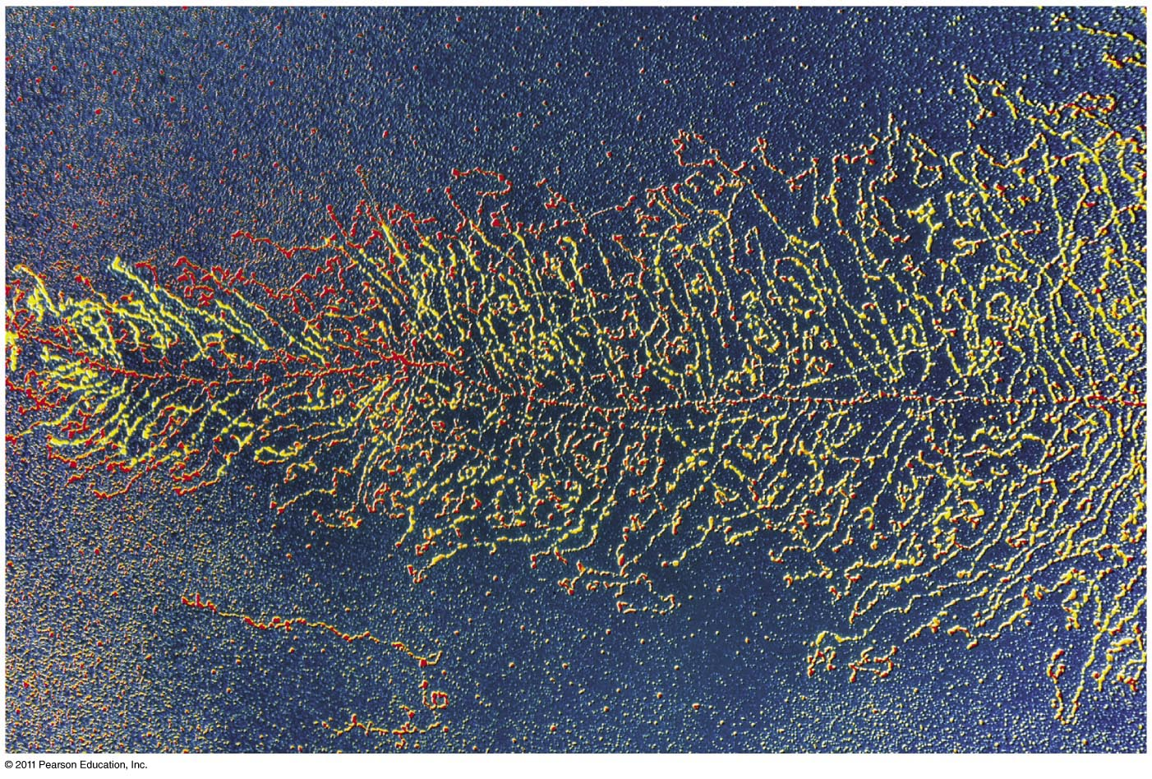
Lecture 16
Chapter 16: Transcription, RNA Processing & Translation
Frog chromosome being transcribed

Slide 39
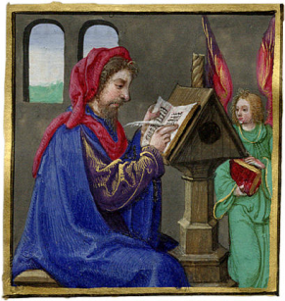

Central Dogma of Biology
Francis Crick: DNA codes for RNA which codes for proteins.
The sequences of bases in the DNA, specify the sequence of bases in RNA, which specify the sequence of amino acids in the protein.
Many types of proteins: Motor proteins, structural proteins, peptide hormones, membrane transport proteins, antibodies etc.
Gene expression occurs through transcription and translation
DNA
(information storage)
Reverse Transcription
Transcription
RNA
(information carrier)
Translation
Proteins
(active cell machinery)
http://www.fromoldbooks.org/Rosenwald-BookOfHours/pages/016-detail-miniature-scribe/
http://www.barnesandnoble.com/

Slide 40
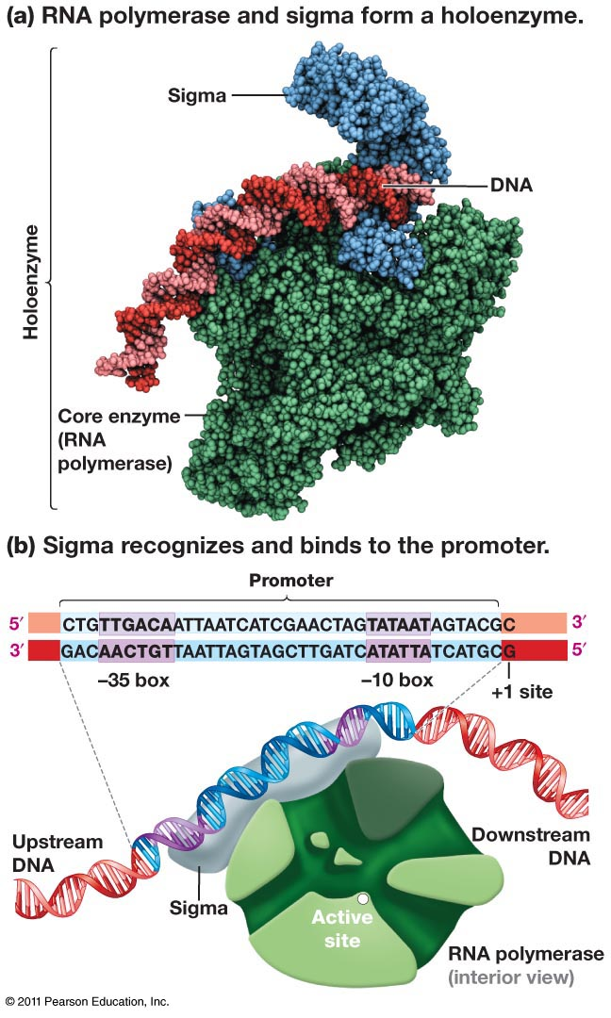
RNA Polymerase
Holoenzyme- “whole enzyme” is the catalytic core of RNA polymerase
Sigma-detachable subunit which recognizes and binds to the promoter
Promoter-Landing pad for RNA pol which positions it near the transcription start site to promote initiation in the right spot.
Transcription begins at the +1 site. The promoter is slightly upstream

Slide 41
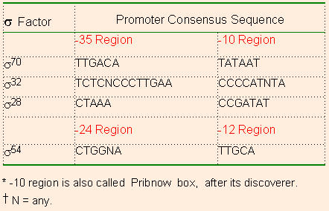
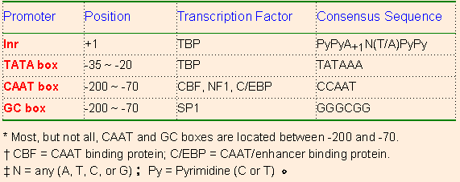
Prokaryotic and Eukaryotic Promoter Elements
E. Coli has multiple sigma Factors
E. Coli has 7 different Sigma factors.
Each factor binds to slightly different sequences to allow RNA polymerase to transcribe different kinds of genes.
e.g. one type of sigma factors helps RNA pol transcribe genes that help the cell cope with high temperatures.
Eukaryotic Promoter Elements
Eukaryotes don’t have sigma factors but do have a number of basal transcription factors.
http://www.web-books.com/MoBio/Free/Ch4C1.htm
Notes:
TBP=Tasty bone protein

Slide 42
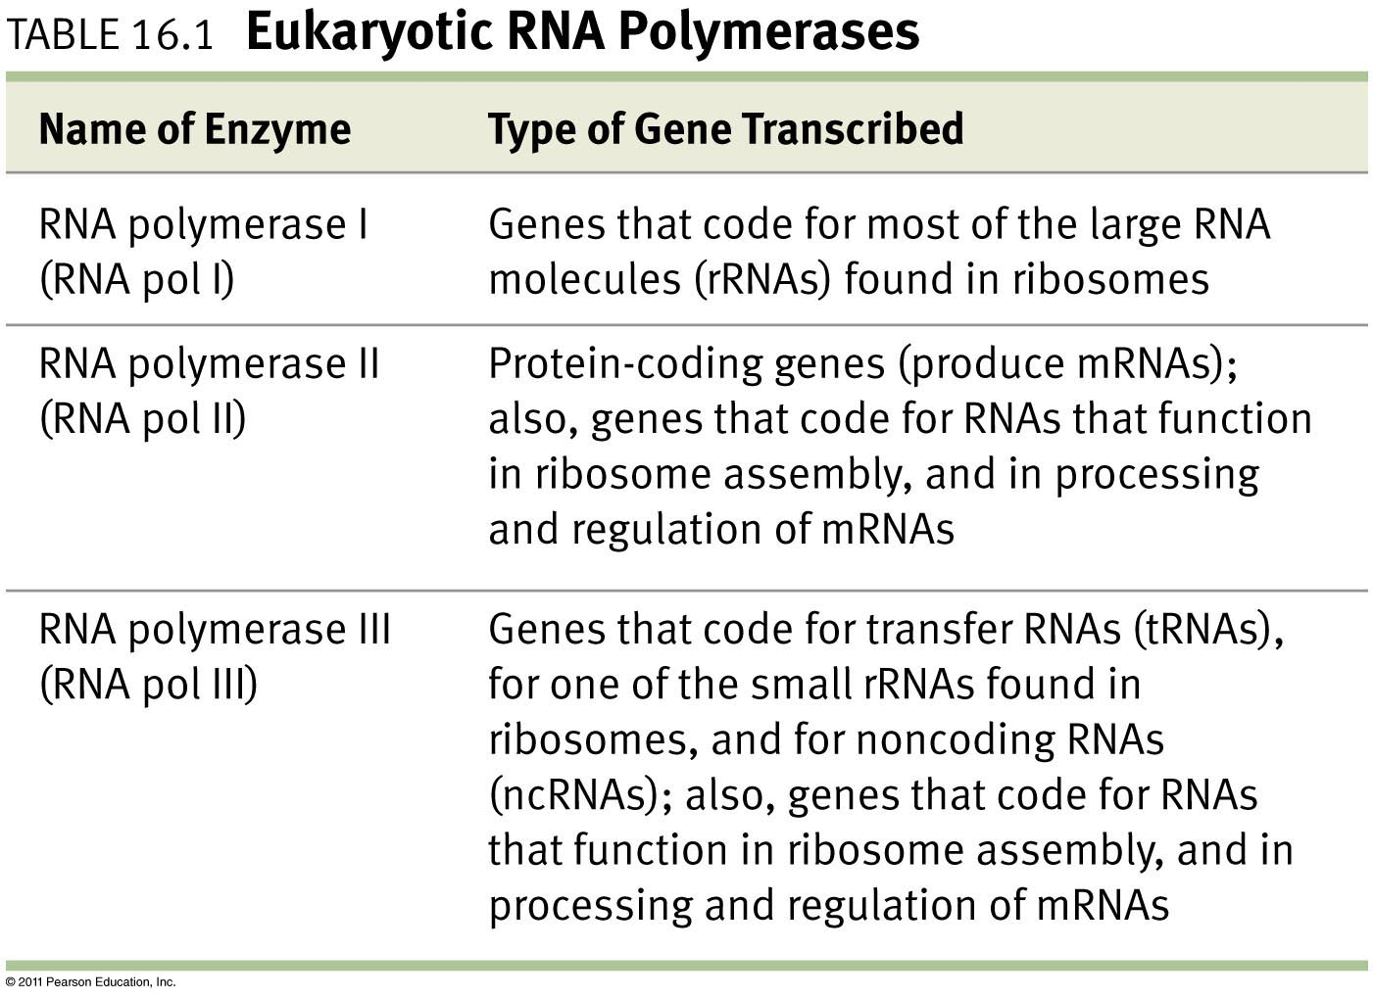
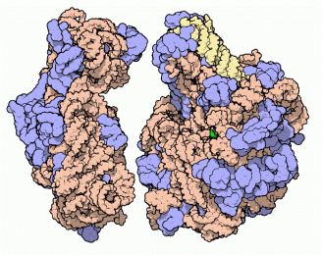
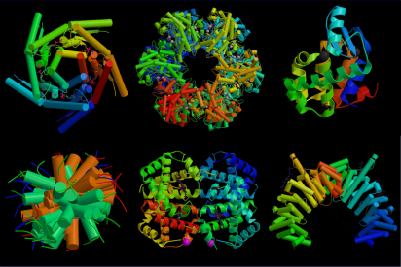
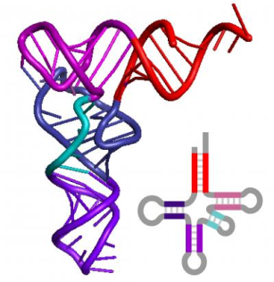
Three Flavors of RNA Polymerase in Eukaryotes
How does the cell know which one to use?
http://martin-protean.com/protein-structure.html
http://www.eurekalert.org/multimedia/pub/7027.php?from=109749
http://www.pdb.org/pdb/static.do?p=education_discussion/molecule_of_the_month/pdb10_1.html
Notes:
How does the cell know which polymerase to use?

Slide 43
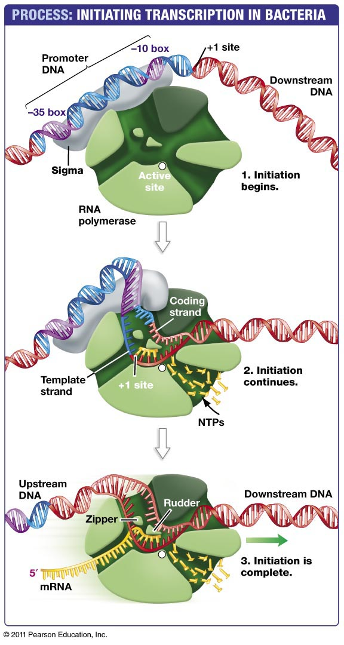
Txn Initiation and Elongation in Bacteria
Sigma binds the promoter region
Sigma opens the DNA helix and transcription begins at the active site. The rudder steers the template and non-template strands through the enzyme. The zipper separates the new RNA from the DNA template and forces the mRNA out of the enzyme.
Sigma is released and mRNA synthesis continues during the elongation phase. (50 nt/sec)

Slide 44
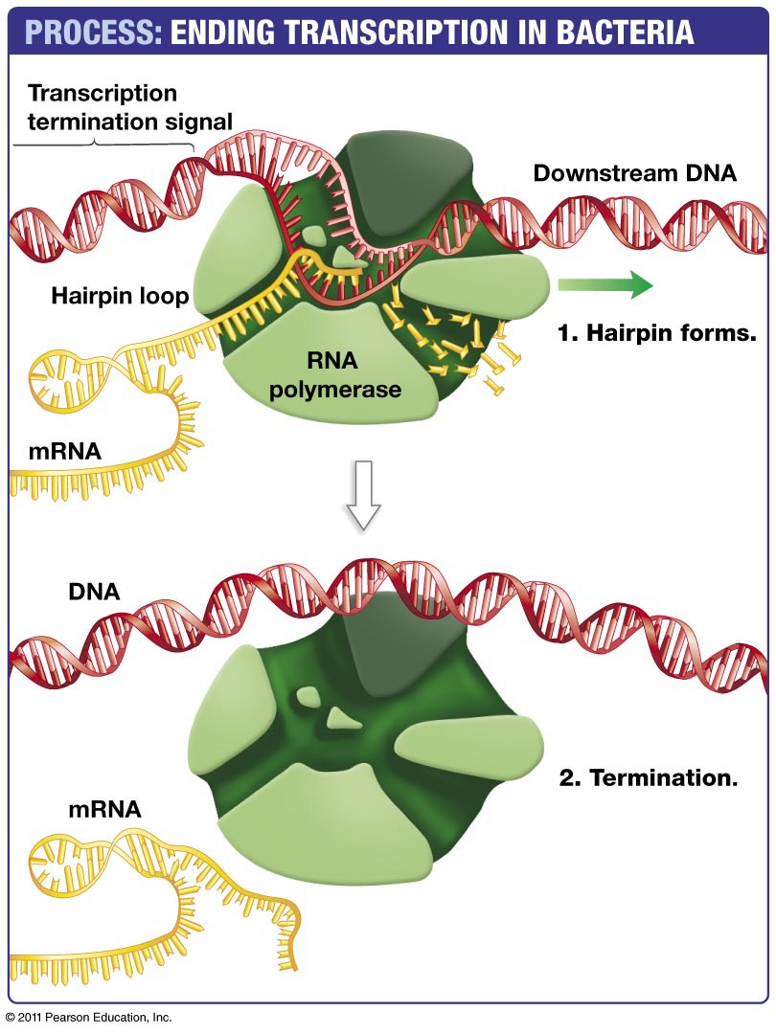
Termination of Transcription in Bacteria
Termination occurs when a transcription termination signal is transcribed.
Complementary sequences in the termination signal base pair with one another to form a hairpin.
The hairpin makes RNA polymerase loose its grip on the RNA transcript which is then subsequently released.
Transcription termination in vertebrates is poorly understood!!!

Slide 45
Mechanism: Transcriptional Regulation of the CFTR Gene
INSERT PICTURE OF CFTR GENE OR MAKE ONE
-Promoter
-Enhancer
-Txn factors
http://drtedwilliams.net/kb/index.php?pagename=Eukaryotic%20Transcription%20Initiation

Slide 46
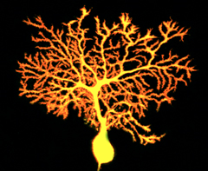

Slide 47
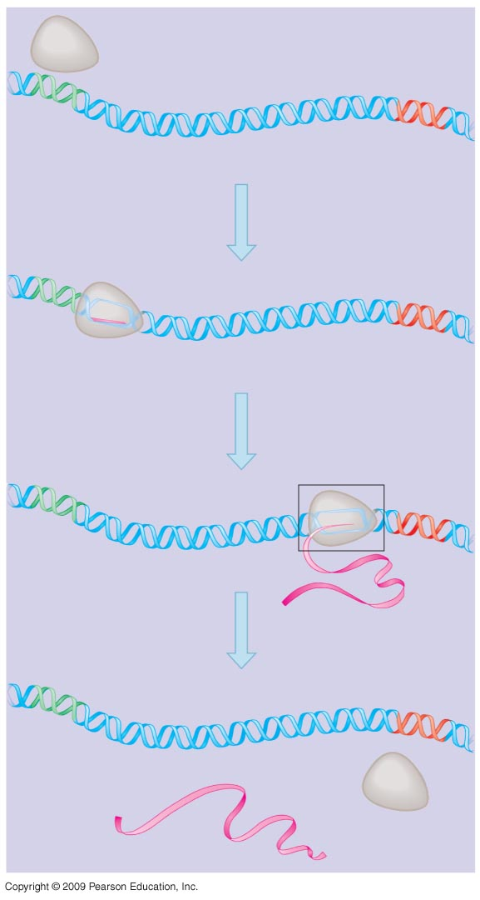
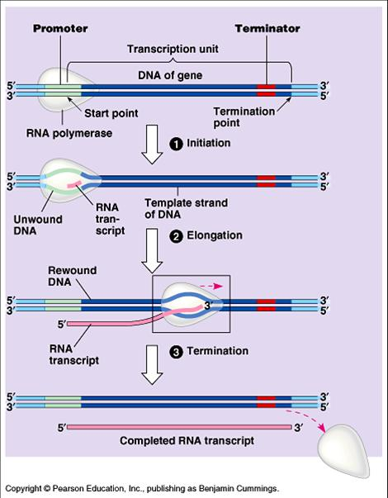
Transcription Refresher
RNA polymerase
DNA of gene
Promoter
DNA
Terminator
DNA
Initiation
Elongation
Termination
1
Initiation
Area shown
in Figure 10.9A
2
Elongation
3
Growing
RNA
Termination
http://faculty.irsc.edu/FACULTY/TFischer/micro%20resources.htm
Completed
RNA
RNA
polymerase

Slide 48
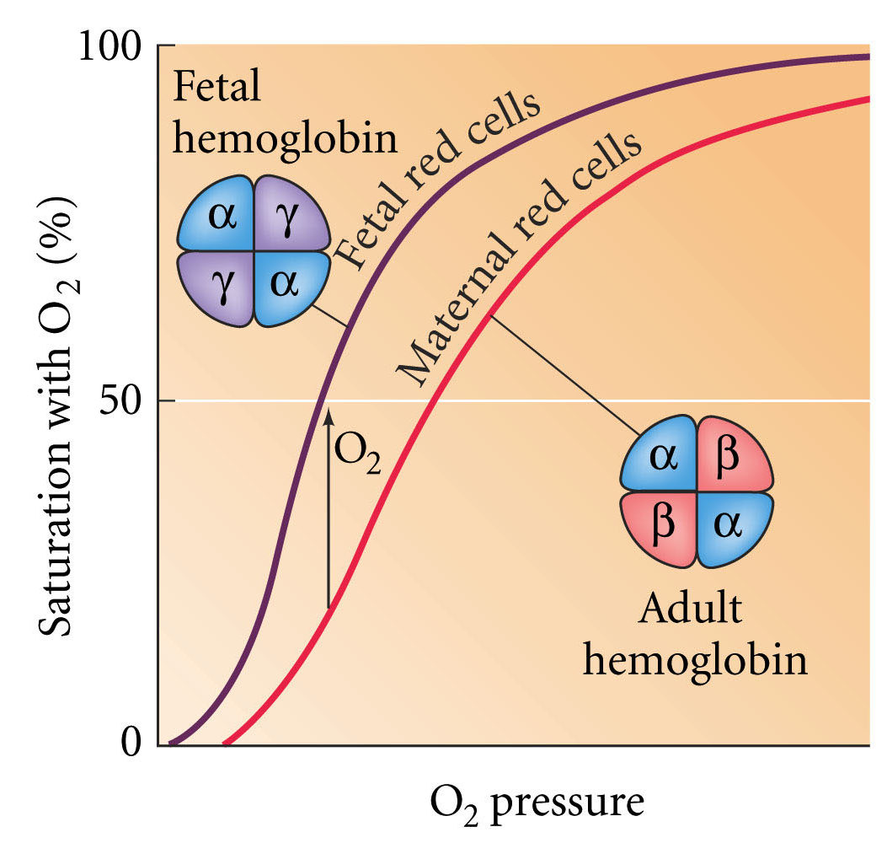
15.10 Adult and fetal hemoglobin molecules differ in their globin subunits
The β-globin of the adult binds to disphosphoglyerate which helps to unload oxygen.
The γ-globin subunits of the fetus, can’t bind disphosphoglycerate so they have a higher affinity for oxygen.
The resulting small difference in oxygen affinity mediates the transfer of oxygen from the mother to the fetus.
Notes:
devbio8e-fig-15-10-0.jpg

Slide 49
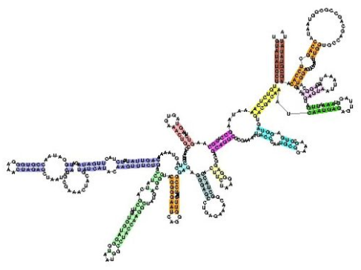
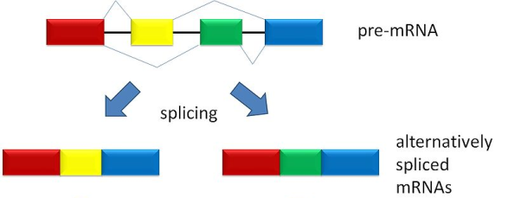
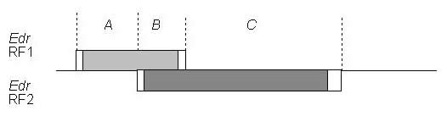
So What’s A Gene?
Not all genes encode proteins. (e.g. rRNA genes, miRNA genes)
Some genes produce multiple polypeptides via alternative splicing.
Some genes overlap
Are promoters and enhancers part of the gene?
Genetic Definition: A gene is defined by a set of mutations which fail the ‘complementation test’.

Slide 50
Anatomy of a Gene
Regulatory regions-include enhancers and promoters
Exons-regions of the gene that are included in the processed mRNA.
  NOT ALL EXONS ENCODE PROTEIN. Exons can be in non-coding RNA.
Introns-regions of the mRNA which get spliced out during processing.
Transcription initiation site- Site where transcription (txn) starts. (Cap site)
Translation initiation site-Site where translation begins. (AUG codon)
5’ UTR-Sequence between transcription and translation initiation sites.
Translation termination codon-Site where translation stops. (TAG, TGA, TAA)
3’UTR-Everything after the translation termination codon. Includes AAUAAA sequence which is needed for polyadenylation.
  PolyA tail helps stabilize mRNA, facilitates its nuclear export, and increases the efficiency of translation.
Transcription Termination Site
-Not well defined. Generally it continues ~1000 bp beyond the AAUAAA site.

Slide 51
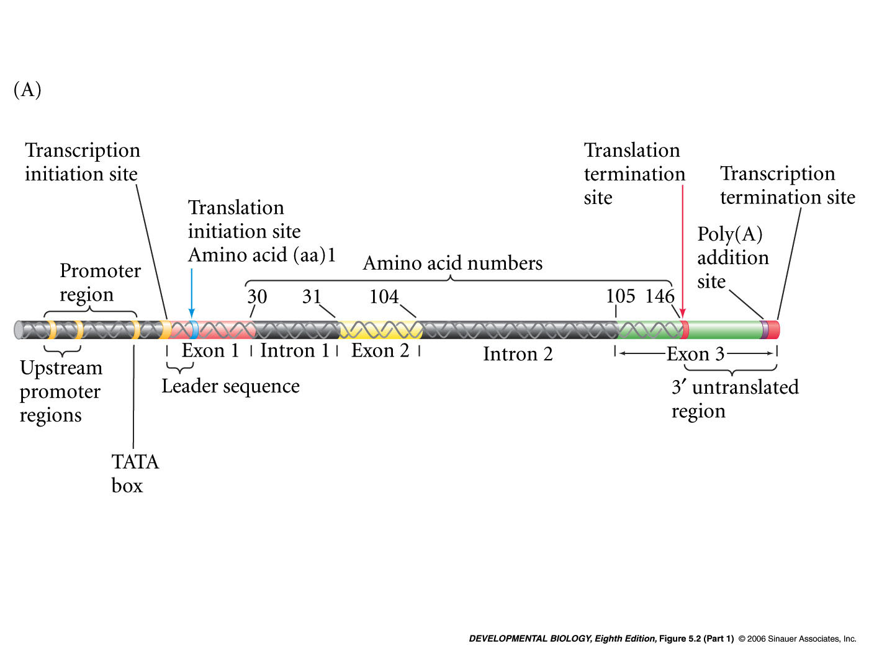
5.2 Nucleotide sequence of the human β-globin gene (Part 1)
Notes:
devbio8e-fig-05-02-1.jpg

Slide 52
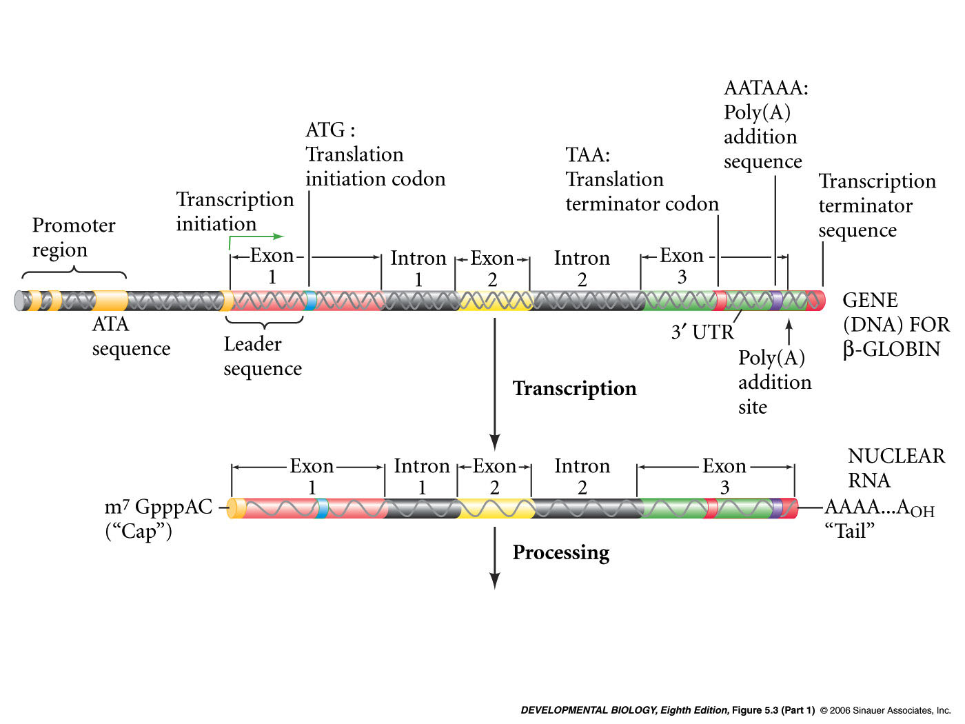
5.3 Summary of the steps involved in the production of β-globin and hemoglobin (Part 1)
DNA
RNA
Splicing
Notes:
devbio8e-fig-05-03-1.jpg

Slide 53
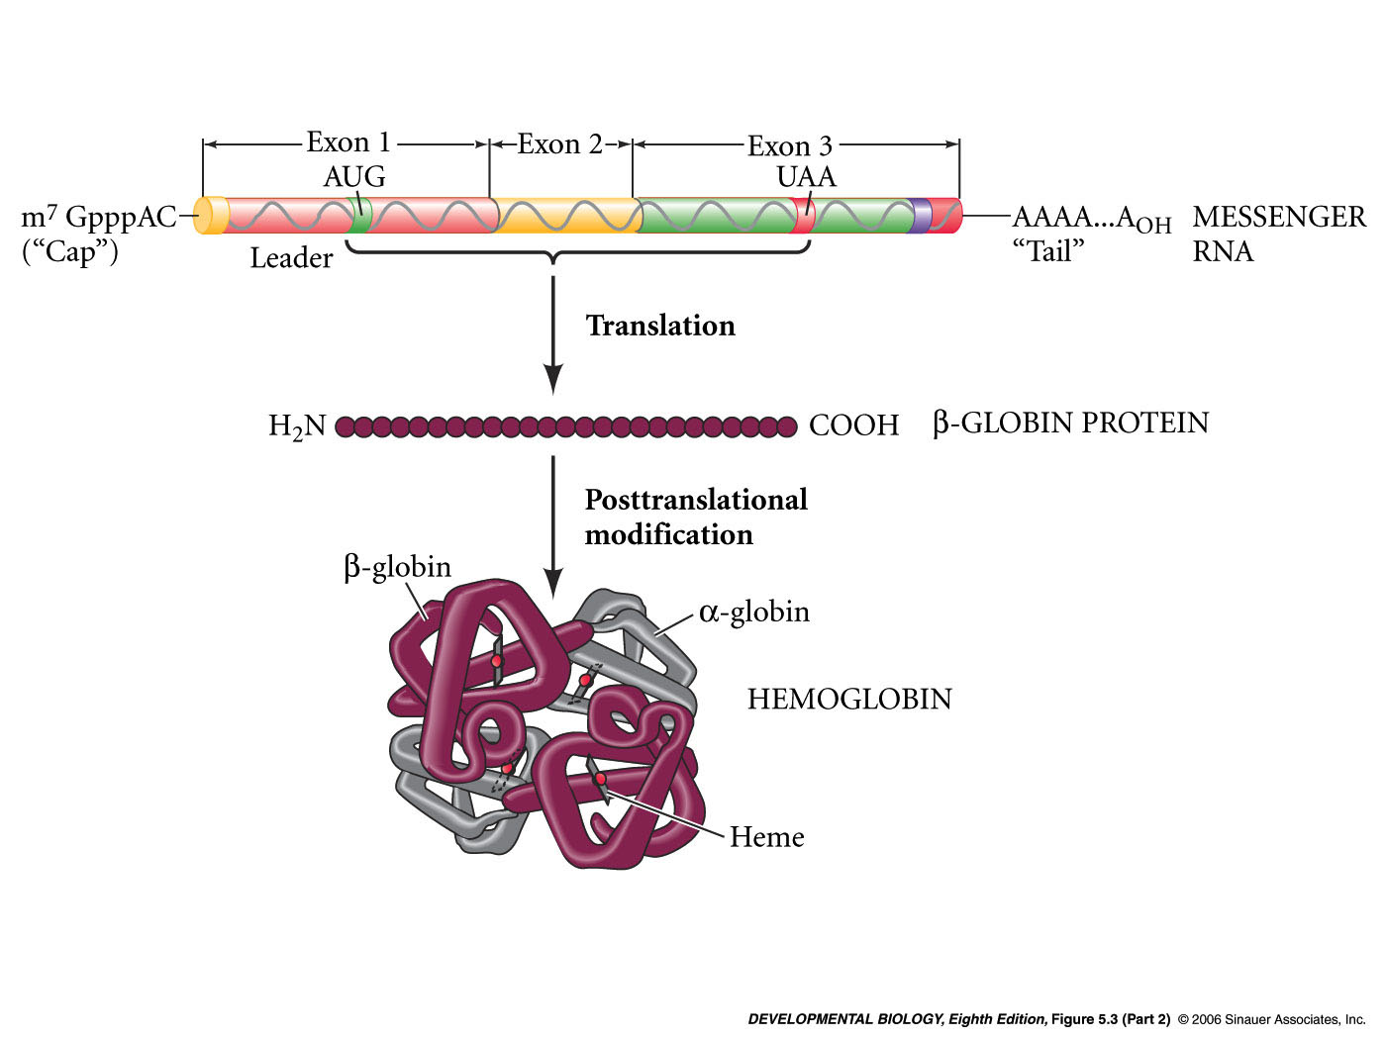
5.3 Summary of the steps involved in the production of β-globin and hemoglobin (Part 2)
Notes:
devbio8e-fig-05-03-2.jpg

Slide 54
Enhancers and Promoters
Enhancer-Sequence that enhances transcription. It is position and orientation independent and can be far away from the gene it controls.
  Most genes require enhancers
  Determine temporal and spatial regulation of transcription.
  Oftentimes multiple enhancers per gene
  Multiple enhancers allow for different signal inputs to control gene expression.
  Transcription factors bind enhancer sequences to increase promoter accessibility or stabilize RNA polymerase.
  They can sometimes inhibit gene expression (Silencers).
Promoter-Binds RNA polymerase to help initiate transcription. Usually close to the 5’ end of the gene. Most contain TATA box.

Slide 55
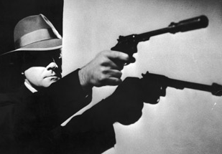
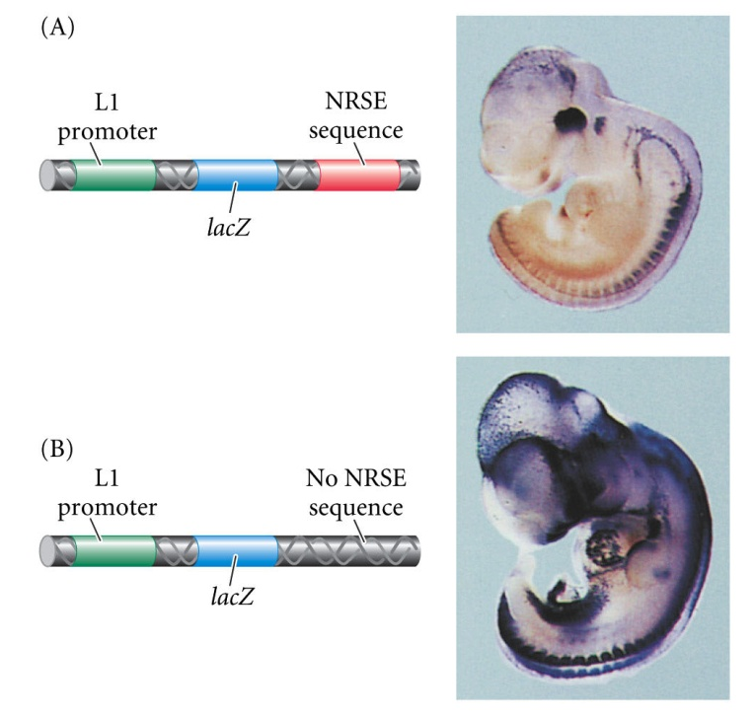
Silencers
Silencers=Negative enhancers
Neural Restrictive Silencer Element(NRSE) is found on several mouse genes.
Bound by Neural restrictive silencer factor (NRSF), a zinc finger txn factor
It prevents transcription everywhere except the nervous system.
Ectopic expr. When NRSE is removed.
Notes:
devbio8e-fig-05-18-0.jpg

Slide 56
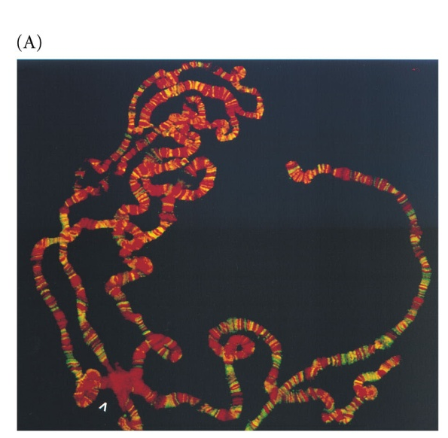
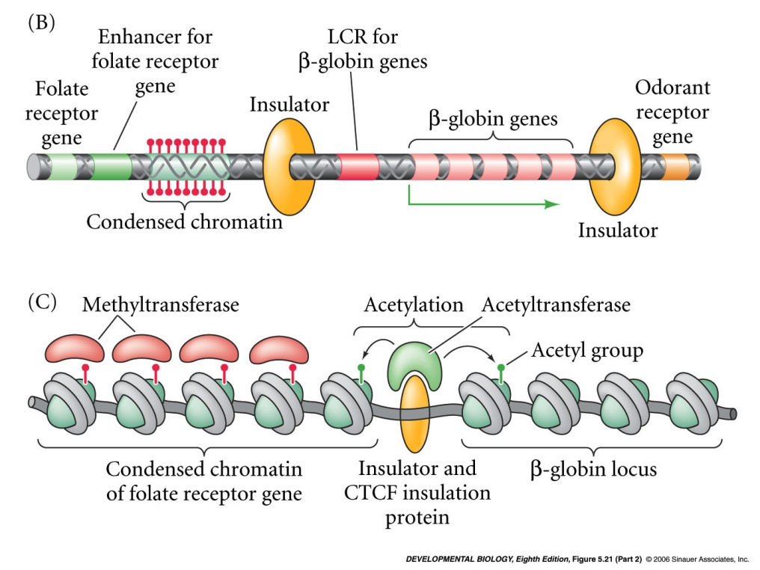
Insulator Elements
BEAF32 insulator protein
DNA sequences which limit the range over which enhancers can act.
Insulators bind proteins that prevent enhancers from activating adjacent promoters
Insulators flanking B-globin locus prevent its enhancer from affecting odorant receptor gene and folate receptor genes.
Insulators also act as boundaries between heterochromatin and euchromatin.
Insulator CTCF protein recruits acetyltransferases to prevent heterochromatin from spreading.
Notes:
devbio8e-fig-05-21-1.jpg

Slide 57
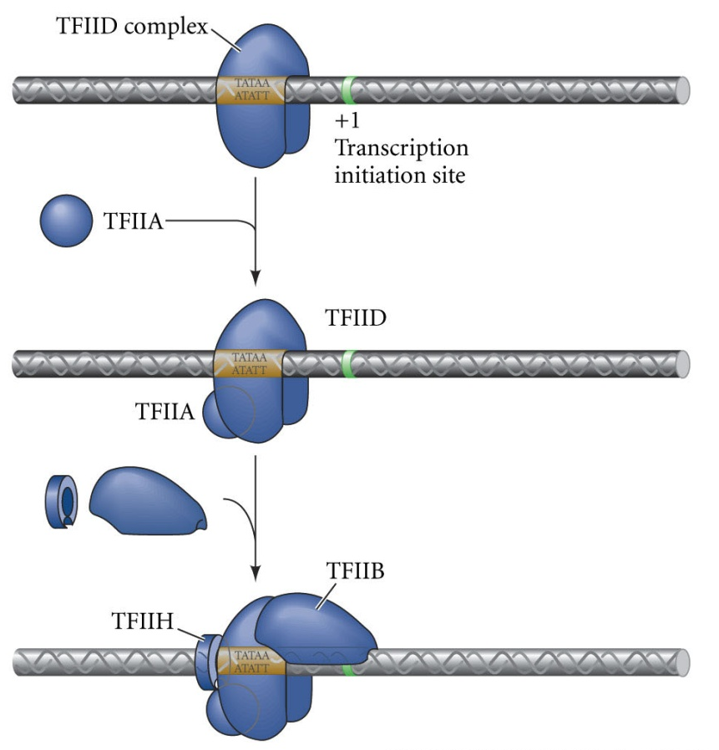
5.4 Formation of the active eukaryotic transcription initiation complex (Part 1)
Basal txn factors are required for most genes:
TFIID(TBP)-binds to TATA box and later binds to CTD of RNA Pol II.
TFIIA-Stabilizes TFIID
TFIIB-Positions RNA Pol II
H
B
Notes:
devbio8e-fig-05-04-1.jpg
Joke idea: Basil Transcription Factors

Slide 58
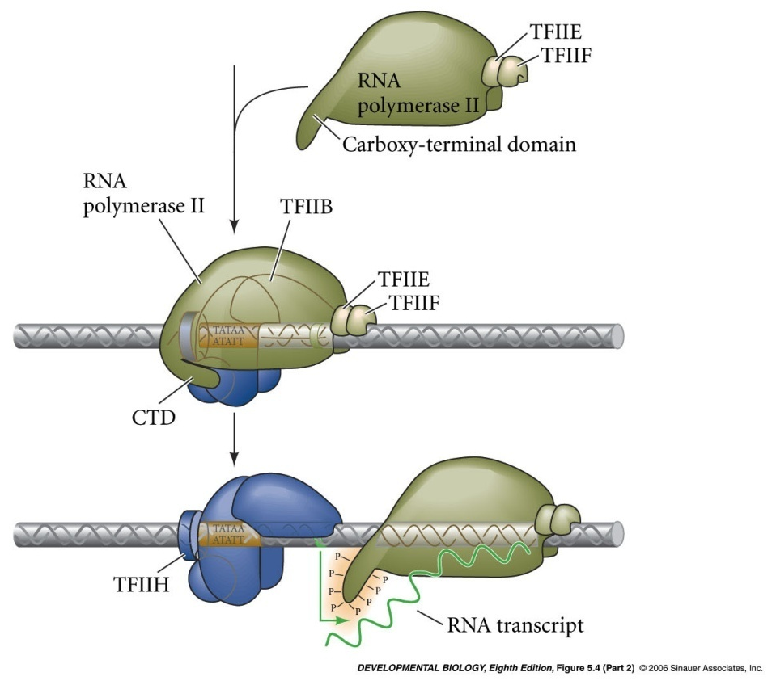
5.4 Formation of the active eukaryotic transcription initiation complex (Part 2)
TFIIH-Phosphorylates CTD of RNA Pol II (‘H’ for Here we go!)
TFIIE & TFIIF-Release RNA Pol II to initiate transcription.
Notes:
devbio8e-fig-05-04-2.jpg

Slide 59


Transcription Initiation Factor Mnemonic:
TFIID(TBP)-Dog with Tasty Bone Protein
TFIIA-A
TFIIB-Boy
TFIIH-His
TFIIE-Extended
TFIIF-Family

Slide 60
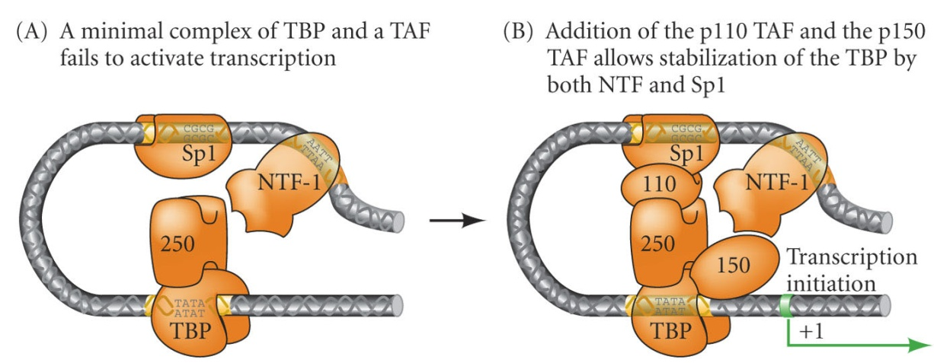
Basal Txn Factors Interact with RNA pol through TAFs and the Mediator Complex
TAFs
Txn
Factors
TAF(TBP-Associated Factors)
-Stabilize TBP onto TATA box.
-bound by promoters
-Sometimes Txn factors bind TAFs to stabilize initiation complex. (e.g. Pax6)
Mediator Complex
-contains ~25 proteins
-Modulates RNA pol II and TFIIH
-Facilitates interaction between transcription factors and RNA pol II
Notes:
devbio8e-fig-05-05-0.jpg

Slide 61
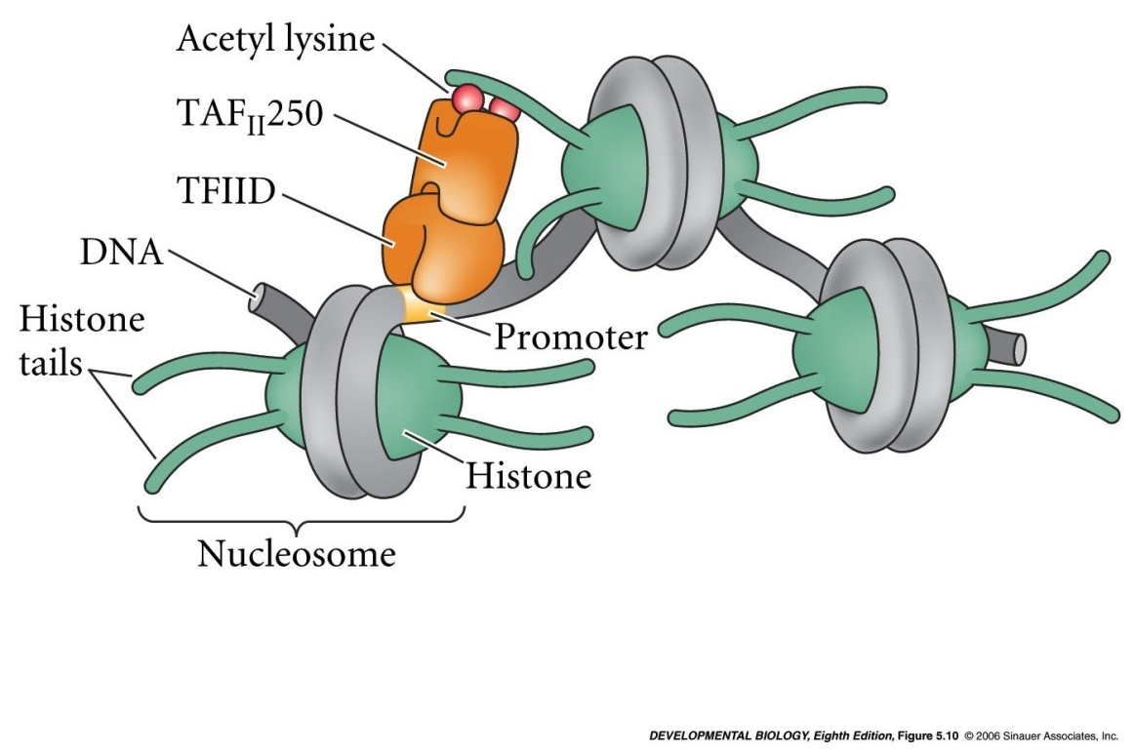
5.10 TAF_{II}250, a TAF that binds TBP, can function as a histone acetyltransferase
TAF_{II}250:
acetylates histones to disrupt nucleosomes
It then binds acetylated lysines
It recruits TBP to the promoter.
Note: Usually TAFs and histone acetylases are two separate proteins.
Notes:
devbio8e-fig-05-10-0.jpg

Slide 62
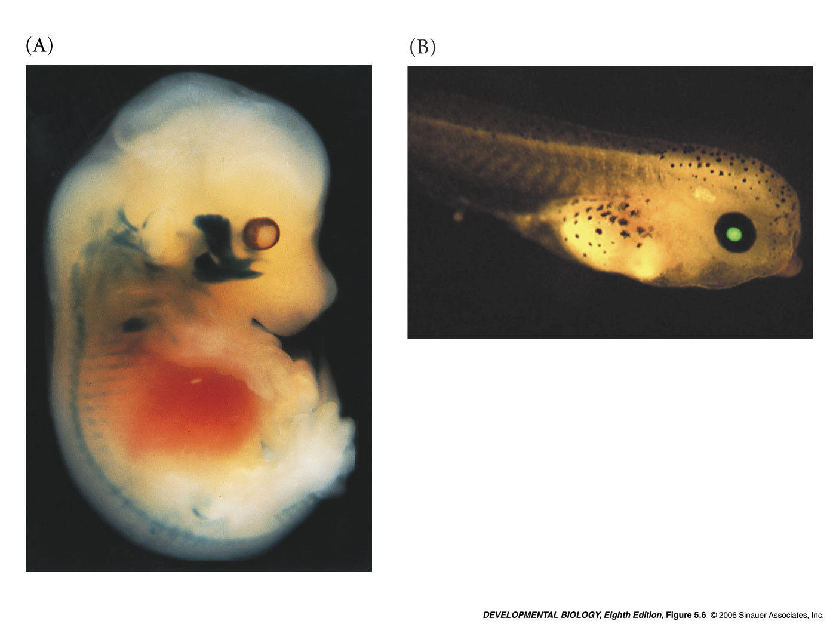
Identifying Regulatory Elements
Goal: Identify regulatory elements and what tissues those promoters/enhancers normally function in.
Fuse suspected regulatory element next to a reporter gene.
Reporter gene must be:
  Easily detectable
  Not normally expressed in the animal being studied
  Not expressed without regulatory flanking sequence.
Lens crystallin enhancer fused to
GFP
Myf-5 enhancer fused to
β-galactosidase
Notes:
devbio8e-fig-05-06-0.jpg

Slide 63
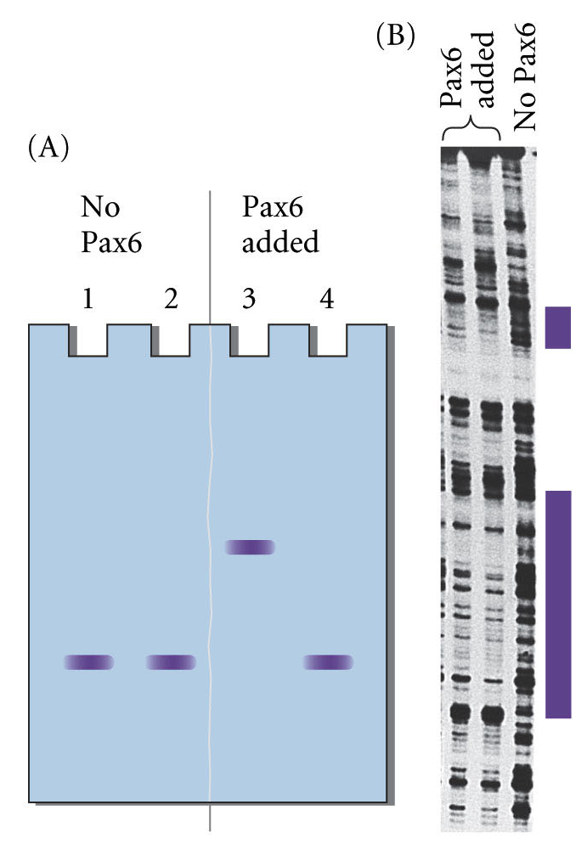
Technique: Identifying Regulatory Elements
Gel Mobility Shift Assay
  Perform electrophoresis w/ + w/o protein added.
  If protein causes an apparent shift in the size of the DNA fragment, it binds that fragment.
  If it the txn factor binds, then that DNA contains a regulator element.
DNase Protection Assay
  Used to confirm Gel Mobility shift assay
  Dnase I randomly cleaves DNA
  Combine protein and DNA and see if protein protects DNA from Dnase digestion.
Purple boxes are regions where no cleavage had occurred
5.14 Procedures for determining the DNA-binding sites of transcription factors
Notes:
devbio8e-fig-05-14-0.jpg

Slide 64
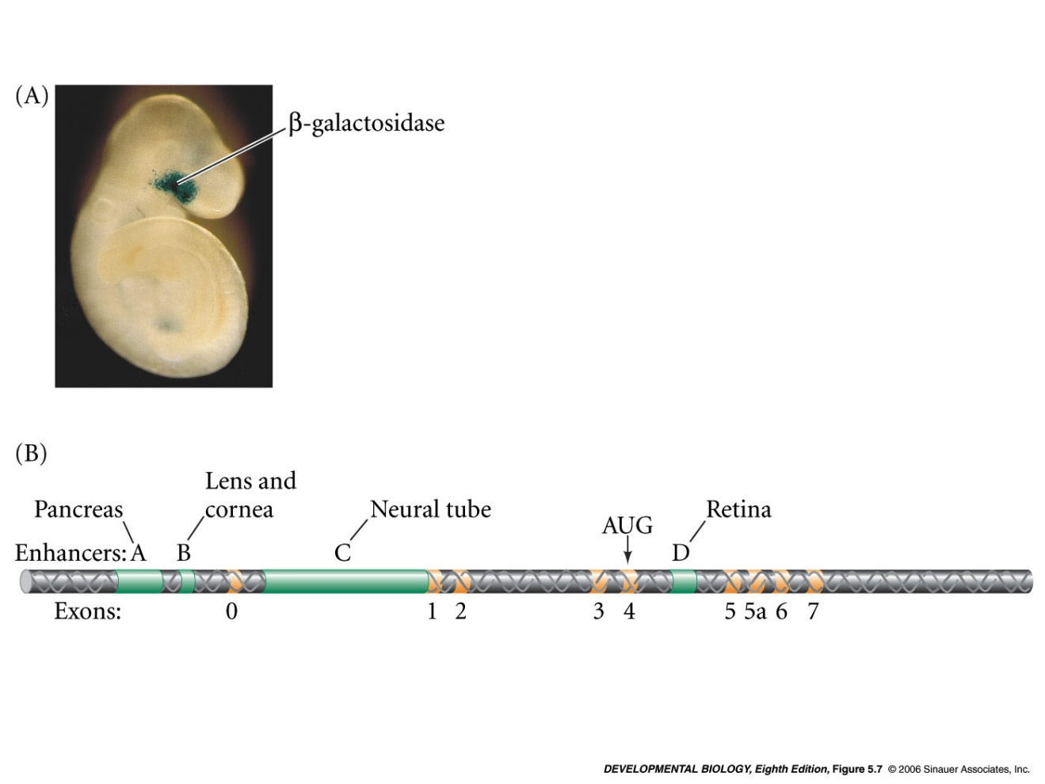
5.7 Regulatory regions of the mouse Pax6 gene
Expression in Optic Cup
Reporter Gene
Mouse
Enhancers of Pax6 Gene (A-D)
Notes:
devbio8e-fig-05-07-0.jpg

Slide 65
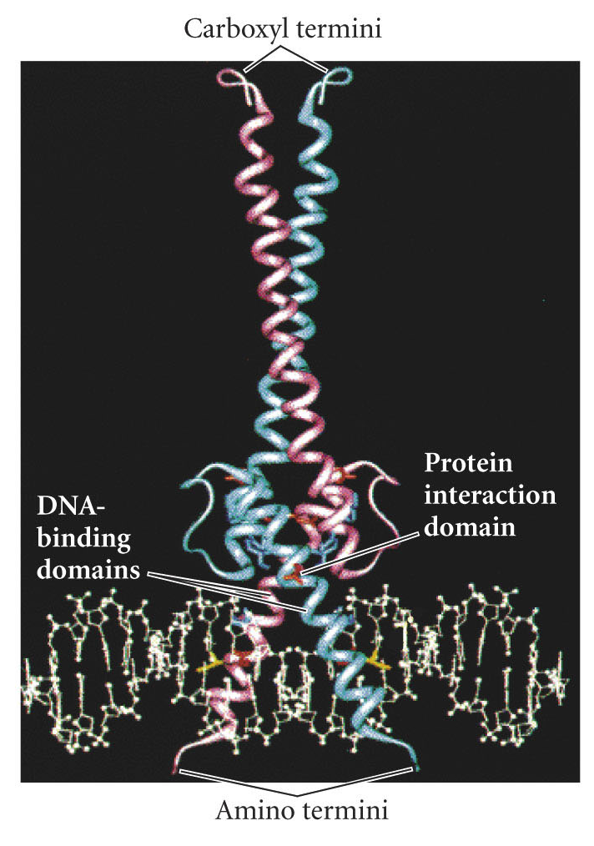
Transcription Factor Domains
DNA-binding domain: Binds DNA, duh! Often contains basic(positively charged amino acids). Often recognize a certain sequence (e.g. CATGTG).
Trans-activating domain: Activates or suppresses transcription, usually by allowing the Txn factor to interact with transcription initiation factors, or with enzymes that modify histones.
Protein-protein interaction domain: Allows transcription factors to form homodimers or heterodimers with other transcription factors or interact with TAFs.
Trans-activating Domain
MITF Transcription Factor

Slide 66
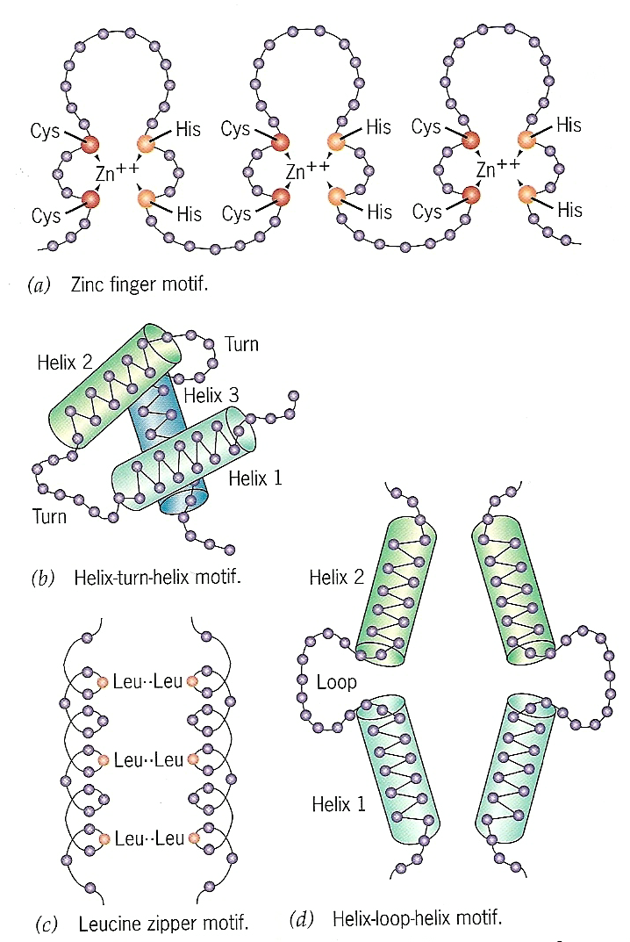
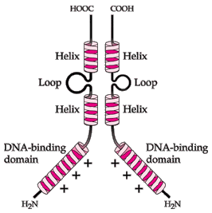
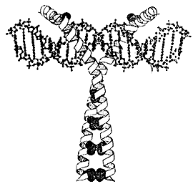
Types of Transcription Factors
A. Basic helix-loop-helix (bHLH) Form heterodimers. Oftentimes one dimer is ubiquitous while the other is cell type specific. Bind E-box consensus sequence.(ex. MyoD, c-Myc)
B. Leucine Zipper (bZIP) also form dimers, they have a basic DNA binding region, and Leucine residues that interact with each other to ZIP the dimers together. “Scissor grip” on DNA(ex. C/EBP, AP1)
C. Zinc finger: two cysteines on one part of the polypeptide bind zinc with two histidines on the other side of the polypeptide. Fingers bind DNA. (ex. Kruppel, Engrailed)
D. Homeodomain proteins have a 60 AA residue region that gives a helix-turn-helix type of structure, a third helix actually sticks into the major groove of DNA. (ex. Hox, Pax)
Zinc finger
Homeodomain
Leucine Zipper
bHLH

Slide 67
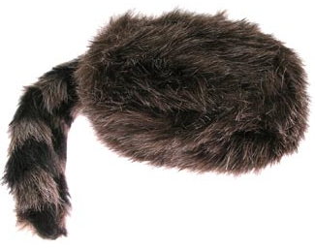
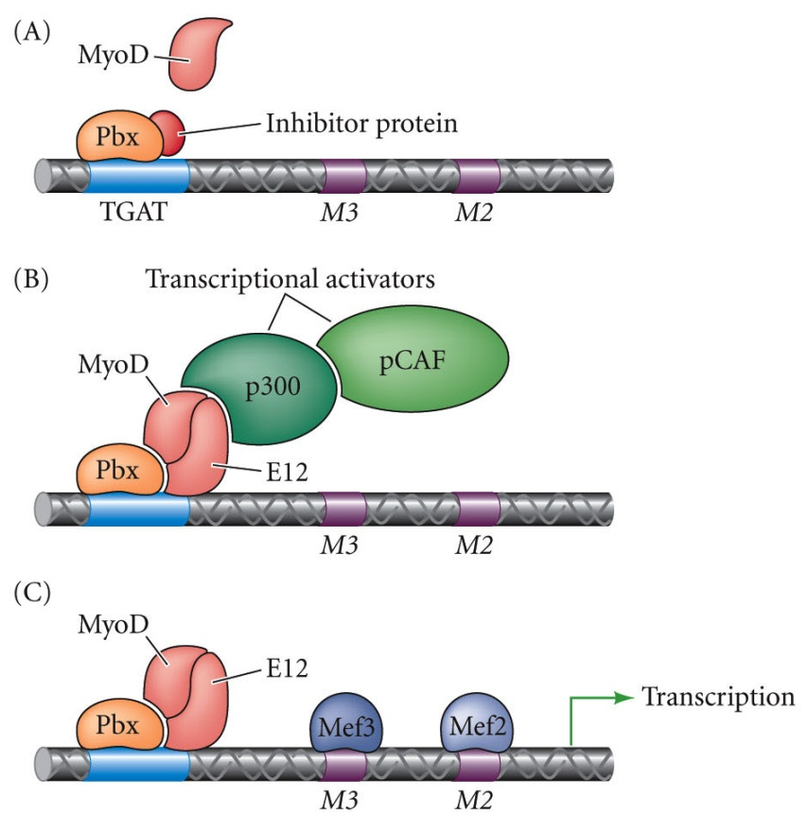
Pioneer Transcription Factors
Help txn factors find their binding sites when they’re covered by nucleosomes.
Bind and displace histones 3 +4
Pbx is made in every cell and acts as a beacon for MyoD (a muscle txn factor)
Pbx binds nucleosome covered sequences and recruits MyoD/E12.
E12 recruits other factors(histone acetyltransferases and chromatin remodeling complexes) which make the chromatin more accessible.
Notes:
devbio8e-fig-05-13-0.jpg

Slide 68
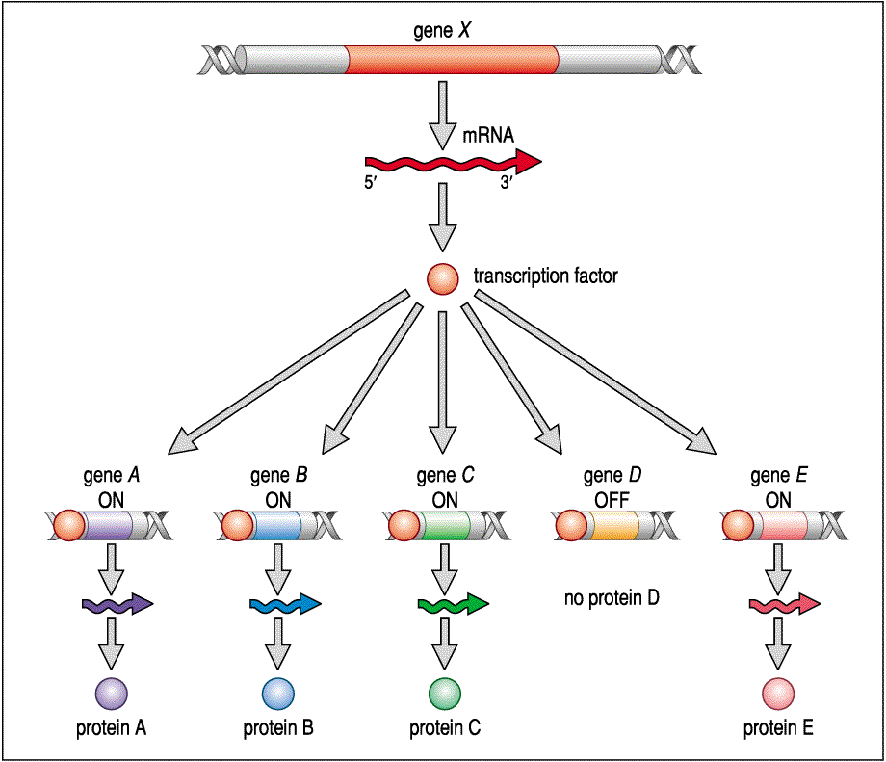
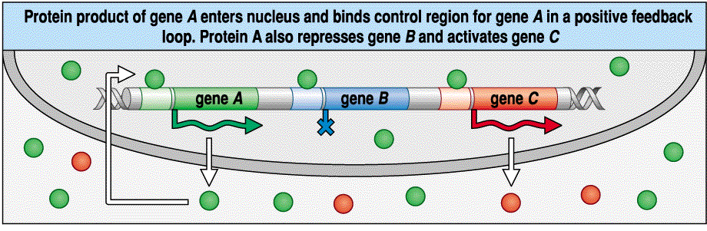
Transcription Factors Act on Many Genes

Slide 69
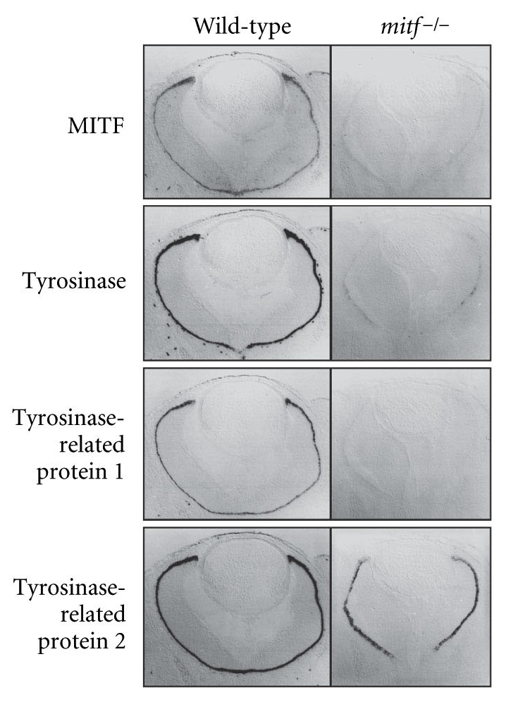
Transcription Factor Example 1: MITF
MITF(microphthalmia)
-Basic helix-loop-helix txn factor
-DNA binding domain binds CATGTG sequences in 3 the genes for three enzymes of the tyrosinase family.
-transactivating domain recuits p300/CBP a TAF/histone acetylase.
-protein-protein interaction domain helps form homodimers
-Active in ear and pigment forming cells in eye + skin.
-mutations in MITF cause microphthalmia, a syndrome of deafness, multicolored irises, and white forelock of hair.
Txn Factor
Txn Activated by MITF
Notes:
devbio8e-fig-05-09-0.jpg

Slide 70


Transcription Factor Example 2: Pax6
PAX6 DNA binding Domain
PAX6:
-Homeodomain txn factor
-Needed for mammalian eye, nervous system, and pancreas development
-Pax6 binds to its own promoter to continue its production after its been initiated.
-Protein interaction domain interacts with Sox2+Maf to activate crystallin
Intron 3
activator
Sp1=general txn activator
Sox2=specific to lens forming ectoderm
Repressor:
Prevents Crystallin in CNS
Notes:
devbio8e-fig-05-11-0.jpg

Slide 71

Transcription Factor Summary

Slide 72



Transcription Initiation Complex
Parts of Eukaryotic Promoter
Several txn factors
Txn initiation complex
Enhancers
Directionality?
RNA Pol
Transcription Factors
http://drtedwilliams.net/kb/index.php?pagename=Eukaryotic%20Transcription%20Initiation
http://www.cbs.dtu.dk/staff/dave/roanoke/genetics980408f.htm

Slide 73

Muticellular Organisms Contain Many Cell Types
Figure 1.1 Some Representative Differentiated Cell Types of the Vertebrate Body
Notes:
Machines roll off the assembly line ready to go. Animals must function BEFORE they are completed. Developmental Biology is centered on Becoming rather than Being. To Become, cells must differentiate.
Figures\Chapter01\DevBio7e01010.jpg

Slide 74

Muscle & Nerve Cells

Slide 75

Muscle and Nerve Cells: Closer Up

Slide 76
Planned Activities:
Review and reinforce questions (5 clicker questions)
Think-pair-share #1: identify 2 different cell types
compare and contrast
Pair-think-share: show two example cells, list macromolecules
Of these macromolecules which is the principal cause of
the cellular differences. Why?

