Slide 1
Gene Expression I
Becky Morrow
Tom Torello
Nancy Trun
Mary Ellen Wiltrout
Sarah Woodley

Slide 2
Context of our Teachable Tidbit
Sophomore level students with introductory Chemistry and Biology background.
Teaching Unit on Regulation of Gene Expression

Slide 3
Learning Objectives for the Tidbit

Slide 4
Are you:
  Female
  Male
  Prefer not to answer

Slide 5
Recall from previous lectures mammalian sex determination. Which of the following would lead to a male phenotype?
  XX
  XY
  XXY
  XO
  XYY

Slide 6
Some individuals have been found with an XX genotype, but a MALE phenotype. What could account for this?
Think-Pair-Share

Slide 7

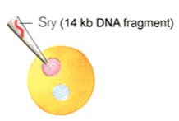
Sry
XX:Sry Male

Slide 8
Using the following data, determine which phenotype would be produced by each genotype.

Slide 9
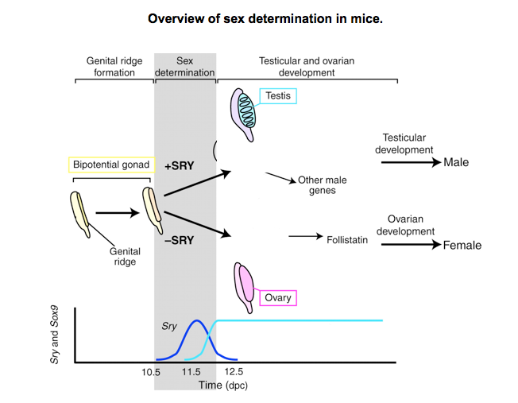
Sox9
Female
genes
Sry and Sox9
expression
Sox9

Slide 10
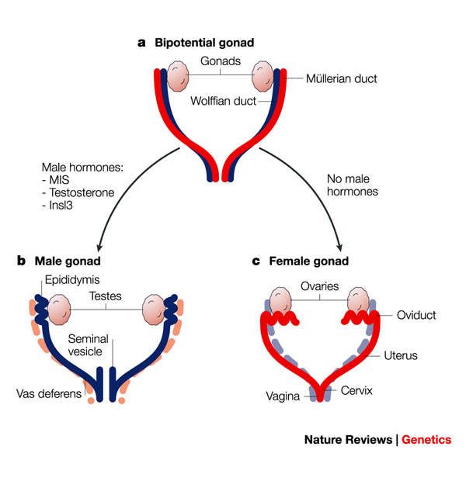

Slide 11
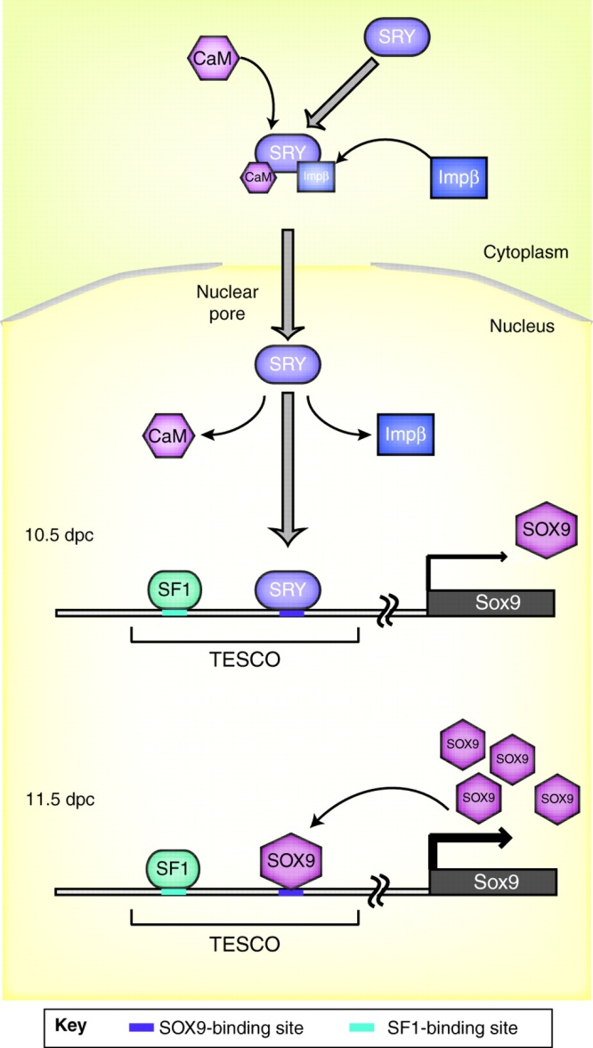
Teaching Gene Regulation with SRY
How SRY is regulated
post translational modifications
translocation into nucleus
other unknown mechanisms
How SRY regulates other genes
DNA binding
protein-DNA interactions
transcriptional regulation
Different categories of gene regulation
Strategies for gene regulation in
prokaryotes and eukaryotes
Evolutionary relationships
based genes & gene function
Placental mammals all have a similar
version of SRY
Cellular mechanism of SRY function.
Kashimada K , Koopman P Development 2010;137:3921-3930
Notes:
Cellular mechanism of SRY function. A schematic of the cellular mechanisms of SRY action. In the cytoplasm, SRY is bound by calmodulin (CaM) and importin β (Impβ), which recognize the N- and C-terminal nuclear localization signals (NLSs) on SRY, respectively, and recruit it to enter the nucleus. At 10.5 dpc, SRY and steroidogenic factor 1 (SF1) bind directly to specific sites (`TESCO', testis-specific enhancer of Sox9 core) that lie within the gonadal specific enhancer of Sox9 (indicated by the coloured regions on the DNA) and upregulate Sox9 expression cooperatively. At 11.5 dpc, after initiation of Sox9 expression, an auto-regulation system operates in which SOX9 also binds directly to TESCO with SF1 to prolong and amplify Sox9 expression. Abbreviations: SOX9, SRY box containing gene 9; SRY, sex-determining region on the chromosome Y.

Slide 12
Learning Objectives for the Tidbit
Students will understand the scientific process
Students will gain problem solving skills
Students will be able to transfer basic principles of gene expression to a new context
  Students will be able to categorize new examples into one or more of the four types of gene regulation based on presented data.

