Slide 1
GENE EXPRESSION I
Mehmet Candas
Xinqiang He
Susan Keenan
Judith Leatherman
Stephen Spiro
Ming Tian
Facilitator: Peggy Brickman

Slide 2
Group 1: Gene Expression I
Ribo-regulation:
controlling gene expression at the level of RNA
Gene expression can be regulated by multiple mechanisms that influence the activity of messenger RNA
This teachable unit will be presented to a student body consisting of majors at the junior/senior level, in the context of a course covering molecular mechanisms of gene regulation
The unit assumes that the students will have competency in genetics and molecular biology

Slide 3
Unit Learning Goals
Students will be able to describe examples of mechanisms of gene regulation involving mRNA localization, degradation, capping and tailing, splicing, editing, and by RNA interference
Outcome
Students will be able to discuss ribo-regulation in the context of gene regulatory mechanisms that operate at other levels of the central dogma.

Slide 4
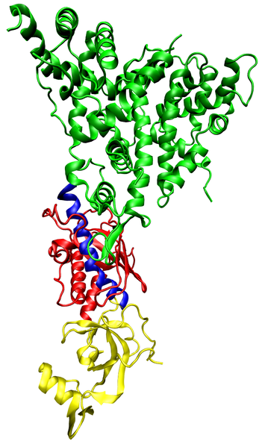
Tidbit
RNA interference
Learning Objectives
Students will describe the mechanism of RNAi
Students will evaluate and interpret research data
Students will evaluate the potential for RNAi-based therapeutics
Dicer
(Giardia intestinalis)

Slide 5
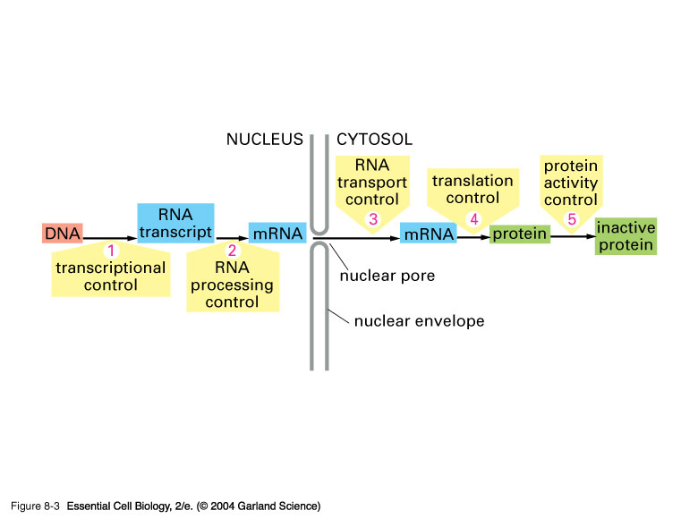
Brain storm:
How can the activity of a mRNA be regulated?

Slide 6
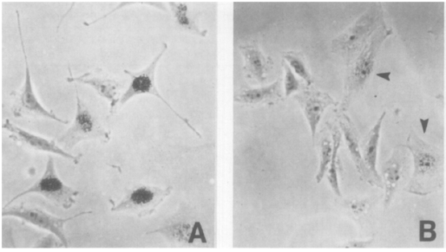
How can a specific mRNA in a cell be experimentally decreased?
Target mRNA
sense RNA
AAAAAAAAA
antisense RNA
Double-stranded RNA is specifically degraded by cell
Expression with antisense RNA
Normal expression
Izant and Weintraub, Cell 1984

Slide 7
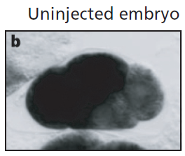

Fire and Mello experiments with C. elegans
(Fire et al. Nature 1998)
Uninjected
1. Inject purified antisense RNA
?
Clicker question:
What will happen to the mRNA level?
Increase
Decrease
Stay the same
mRNA
level
uninjected

Slide 8
Fire and Mello experiments with C. elegans
(Fire et al. Nature 1998)
Uninjected
1. Inject purified antisense RNA
Answer: B
What will happen to the mRNA level?
Increase
Decrease
Stay the same
mRNA
level
uninjected
Antisense RNA

Slide 9
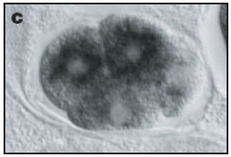
Fire and Mello experiments with C. elegans
(Fire et al. Nature 1998)
Uninjected
Antisense RNA
mRNA
level
uninjected
Antisense RNA

Slide 10

Fire and Mello experiments with C. elegans
(Fire et al. Nature 1998)
Uninjected
Antisense RNA
2. Inject double-stranded RNA
Clicker question:
What will happen to the mRNA level?
Increase
Decrease
Stay the same
mRNA
level
uninjected
Why did you answer as you did?

Slide 11
Fire and Mello experiments with C. elegans
(Fire et al. Nature 1998)
Uninjected
Antisense RNA
2. Inject double-stranded RNA
Answer: B
What will happen to the mRNA level?
Increase
Decrease
Stay the same
mRNA
level
uninjected
Antisense RNA

Slide 12
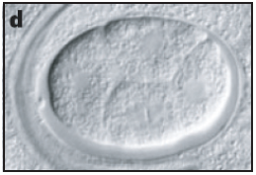
Fire and Mello experiments with C. elegans
(Fire et al. Nature 1998)
Double-stranded
RNA
Uninjected
Antisense RNA
mRNA
level
uninjected
Antisense RNA
Double-stranded RNA

Slide 13
2006 Nobel Prize in Medicine or Physiology
RNA Interference
A naturally occurring mechanism
Destruction of mRNA results in the post transcriptional inhibition of gene expression and the prevention of protein synthesis.

Slide 14
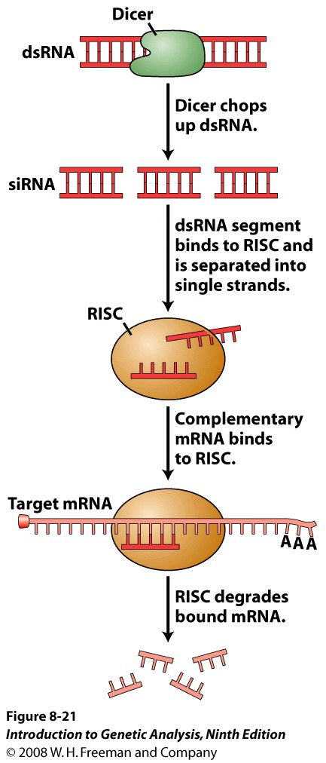
Mechanism of RNAi

Slide 15
Group Discussion
Which one of the following diseases is amenable to RNAi-based threapy?
    Lymphoma – overexpression of bcl2
    Cystic fibrosis – loss-of-function mutation of CFTR
    PKU – loss of enzyme to breakdown phenylalanine
What are the challenges and potential pitfalls in using RNAi-based therapies?

Slide 16
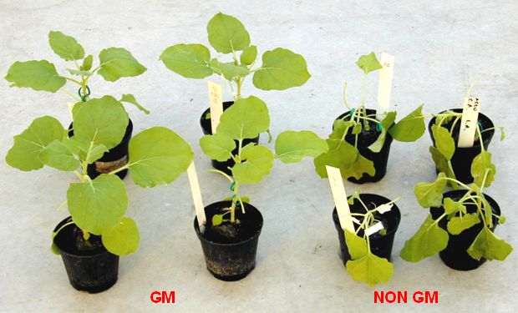
Homework: propose a mechanism for how the plant acquired resistance to the virus.
Genetically-modified (GM) plant expressing a portion of a virus genome is resistant to the virus.

Slide 17
Scientific Teaching
Active Learning
  Call out
  Clickers
  Group Discussion
Diversity
Assessment
Formative
  Clickers
  Discussion
Summative Assessment
  Homework
  Take home exam

