Slide 1
Structure and Function of the Mammalian Kidney
Tidbit: Grow the Gradient

Slide 2
Context
Intro Bio, Anatomy & Physiology, Toxicology, Pharmacology, any course covering the kidney
3, 50-minute sessions

Slide 3
Learning Goals
Students will understand structure and function of the mammalian kidney and how membrane transport processes are intrinsically integrated with kidney function.
Students will be able to associate the diversity in structure and function of the mammalian kidney in organisms that live in different habitats.
Students will elucidate the role of mammalian kidney in disease and toxicology.

Slide 4
Learning Goals
Students will understand structure and function of the mammalian kidney and how membrane transport processes are intrinsically integrated with kidney function.
Students will be able to associate the diversity in structure and function of the mammalian kidney in organisms that live in different habitats.
Students will elucidate the role of mammalian kidney in disease and toxicology.

Slide 5
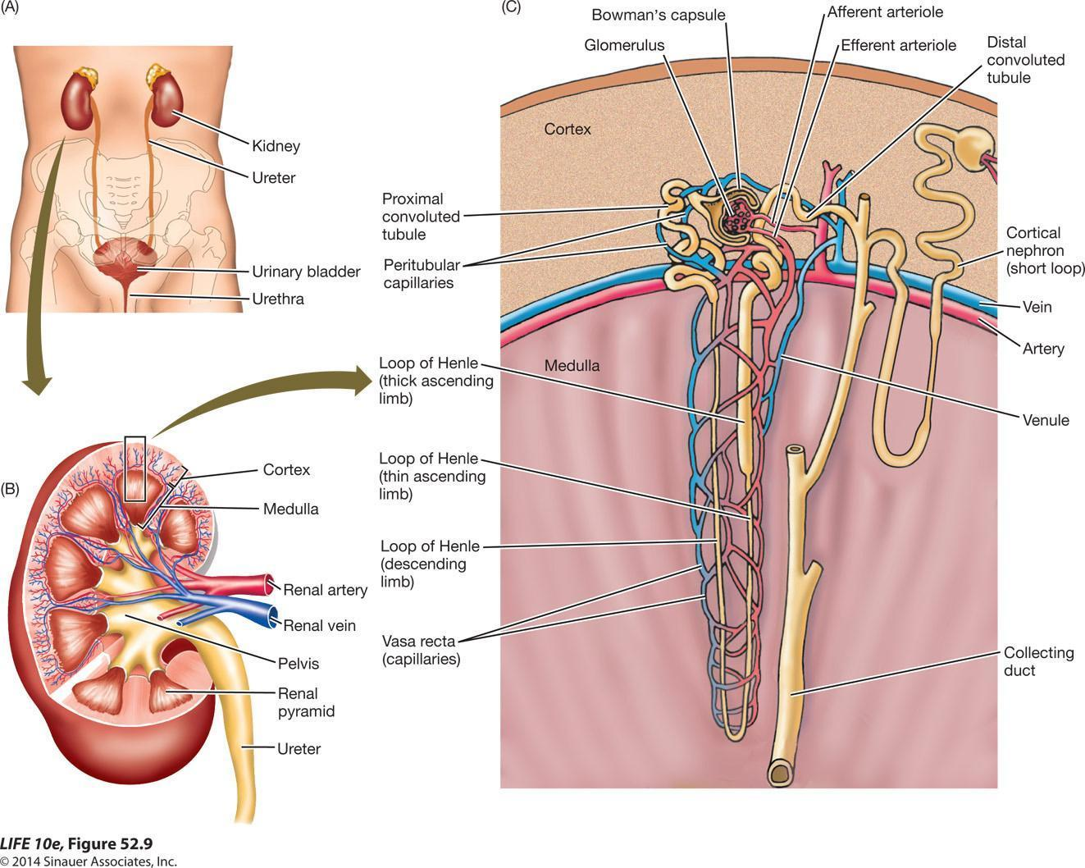
We chose this because…

Slide 6
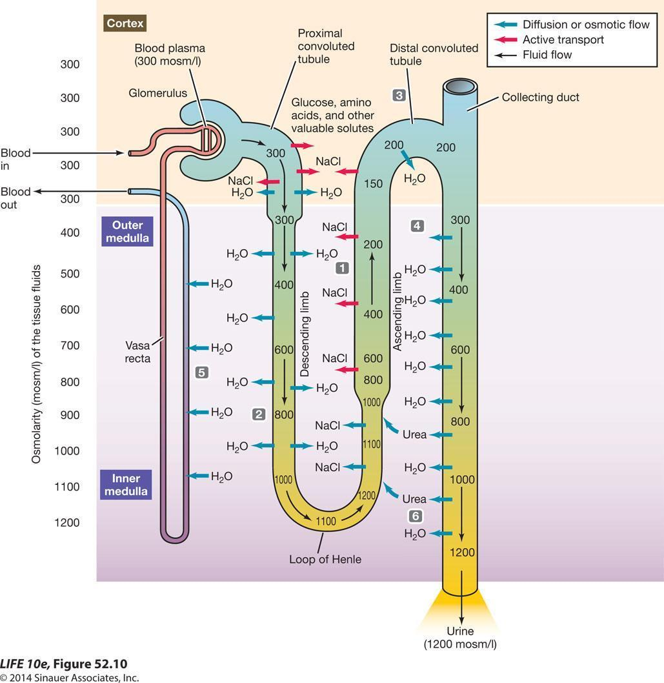
…and this…
Reabsorption:
100% Glucose
Most salts
No Urea
Urea reabsorption here only
Adds to medulla mosm/L
Loop of Henle:
Countercurrent Multiplier
NaCl and water reabsorption
Urine is more concentrated than blood

Slide 7
Learning Objectives
Simulate the movement of water and sodium at each region of the Loop of Henle
Associate osmosis and active transport with movement of water/solutes at each region of the Loop of Henle
Discuss how the descending and ascending limbs of the tubules maintain a concentration gradient
Predict the impact of the length of the Loop of Henle on the magnitude of the salt gradient
Predict the length of the Loop of Henle in organisms from different habitats

Slide 8
Students already can:
Define osmosis, active transport
Label the parts of a kidney
Label the parts of a nephron
We know they can because…

Slide 9
Pre-Assessment
Online pre-class quiz
OR
Clicker questions at beginning of class

Slide 10
Pre-Assessment
Questions to address:
osmosis
active transport

Slide 11
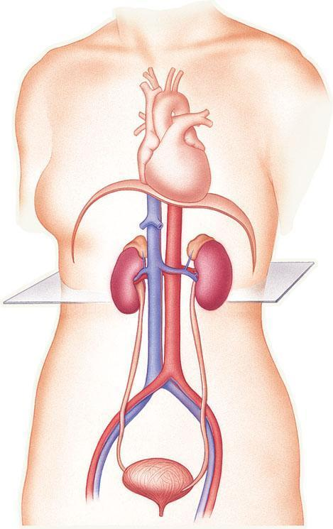
Macro-scale anatomy
Kidney (one of a pair)
Ureter (one of a pair)
Urinary Bladder
Urethra
Fig. 12-3a, p. 228

Slide 12
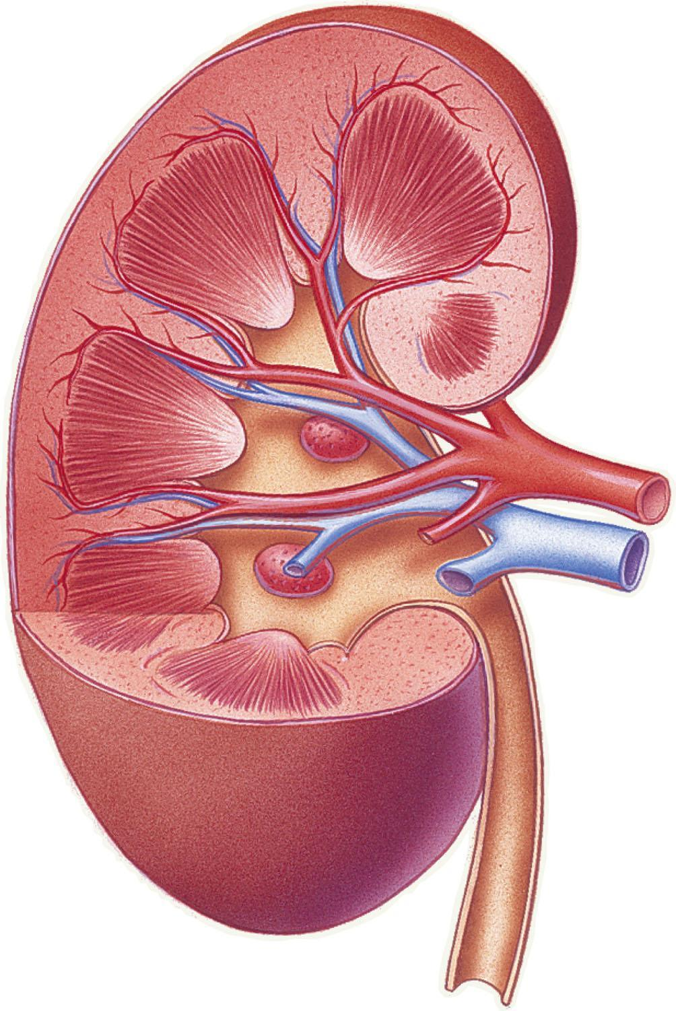
renal cortex
renal medulla
Kidney anatomy
renal artery
renal vein
renal capsule
renal pelvis
ureter

Slide 13
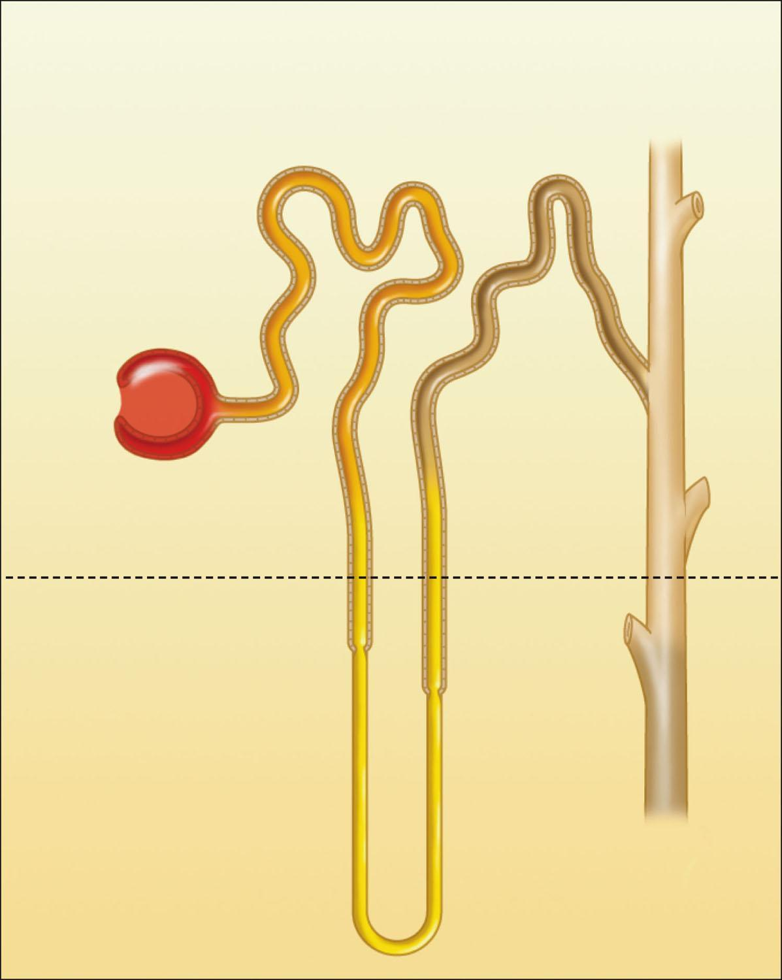
Nephron anatomy
Bowman’s capsule
proximal tubule
distal
tubule
KIDNEY CORTEX
KIDNEY MEDULLA
loop of Henle
collecting
duct

Slide 14
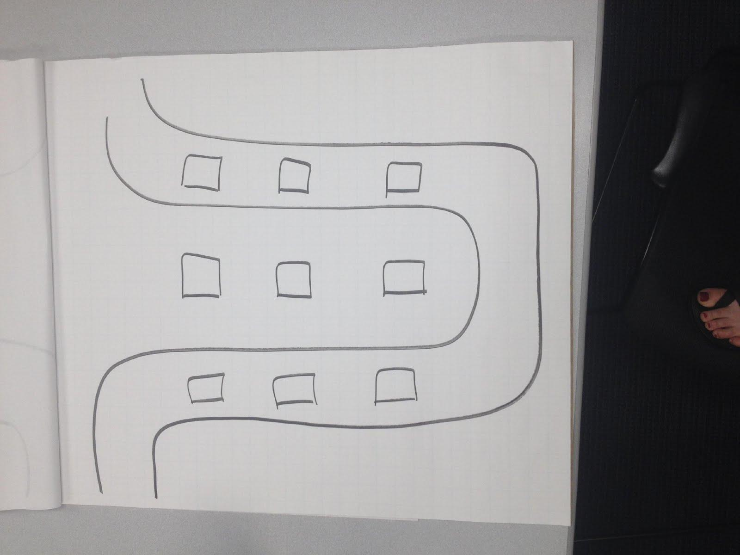
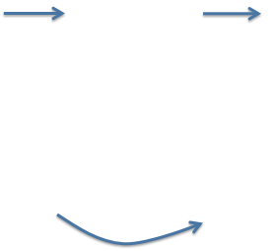
Final labeling question on pre-assessment
Loop of Henle
From proximal tubule
filtrate
Interstitial fluid
To distal tubule and collecting duct
Descending limb
Ascending limb

Slide 15
Example of an Animation of Filtrate Flow and Membrane Transport Processes

Slide 16
Your game board looks like:
From proximal tubule
filtrate
Interstitial fluid
To distal tubule and collecting duct
Descending limb:
Water permeable only
Ascending limb:
Water IMpermeable
Na Active Transport

Slide 17
Teaching Tidbit

Slide 18
Grow the Gradient
Your team’s job:
Use appropriate transport processes to establish a concentration gradient in the kidney
Follow along as we familiarize you with the rules.
Check in at each stopping point to make sure you are on the right track.

Slide 19
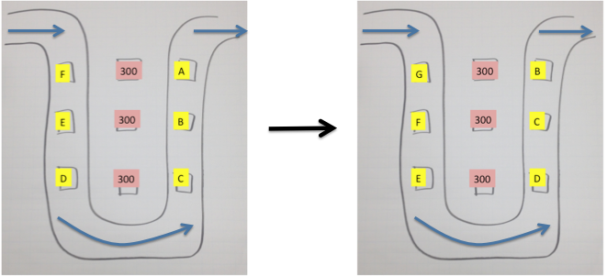
Filtrate Pump
Rule 1: Move Filtrate 1 space

Slide 20
Filtrate Pump
Rule 1: Move 1 space; Rule 2: Check Diagram!
300
300
300
300
300
300
300
300
300
1

Slide 21
Membrane Transport: sodium and water
Rules 3 and 4
400
400
200
400
400
200
400
400
200
Is there a gradient in the interstitial fluid?
1

Slide 22
Filtrate Pump
Rules 1 and 2
300
300
200
400
400
200
400
400
400
2

Slide 23
Membrane Transport: sodium and water
Rules 3 and 4
350
350
150
400
400
200
500
500
300
Is there a gradient in the interstitial fluid?
2

Slide 24
What would happen to the concentration gradient if you continued the “game”?
350
350
150
400
400
200
500
500
300
2

Slide 25
Na gradient
300
600
1200

Slide 26
Loop of Henle and Water Conservation
B.
A.
Predict which Loop of Henle, A or B, would establish the largest concentration gradient in the interstitial tissue?

Slide 27
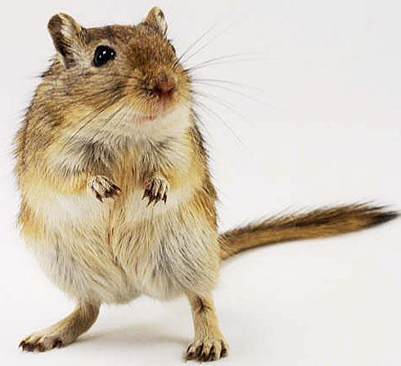
Loop of Henle and Water Conservation
?
B.
A.
Predict which Loop of Henle, A or B, belongs to a desert rat?

Slide 28
Other Post-Assessment
Label the game board with:
osmosis, sodium transport pump, direction of water and sodium movement
Write a reflection
Use strip sequence to order the steps that occur in the Loop of Henle

Slide 29
Diversity/Inclusion
Group activity
Students of different backgrounds, genders, experience, etc working together
Peer – peer instruction
Facilitate learning in those that learn best in different modalities:
reading, verbal, visual, kinesthetic

Slide 30
Learning Objectives
Simulate the movement of water and sodium at each region of the Loop of Henle
Associate osmosis and active transport with movement of water/solutes at each region of the Loop of Henle
Discuss how the descending and ascending limbs of the tubules maintain a concentration gradient
Predict the impact of the length of the Loop of Henle on the magnitude of the salt gradient
Predict the length of the Loop of Henle in organisms from different habitats
Notes:
These are specifically addressed by our activity

Slide 31
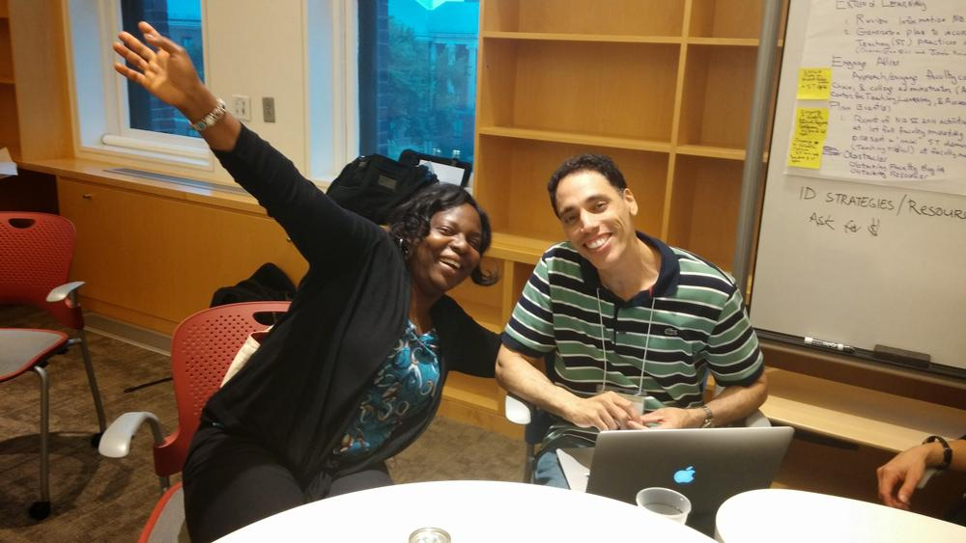
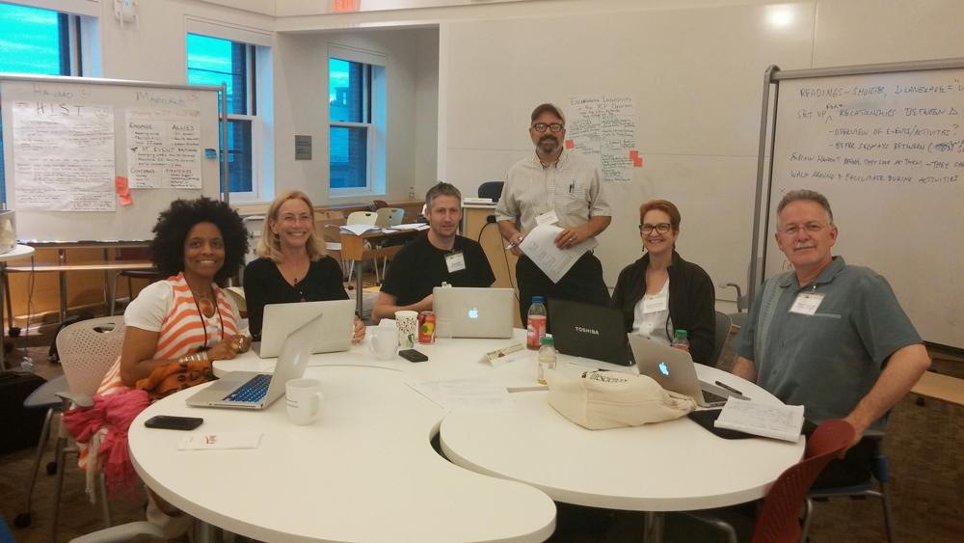
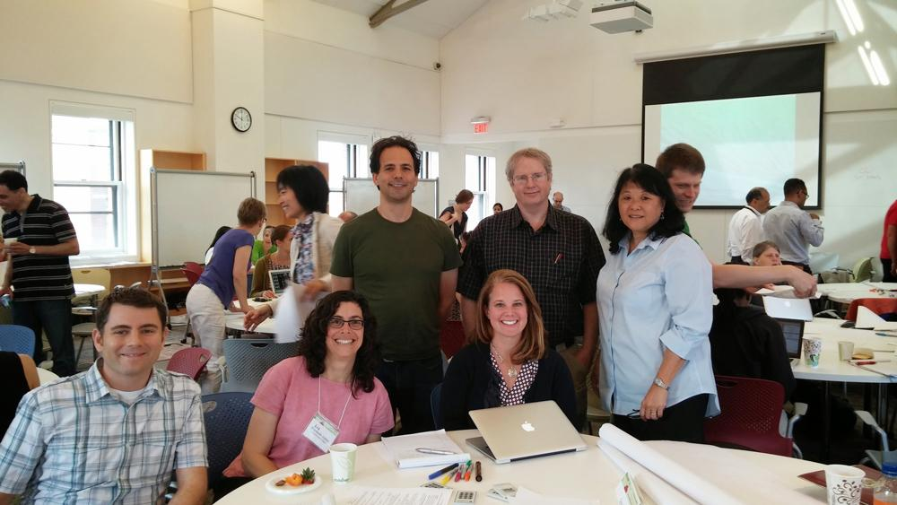
Thank you!
Nike and Christov
Group 4
Group 7

