Slide 1
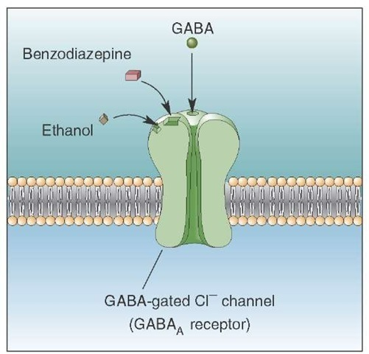
How Alcohol Enhances Inhibitory Actions of GABA Neurotransmission
Agonist
(+)
Jackie
Notes:
r-aminobutyrate

Slide 2
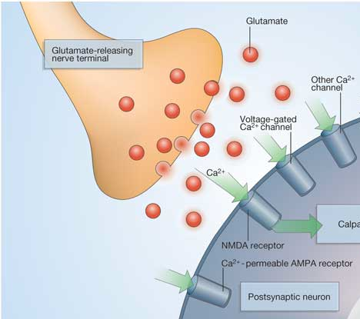
How Alcohol Reduces The Excitatory Actions of Glutamate Neurotransmission
Antagonist
(-)
Alcohol
Jackie

Slide 3
Alcohol + “downers” = ???
Xanax
Jackie
Notes:
r-aminobutyrate

Slide 4
Summative
*
Jackie

