Slide 1
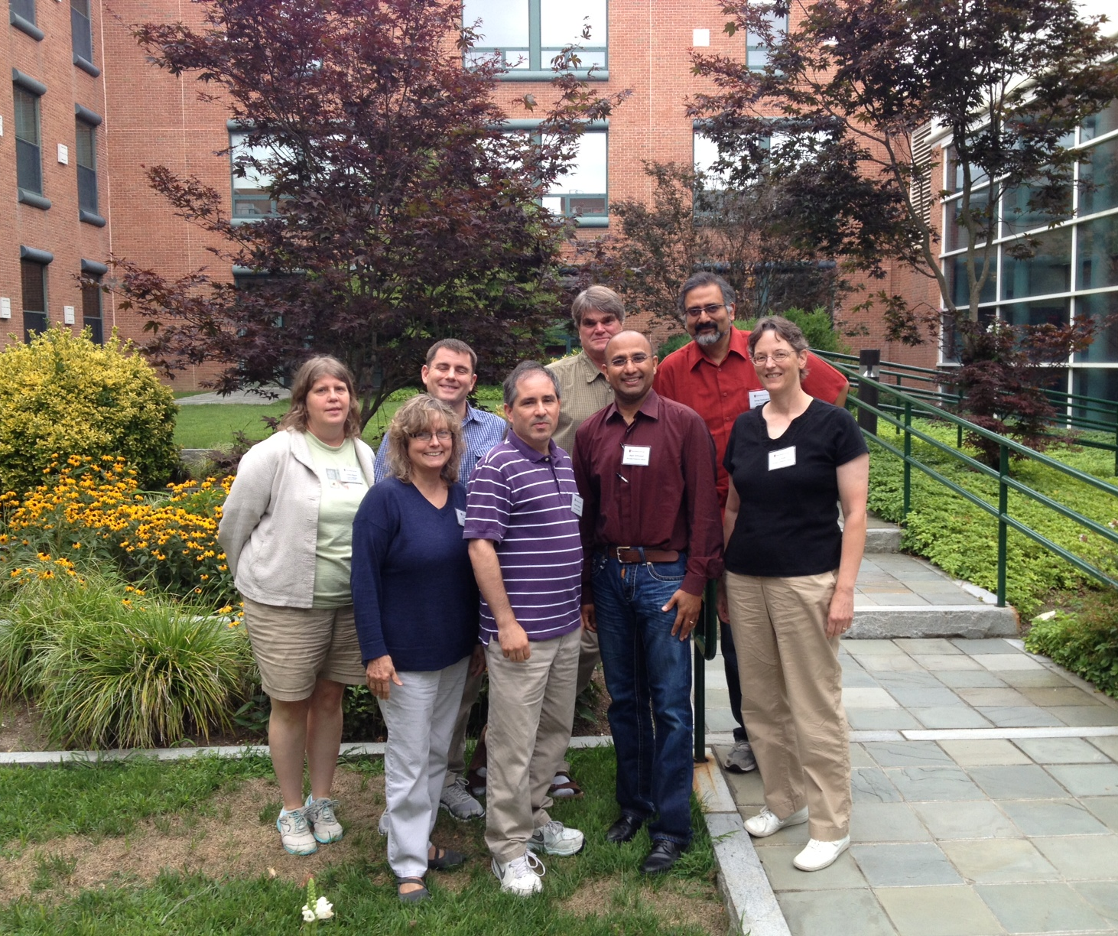
Unit Title: Excitable Cells Tidbit Title: Understanding membrane potential
Howard Sirotkin, Abhay Deshpande: Stony Brook University
Thomas Abbott, Kristen Kimball: UCONN
Jagan Srinivasan, Elizabeth Ryder: WPI
Neurobiology & Physiology Group
Northeast Summer Institute
Stony Brook University 2013
Facilitators:
Thomas Torello, Harvard University
Cynthia Wagner, UMBC

Slide 2
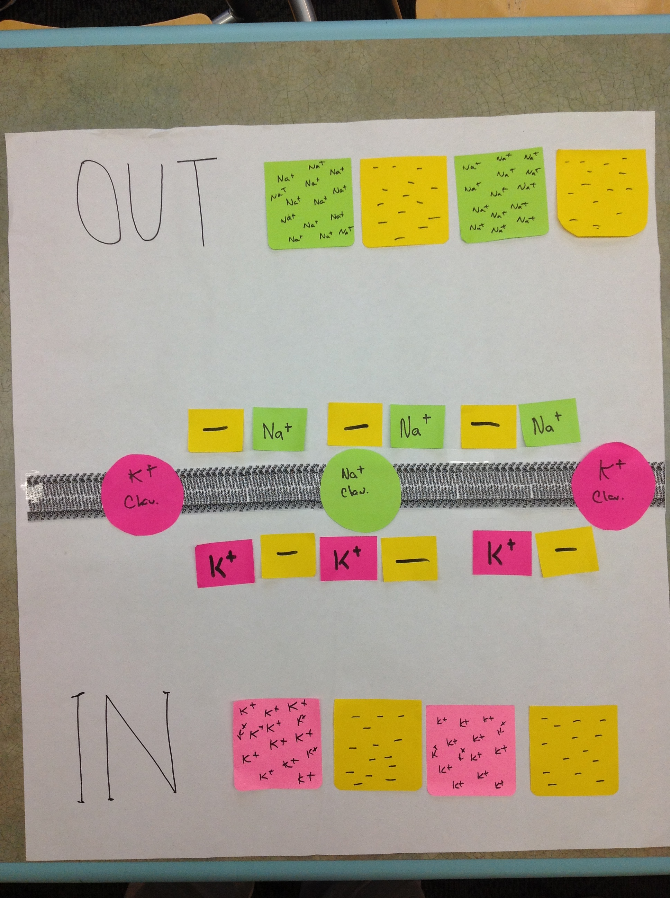
For the Instructor: Components of the Activity Sheet

Slide 3
Materials required for this activity:
A large sheet of white paper (approximately 3’ x 4’). Note: this entire activity can be done with smaller activity boards.
Sticky notes (3 colors) and sizes (small and large).
Prepare the activity boards:
Draw a representation of the phospholipid bilayer on the white paper across the long axis (“landscape mode”). The bilayer should divide the paper in half.
Using small stickies, prepare sticky note “ions” (Na+ and K+). These individual ions represent the ions that can move across the membrane to establish the electrical gradient). One color sticky will be K+ ions, the other will be Na+ ions (e.g. pink stickies for K+ ions and green stickies Na+ ions). Label the sticky notes (6-10 per activity board).
Using larger stickies, prepare “pools” of immovable K+ and Na+ ions (these represent the intracellular and extracellular excess concentrations of ions that maintain the chemical concentration). Ensure that the color is consistent between the big and small stickies (e.g. pink stickies for K+ ions and green stickies Na+ ions).
Using the third color stickies, label the small stickies ‘-’, and the large stickies will be ‘pools’ of – charges. These ‘-’ charges are kept deliberately vague, as they might represent Cl-, or other larger anions.
Using larger stickies, prepare Na+ and K+ channels. Ensure that the color is consistent between the big and small stickies (e.g. pink stickies for K+ channels and green stickies Na+ channels).

Slide 4
Context of our tidbit
Introductory Biology Course /Applications of Physics to Biology
Beginning of a Neurophysiology Section of a advanced Animal Physiology course
Students are already familiar with:
Cell membrane structure and function
The chemical and structural nature of neurons

Slide 5
Tidbit: Understanding Membrane Potential
Goals for the Tidbit:
To understand membrane potential, how it is generated and why it matters
To recognize the interdisciplinary nature of neurobiology

Slide 6
Objectives for the tidbit
Students will be able to diagram how chemical and electrical gradients generate membrane potential

Slide 7
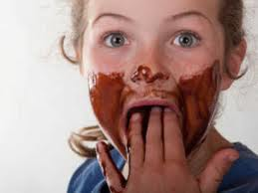
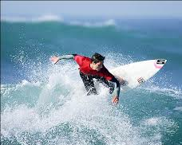
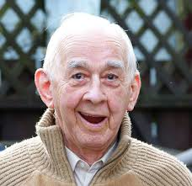
Notes:
Soooooooooooo!!!!! Why do we need excitable cells? They allow us to do all the things we see in this picture: taste, sing, jump, surf, scream… even fall in love. Let’s take a closer look…

Slide 8
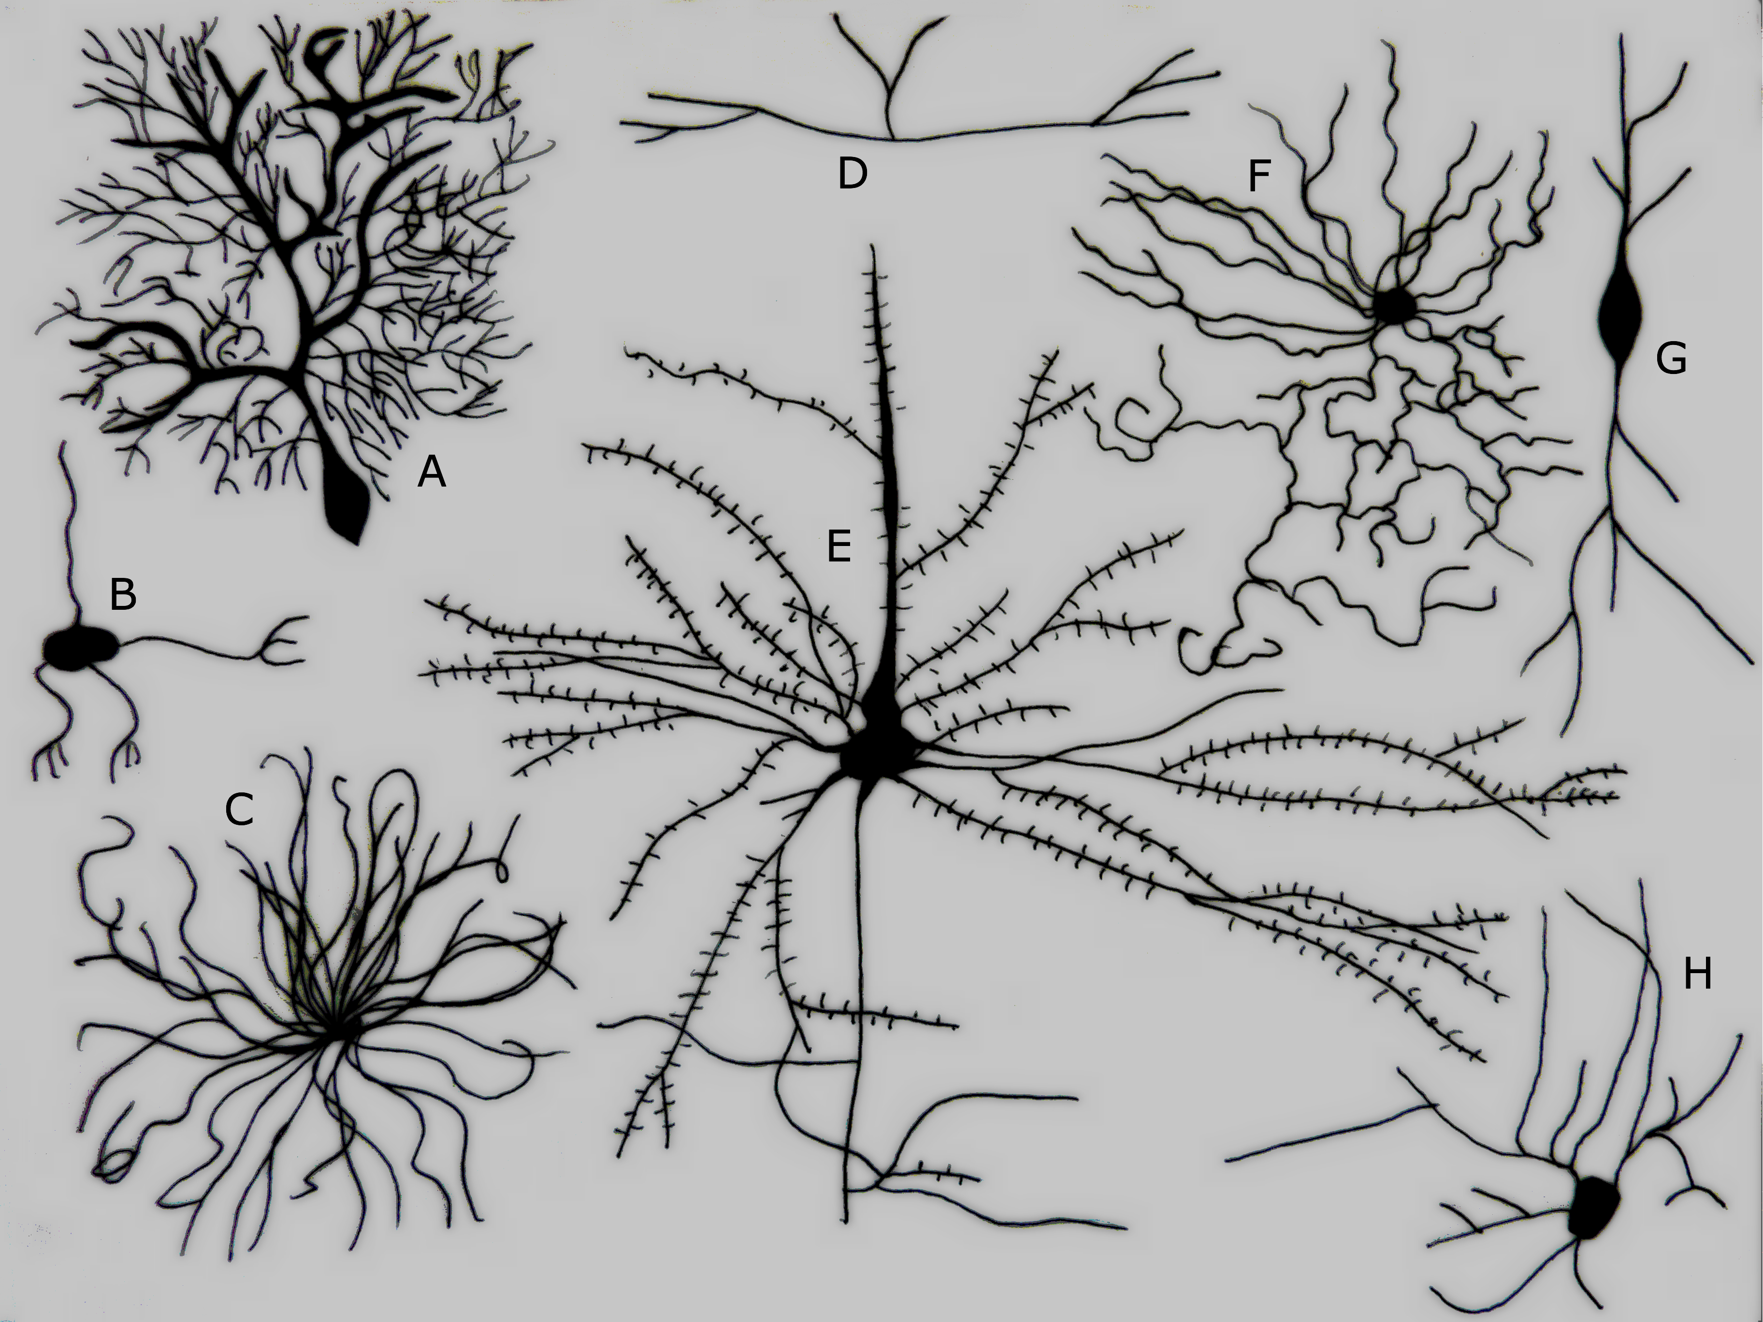
Different activities require different
types of neurons…
….but all neurons need to have a baseline resting potential in order to be excitable.
Notes:
So today you are going to discover how that baseline resting potential is generated.

Slide 9
From your pretest…
Which of the following describes the ion concentrations in a typical neuron?
A) [Na+] high inside, [K+] high inside
B) [Na+] high outside, [K+] high outside
C) [Na+] high inside, [K+] high outside
D) [Na+] high outside, [K+] high inside
Notes:
From your pre-test… (D is correct)

Slide 10
Set up your activity sheet using what you know about the cell

Slide 11
Na+
OUT
Na+
Na+
Na+
Na+
Na+
Na+
Na+
Na+
Na+
Na+
K+
K+
K+
K+
K+
K+
K+
IN
K+
K+
K+
K+
Notes:
Your sheet should look something like this. This is a MODEL of a simple cell membrane – note you have a phospholipid bilayer, you have more Na outside and more K inside. We have some Na and K ions lined up at the membrane. The large boxes of ions are meant to remind us that there are large reservoirs of Na and K ions and anions outside and inside the cell. The anions are left vague purposely, because they can include many types of anions, such as Cl- and proteins.

Slide 12
Membrane Potential
The potential difference across the membrane, or membrane potential (Vm), is simply the difference in charge between the inside of the cell and the outside of the cell.
Potential difference is measured in volts; for cells the difference is thousandths of a volt, therefore "millivolt“ (mV) is the unit.
By convention, we state the membrane potential as INSIDE relative to OUTSIDE the membrane. Thus, if Vm = -50 mV, the inside of the cell is more negatively charged than the outside.

Slide 13
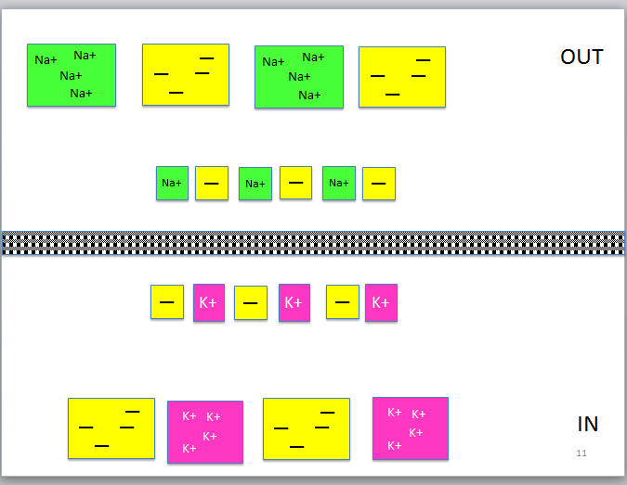
What is the membrane potential (Vm) across this membrane?
< 0 mV (more negative inside)
0 mV (neutral)
> 0 mV (more positive inside)
Notes:
B is correct – charges are equal on both sides of the membrane.

Slide 14
What could you do to change the Vm?
Notes:
Get students to say: Move charges.
Now ask: Can THIS membrane transport ions? Get them to say, ‘No, we need CHANNELS.’
Provide the channels in an envelope with the activity sheet, or get T.A.s to hand them out at this point.

Slide 15
Na+
OUT
Na+
Na+
Na+
Na+
Na+
Na+
Na+
Na+
Na+
Na+
K+
K+
K+
K+
K+
K+
K+
K⁺ Leak channels
K+
K+
K+
K+
K+
IN
K+
K+
K+
Notes:
Let’s add K+ channels to the membrane. These are ‘leak’ channels, which are always open – they don’t require any voltage or ligand to open.

Slide 16
OUT
Let’s start by considering only the K+ ions.
K+
K+
K+
K+
K+
K+
K+
K⁺ Leak channels
What happens now ??
K+
K+
K+
K+
K+
IN
K+
K+
K+
Notes:
Get them to play with their activity sheets in their groups for a minute.

Slide 17
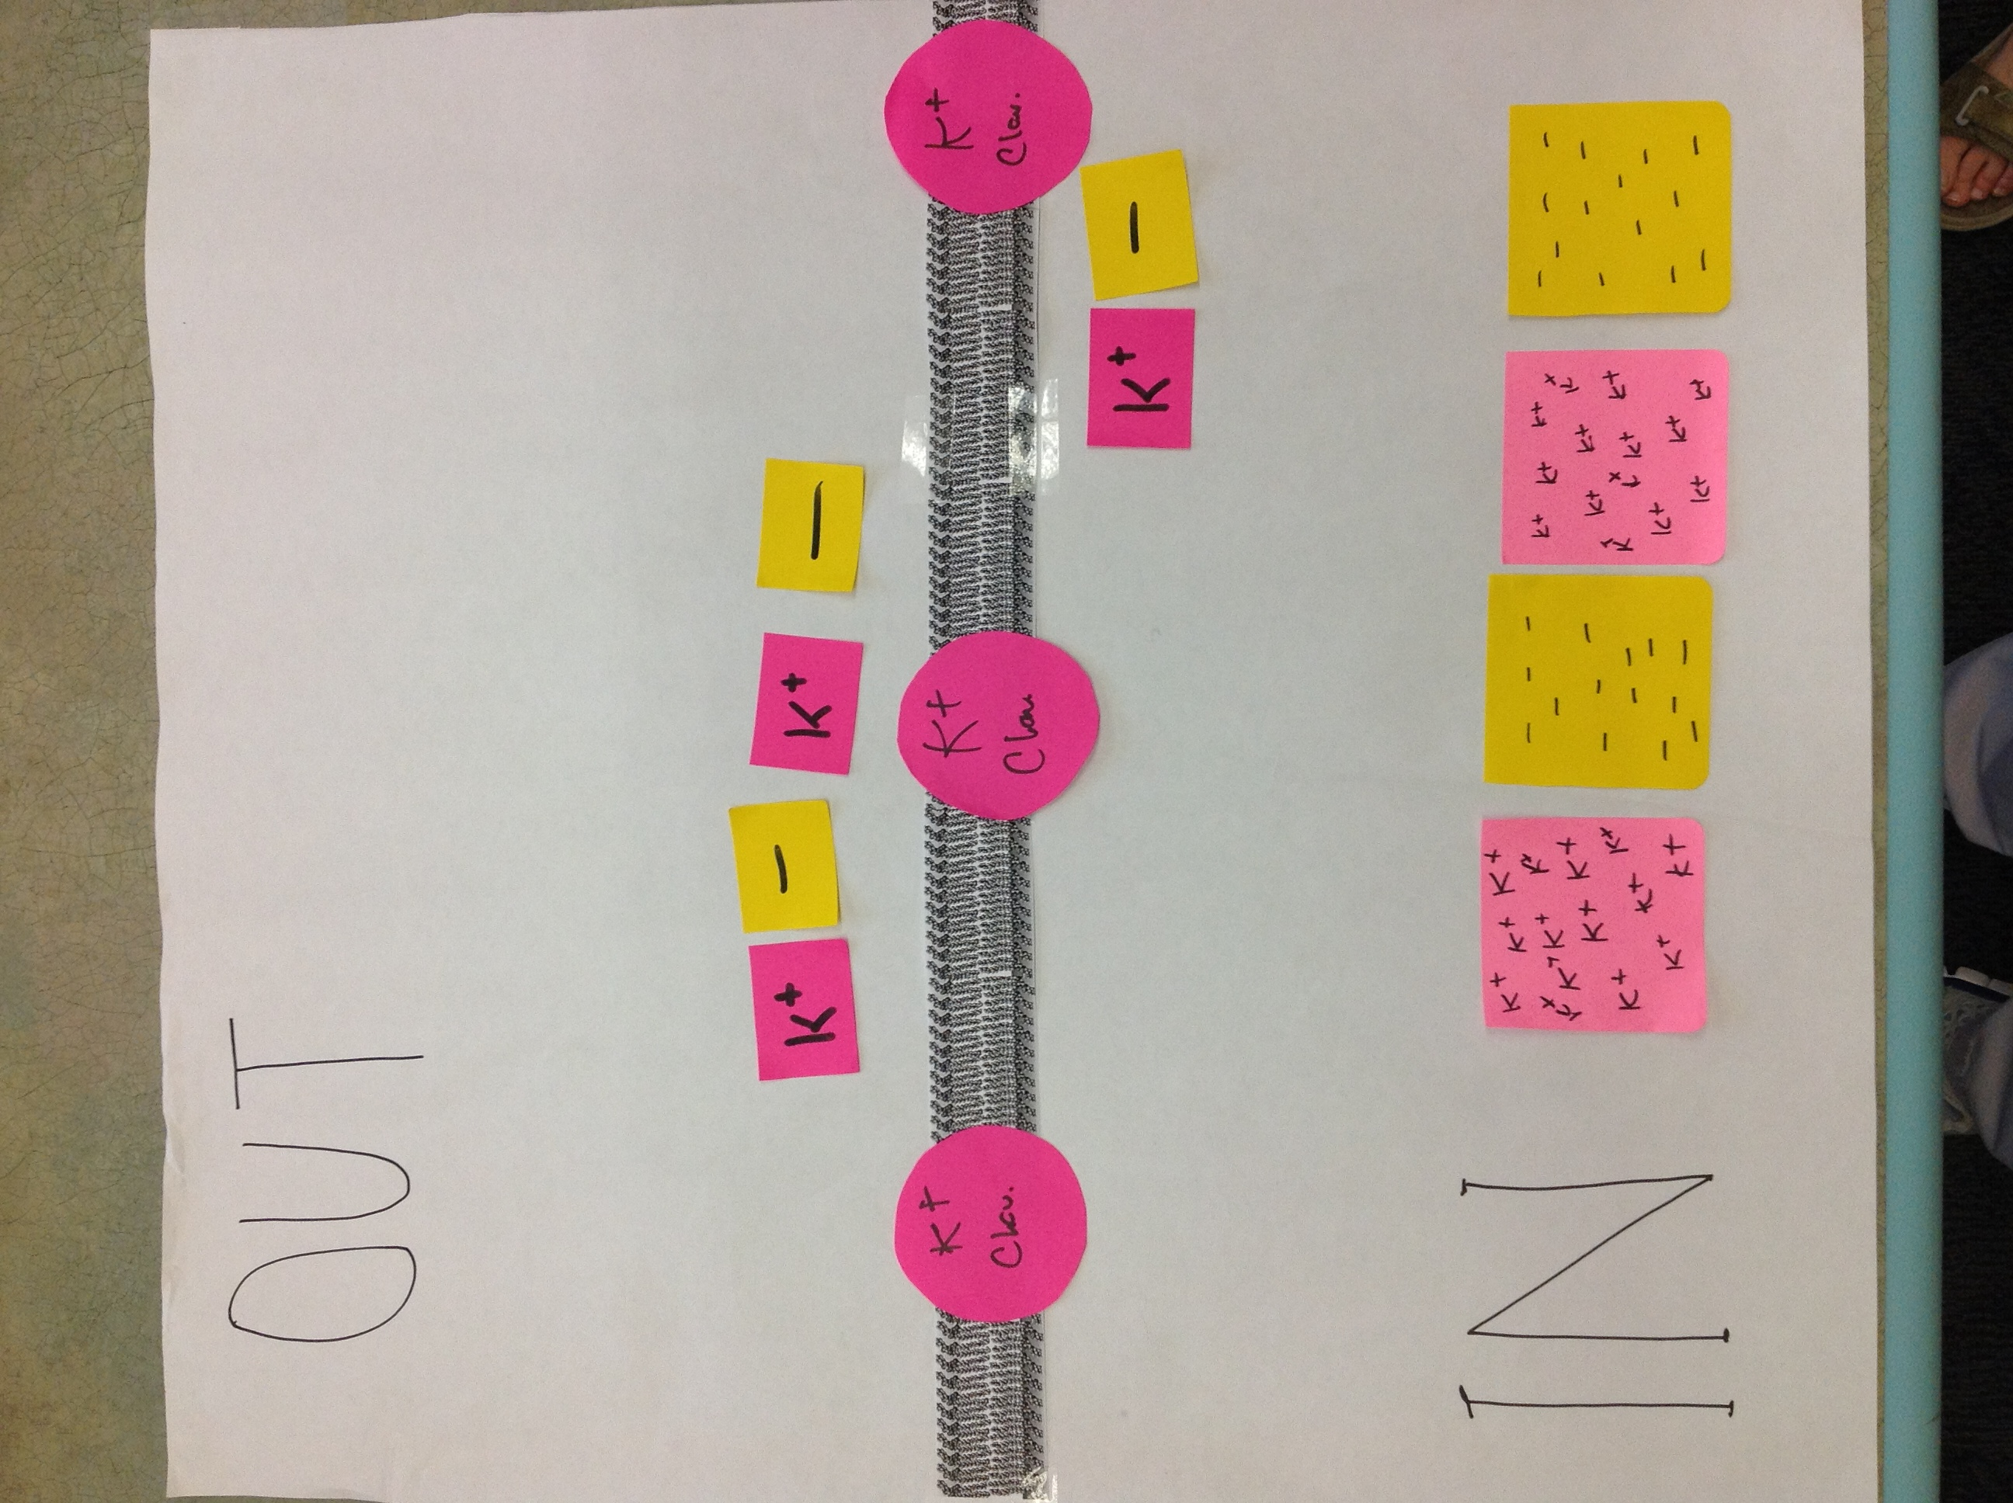
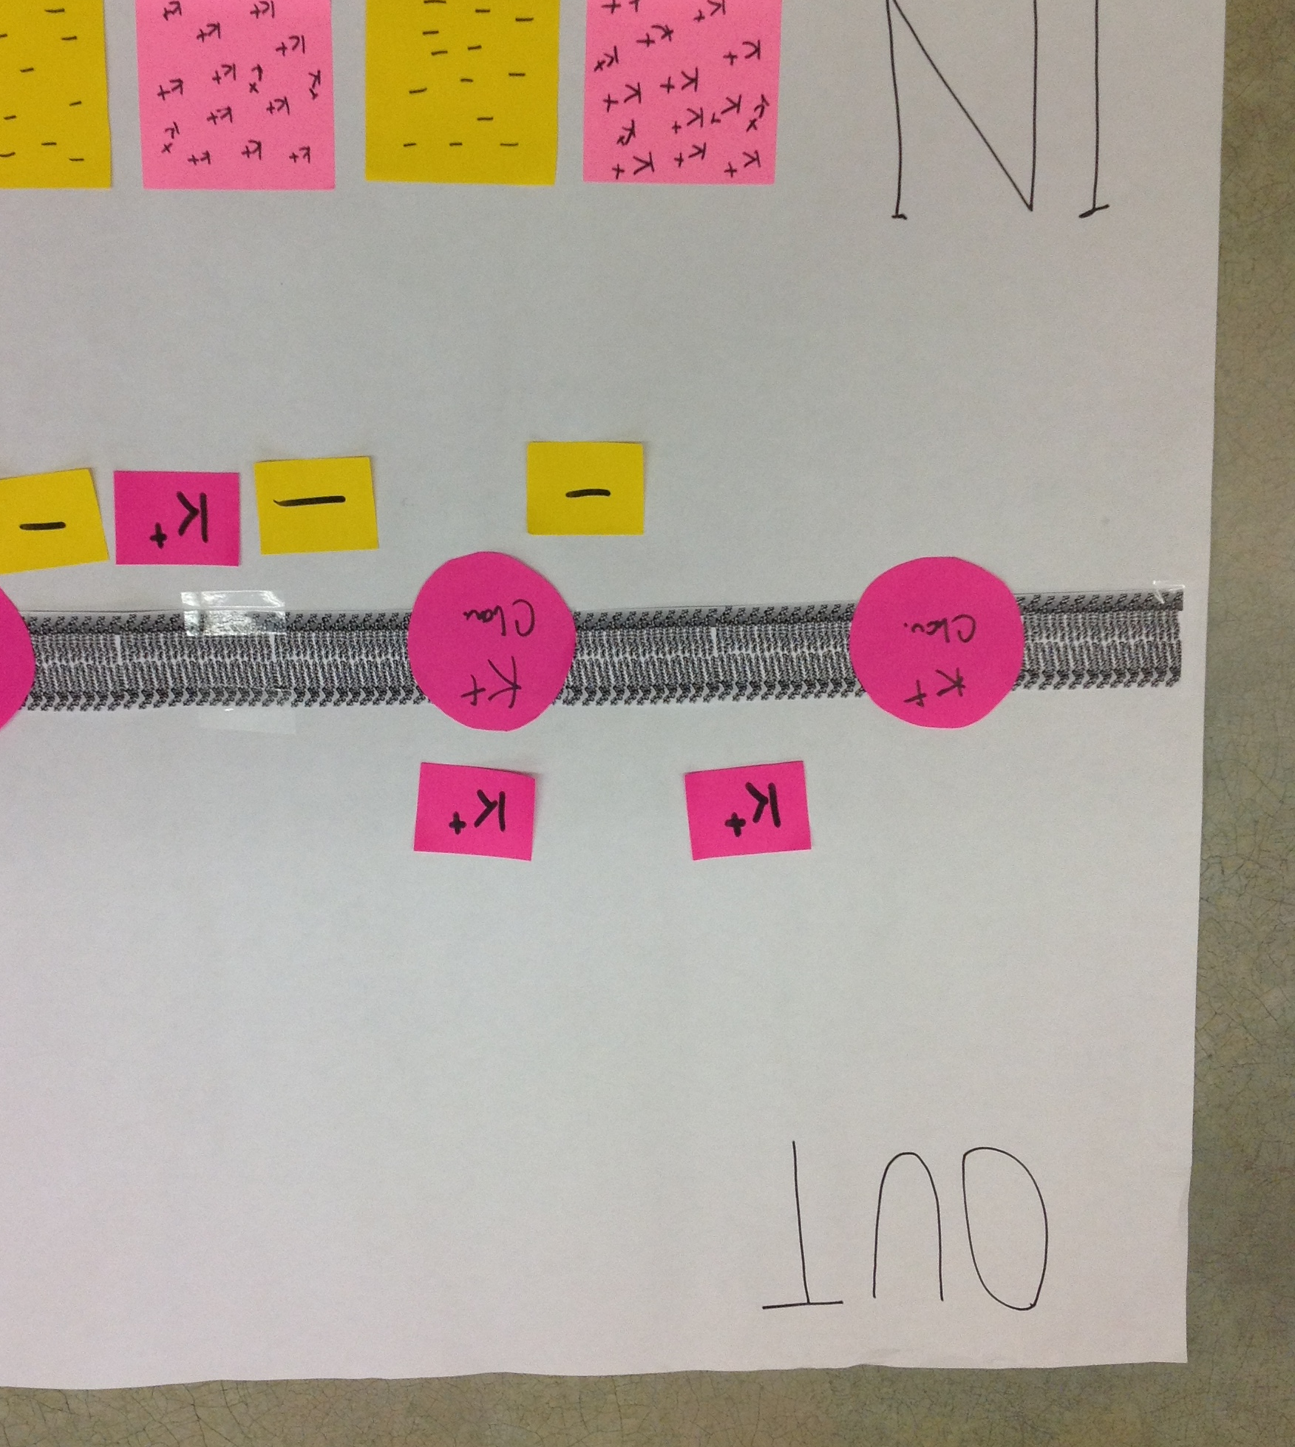
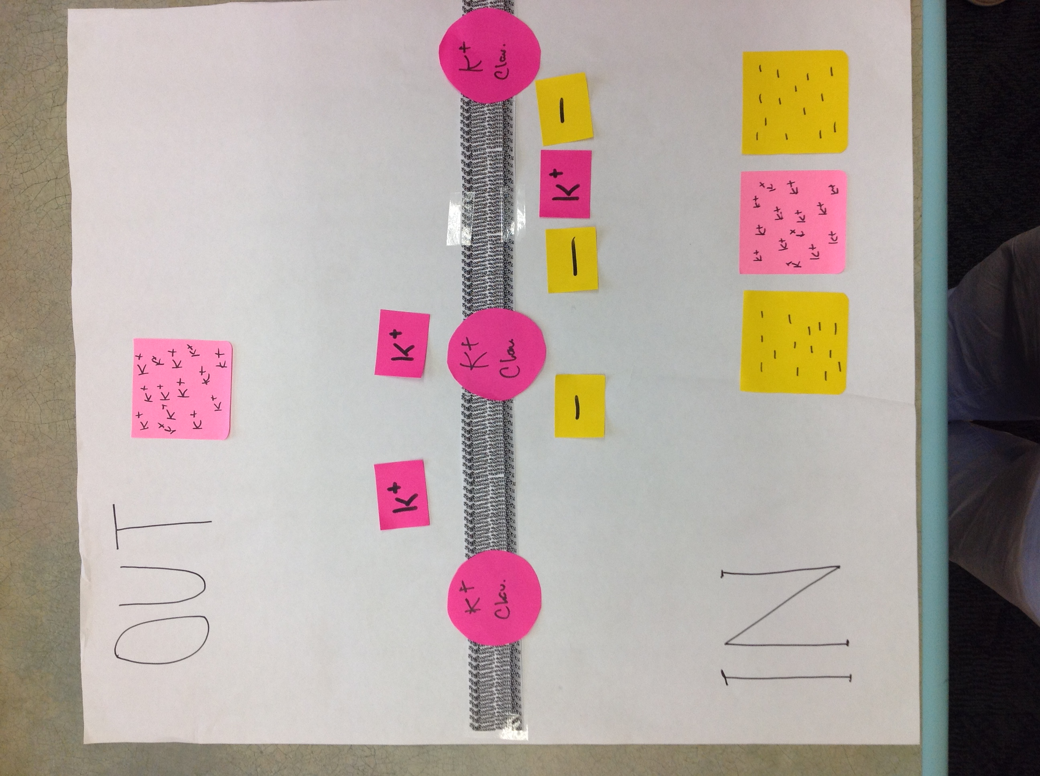
Which of these pictures is the best representation of what happens?
A
B
C
No anion channels in membrane
Tiny numbers of K+ cross membrane
Notes:
Go through the answers with the students, perhaps having them defend different choices. B is correct. A is a misconception – negative ions will not go outside, because there are no anion channels in the membrane, and also there is no gradient pushing them outside. (Remind them that we have equal numbers of negative charges on both sides of the membrane, although we are only focusing on inside of cell at the moment.) C is a misconception – only a small number of K+ ions will cross the membrane, because there will be an electrical force ‘pushing’ them back inside the cell. The overall concentration gradient does not change appreciably. The exact number of ions that cross in B is not important for now – we’ll talk about how the numbers are calculated next class. Once the students have decided on B, try to get them to say how they knew the K+ ions would stop flowing – due to the electrical gradient that is now established that is ‘pulling’ K+ ions back in.

Slide 18
CHEMICAL force driving K+ out of the cell is equal to ELECTRICAL force driving K+ into the cell.
This membrane potential is called the equilibrium potential for K+, or E_{K}.
Vm = E_{K} when only K+ ion channels are present.
Are K+ ions still moving?
Notes:
Instructor could say, “later you will learn to use the Nernst Equation to quantitatively predict the value of the equilibrium potential, given the K concentrations on either side of the cell.”
Yes, K+ ions are still moving. The same number of K+ ions are moving out, down the chemical gradient, and in, down the electrical gradient. Net K+ current is 0.
If there are still questions from students, go back and remind them:
We started from neutral (first “exercise” was to determine that in the initial case, there was no potential difference across membrane, thus membrane potential was zero.) Then we added the K channels.
Remind them that at first, net diffusion of K+ would start to establish negative inside membrane potential (Vm). But, excess negative charge inside represents a force pulling K+ back in. NET diffusion of K from inside to outside stopped when the electrical force pulling K+ back in was great enough to exactly counterbalance the chemical (concentration difference) force pushing K+ out. At that point, we are at E_{K}.

Slide 19
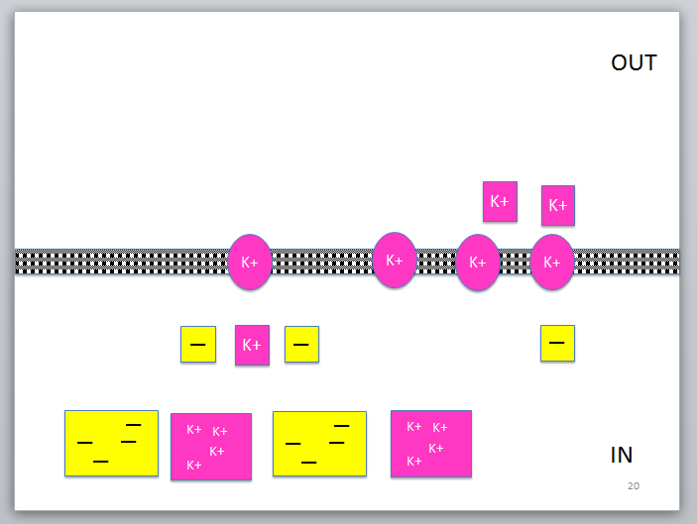
So, what is the Vm across this membrane?
< 0 mV (more negative inside)
0 mV (Neutral)
> 0 mV (more positive inside)
Notes:
A is correct.

Slide 20
Na+
OUT
Na+
Na+
Na+
Na+
Na+
Na+
Na+
Now let’s look at Na+ ions.
Na+
Na+
Na+
Na+
Na+
Na+
Na+
Na⁺ Leak channels
What happens now ??
IN
Notes:
Get them to move ions on their boards, and then vote with next slide.

Slide 21
What is the Vm across this membrane?
< 0 mV (more negative inside)
0 mV (neutral)
> 0 mV (more positive inside)
Notes:
They should move their Na+ ions inside the cell, and realize that C. is the correct answer.

Slide 22
Na+
OUT
Na+
Na+
Na+
Na+
Na+
Na+
Na+
Na+
Na+
Na+
Na+
Na+
Na+
Na+
Does your sheet look something like this?
When only Na+ channels are open in the membrane,
Vm = ????
IN
Notes:
Just to check that they have done the right thing.
Vm = E_{Na} in this situation. Hopefully someone in the class will call this out.

Slide 23
Now let’s look at a slightly more realistic representation of the resting neuron, incorporating both K+ and Na+ ions and channels

Slide 24
Na+
OUT
Na+
Na+
Na+
Na+
Na+
Na+
Na+
Na+
Na+
Na+
K+
Na+
K+
K+
K+
K+
K+
K+
What happens now ??
K+
K+
K+
K+
K+
K+
IN
K+
K+
Notes:
Now we set up the activity sheet so that we are looking at both types of ions, and there are both kinds of ion channels in the membrane. There are many more K+ than Na+ channels; in a real cell, the ratio is even higher.

Slide 25
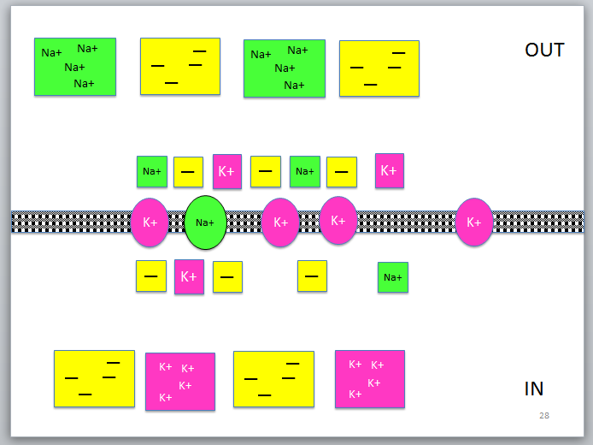
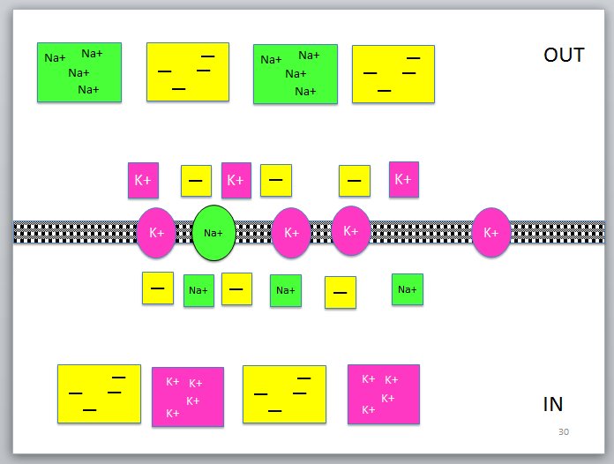
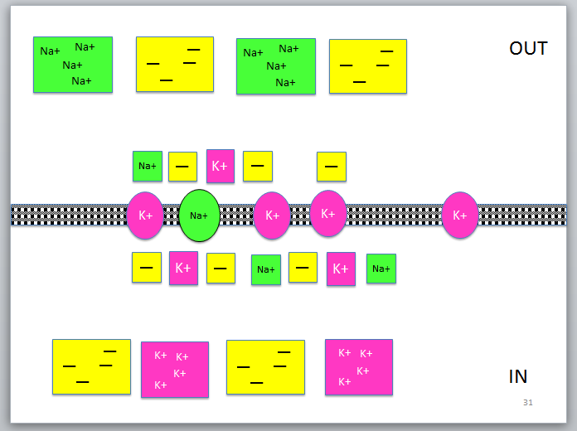
Which is closest to the real resting neuron?
A
B
C
Notes:
A is the best answer, because more K+ ions have gone out of the cell than Na+ ions have come in, leaving the cell with a negative potential. C is wrong, because more Na+ ions have flowed into the cell than K+ ions have flowed out, which would not be true, since there are more K+ channels (and we are assuming the concentration gradients and channel conductance are similar for both ions). B is an interesting case. It is not correct in terms of charge, because it shows 0 membrane potential. However, it could bring up a discussion of the fact that over time, K+ ions will continue to flow out of the cell, and Na+ ions in. Although the NET flow will = 0, both ions will continue to flow in both directions. (Instructor could decide at this point to bring up the Na/K pump which maintains the gradient.) This will be part of their homework. It will be easier to see mathematically when the instructor introduces current equations in the next lecture. IK = gK (Vm-EK) and Ina = gNa (Vm-Ena).

Slide 26
Compared with a membrane containing only K+ channels, the Vm of the resting cell is
More negative than E_{K}
Equal to E_{K}
More positive than E_{K}
Notes:
C. The resting potential is between EK and ENa. Next topic will show quantitatively how this works, using equations.

Slide 27
Basic physics in understanding cell function Membrane Capacitor circuit
CURRENT “I”
Na+
Na+
Na+
Na+
Na+
Na+
Na+
BATTERY
“V” volts
K+
K+
+ + + + + + + + + + + + + + +
+ + + + + + + + + + + + + + + + + + + + + + + +
CAPACITOR “C”
− − − − − − − − − − − − − − −
− − − − − − − − − − − − − − − − − − − − − − − -
RESISTANCE
“R” Ohms
K+
K+
K+
K+
K+
Channel Conductance measured in ‘G’ Seimens
G = 1/R
Notes:
This simple model of the membrane is analogous to some basic ideas of a simple electrical circuit shown on the right, but there are some caveats and differences as well, which are important to keep in mind. First an important thing to note: In the case of the cell membrane, the “current” is carried by charged ions, mostly K+ ions for resting membrane potential; where as in normal electrical circuits the current is carried by electrons which are free to move within the metallic wires. The atoms of the metallic wire are fixed! However beyond this, the behavior of the two have very interesting similarities.
In a cell membrane you talk about “conductance or mobility” of ions, in the circuit diagram the resistance R is equal to 1/conductance
In the model membrane, you learnt that the motion of K+ ions from one to the other side was INITIATED by the difference in the concentration (chemical potential) across the membrane. In the electrical circuit this is provided by the Battery. In fact, if you imagine it to be a chemical cell battery, then this analogy is even exact.
The charge that is collected across the lipid bilayer (left) is exactly analogous to the charge collected on the capacitor shown on the right.
Additional Notes to extend the analogy further:
Now that you understand this: the energy stored in the capacitor is given by ½ (C*V*V) where “*” represents multiplication. It is also given by ½( QV) = ½ (Q*Q)/C. When the battery charges the capacitor, and the capacitor stores that energy. If the energy stored in the capacitor becomes too large, i.e. the capacitor can not hold the charge that it has accumulated on its plates then the capacitor discharges, and that energy is released. Can you think what this energy release would be analogous to in the case of the lipid bilayer/membrane? Hint: Where does the energy for signal transmitted from one to another cell come from?

Slide 28
Summary
Concentration gradients across membranes containing selective ion channels establish membrane potentials
The equilibrium potential for an ion E_{ion} occurs when the concentration gradient ‘pushing’ the ion in one direction is balanced by the electrical gradient ‘pulling’ the ion in the opposite direction
The resting potential in a cell results from opposing Na+ and K+ concentration gradients, combined with the presence of both K+ and Na+ leak ion channels
Cell membranes can be represented by electrical circuits

Slide 29
In the next class, we will look at how changes in
membrane potential create action potentials and
how they are propagated…..

Slide 30
Notes:
… to generate these activities!

Slide 31
Homework
We talked about several situations in class today: a membrane with only K+ channels, a membrane with only Na+ channels, and a resting cell membrane with a mixture of channels.
How does the membrane potential differ in each of these situations?
Are Na+ and K+ ions flowing in the resting cell that has a mixture of channels? If so, in what directions?

